Slide 1
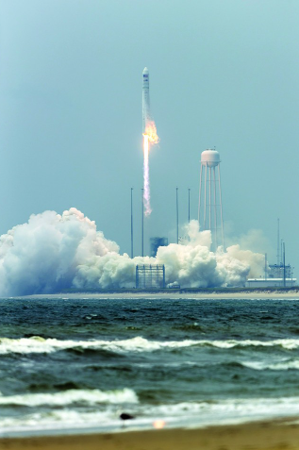
Space Activity at Wallops Island, Virginia
Arlen Bolstad, SCC
John McQueen, VADOC
Michaele White, Governor’s Office
Susan Williams, VADOC
Kimberly Wilson, VMFA
May 5, 2017

Slide 2
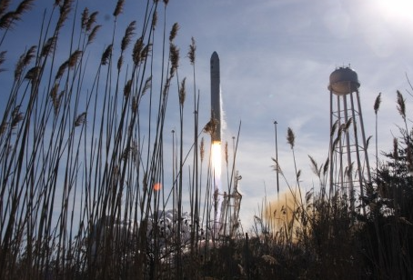
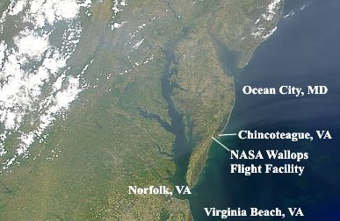

Slide 3
INTRODUCTION
Wallops Flight Facility Overview (1945) – studies, initiatives, partnerships and consortiums
Areas for potential growth and development while preserving the history and beauty of Wallops

Slide 4
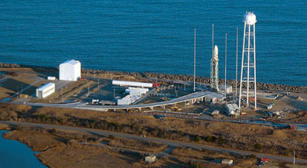
Mid-Atlantic Regional Spaceport (MARS)

Slide 5
12/16 Strategic Plan: proposed MARS expansion Virginia General Assembly Report Document No. 609 (2016)
Increase number of launches by existing and new customers
Upgrade existing facilities and add new launch facilities
Expand operations to promote activity at new landing strip for aerial unmanned vehicles.
Contribute to Virginia STEM initiatives

Slide 6
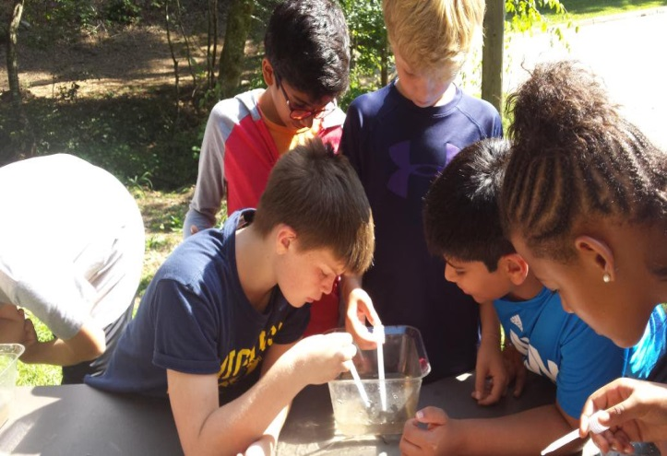
Ways to Enhance STEM
Ecosystems/life science
Robotics
Emerging Technologies

Slide 7
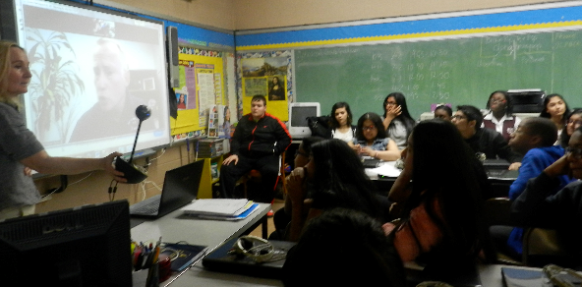
GLOBAL VIRTUAL CLASSROOM
Spaceport America (New Mexico) partners with FieldTripZoom

Slide 8
Bring Wallops Launches to Virginia’s Science Museums
Stream Wallops launches to Science Museums
Live or replays
Combine with STEM educational presentations and hand-on activities associated with launches.
Coordinate with SOLs.

Slide 9
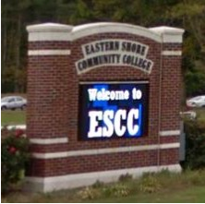
Eastern Shore Community College
Expand the Virginia Space Grant Consortium to include Eastern Shore Community College, Accomack County.
The Virginia Space Grant Consortium (VSGC) is a coalition of five Virginia colleges and universities, NASA, state educational agencies, Virginia's Center for Innovative Technology, and other institutions representing diverse aerospace education and research.
The VSGC acts as an umbrella organization, coordinating and developing aerospace-related and high technology educational and research efforts throughout the Commonwealth and connecting Virginia's effort to a national community of shared aerospace interests.
Eastern Shore Community College would benefit by receiving grants, more students, and enhance programs located within the Wallops community.

Slide 10
Key Points/Recommendations
STEM
Virtual Classroom
Rocket Launch Viewing Sites
Community College Partnership

Slide 11
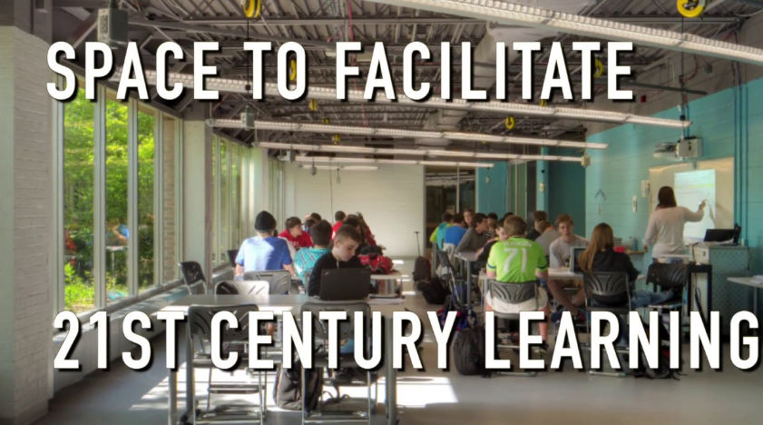
Questions Imagine the Possibilities

