Slide 1
Redistricting Voting Areas
Gerrymandering: The practice of redrawing voting districts to favor one’s chances of being re-elected.
Notes:
Talking Points: Kelly
Kelly Gill-Gordon, Virginia Housing Development Authority
Jaime Hoyle, Department of Health Professions
Scott Grimes, Department for Aging and Rehabilitative Services
Jon Baber, State Commission Corporation
Ed Porner, Virginia Department of Emergency Management
Brain Coy, Governor’s Office

Slide 2
Challenge
How do we ensure the process for redistricting is fair?
How do we gain bi-partisan support in the current political environment?
Notes:
Kelly-
Virginia has the reputation of being a gerrymandered state.
Our challenge is to Ensure the process for redistricting is fair and to gain bi-partisan support in the current political environment?
Through this process we recognize redistricting is both a political and policy challenge
The group will address the current state and ideas to address redistricting reform

Slide 3
Redistricting
In Virginia, the state legislature, has the authority to set congressional voting districts when new census data emerges.
Notes:
Jamie-Talking Points:
In Virginia, state legislators redraw district lines for the U.S. Congress, the Virginia House of Delegates and the Senate of Virginia after every 10-year census.
Under the current system, the party in power in the House and the party in power in the Senate can draw the lines to serve their own interests, not those of our communities.

Slide 4
2013 Elections
56 candidates in the House of Delegates faced no real competition in the general election, with 22 Democrats and 34 Republicans facing no major-party challenger.
Of the remaining 44 races, only 19 were considered competitive to some degree. In the end, only two seats changed parties.
Notes:
Jamie-Talking Points:
Forty-six localities are split in the Virginia Senate district maps
Fifty-nine localities divided in the House of Delegates’ maps.

Slide 5
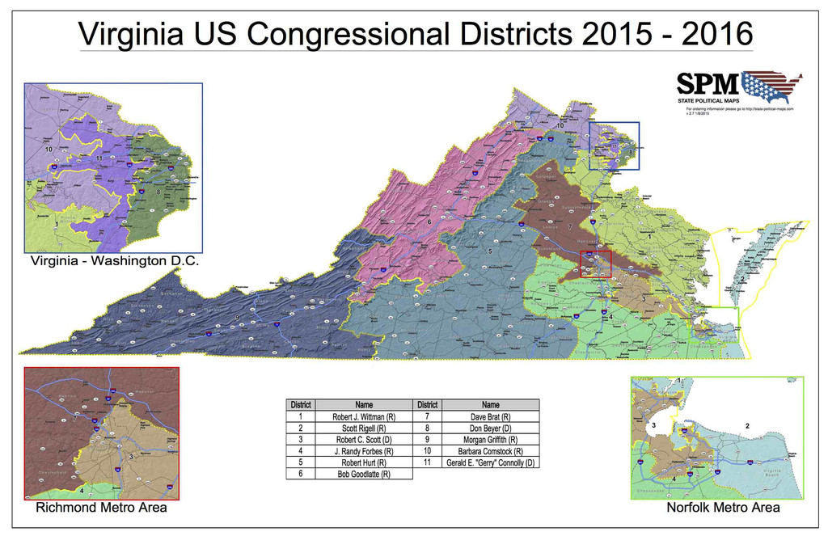
Current State
Notes:
Scott
Five hour Drive from one end to the other of District 5

Slide 6
Current State
2017 General Assembly session, the House defeated Senate approved legislation intended to improve redistricting fairness.
Virginia’s Congressional Map Redrawn by Court Order In Page v. Virginia State Board of Elections
House of Delegates Map Faces the Same Fate
Bethune-Hill v. Virginia State Board of Elections
Notes:
Jon
Virginia’s Congressional Map Has Been Redrawn by Court Order
In Paige v. Virginia State Board of Elections et. al. the US Supreme Court held that the General Assembly applied an unconstitutional racial standard to 4th congressional district. It has since been redrawn, and adjoining districts were impacted.
Our House of Delegates Map Faces the Same Fate
The US Supreme Court has sent Bethune-Hill v. Virginia State Board of Elections back to Virginia District Court, ruling that the court used the improper legal standard to uphold the Commonwealth’s current legislative lines.

Slide 7
What Reform Looks Like
Respect communities of interest
Do not favor the interests of incumbent officeholders
Favor competitiveness
Do not diminish the voting power of minority groups
Allow inclusion of contrary points of view
The Virginia Constitution Requires
Compact
Continuous
Notes:
Ed
The Virginia Constitution Requires Districts that are:
Compact – Districts should be composed of a tightly defined area so that representatives may more effectively communicate with their constituents
Continuous – It should be reasonably possible to traverse a district from one end to the other without crossing into another legislative district.
Additional criteria should include that districts:
Respect communities of interest
Do not favor the interests of incumbent officeholders
Favor competitiveness where possible
Does not diminish the voting power of minority groups
Allow inclusion of contrary points of view (i.e. outside of major parties)

Slide 8
Virginia Redistricting Reform
Model Legislation
Senate Joint Resolution 231 (Hanger)
Establishes a Virginia Redistricting Commission and criteria for legislative and congressional districts
Non-partisan Committee
Judicial Review
Delayed Effective Date
Notes:
Brian
Model Legislation – Senate Joint Resolution 231 (Hanger)
Establishes a Virginia Redistricting Commission and criteria for legislative and congressional districts
Non-partisan Committee composed of 7 members
Four members: Each of the top two parties in each legislative chamber appoints one member
Remaining three members: Nonpartisan state officials (Auditor of Public Accounts, State Inspector General, Executive Director of the Virginia Bar) Step out the enactment date of an amendment past the next redistricting cycle (to 2031).
Draw map using public and pass it with no fewer than 5 votes.
Judicial Review – Virginia Supreme Court will review map for compliance wit state and federal law before it takes effect.
Delayed effective date – new process will not take effect until 2030 census in order to provide time and political room to maneuver

Slide 9
Virginia Redistricting Reform
Leverage
Attrition
Court Action
Community Engagement
Notes:
Brian
Leverage
Governor, refuses to pass redistricting maps that are not drawn by a nonpartisan commission
Attrition
Court Action
cases mentioned in the presentation are part of a nationwide effort to challenge maps that clearly violate federal law and force them to be redrawn
Community Engagement
Economic Pressure

