Slide 1
Increasing representation in state government Promoting a more Inclusive commonwealth

Slide 2
Group 4
Traci DeShazor Deputy Secretary of the Commonwealth | Carlos Hopkins Counsel to the Governor
Andrea Peeks Virginia Retirement System | Bill Mahoney Virginia Department of Emergency Management
Ivory Banks Virginia Department of Medical Assistance Services | Patrick Carr State Corporation Commission

Slide 3
Defining the Scope
Women and minorities continue to face challenges in reaching senior leadership positions in state government.
(2) outlining the challenges faced by minorities and women in reaching senior leadership positions; and
(3) making recommendations on how to increase the number of minorities in senior executive government positions.
(1) This project will focus on examining Virginia’s current level of diversity within the executive branch of government;

Slide 4
Outlining the Scope
mi·nor·i·ty
məˈnôrədē/
noun
A minority is a member of a group of individuals who possess common similarities and, collectively, comprise a smaller subset of a larger group.
This smaller subset may be identified by any number of characteristics, including, race, gender, ethnicity, sexual orientation or physical disability.

Slide 5
A Snapshot: Executive Branch (Office of the Governor)
Cabinet Secretaries, Deputy Secretaries, Counsel, COS, DCOS
Policy, Constituent Services, and Communications
Statewide Boards and Commissions
2,557
total individuals
appointed to serve
43% women
17% Black/
African American
3.4% Hispanic/Latino
3.1% Asian American Pacific Islander

Slide 6
A Snapshot: Executive Branch (Officials/Administrators)
All Classified Employees
Officials/Administrators
White/Caucasian | 65.4% | 77.1%
Black/African American | 29.3% | 17.7%
Asian American Pacific Islander | 2.8% | 3.7%
Hispanic/Latino | 2.1% | 1%
Other | .3% | .5%
Male | 46% | 57%
Female | 54% | 43%

Slide 7
A Snapshot: Legislative Branch

Slide 8
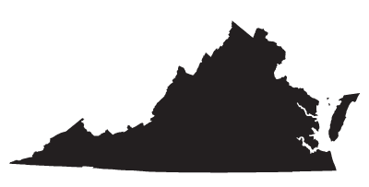
Virginia Defined (2010)
Virginia Population by Races and Gender (most recent census data)
 | TOTAL | PERCENTAGE | MALE | PERCENTAGE | FEMALE | PERCENTAGE
TOTAL POPULATION | 8,001,024 | 100% | 3,925,983 | 49.1% | 4,075,041 | 50.9%
WHITE/CAUCASIAN | 5,486,852 | 64.8% | 2,708,548 | 33.9% | 2,778,304 | 34.7%
BLACK/AFRICAN AMERICAN | 1,551,399 | 19.4% | 740,150 | 9.3% | 811,249 | 10.1%
HISPANIC/LATINO | 631,825 | 7.9% | 328,944 | 4.1% | 302,881 | 3.8%
ASIAN | 439,890 | 5.5% | 207,680 | 2.6% | 232,210 | 2.9%
OTHER | 543,693 | 6.79% | 279,175 | 3.45% | 264,518 | 3.35%

Slide 9
Virginia Defined: 2020
 | WHITE | AFRICAN AMERICAN | HISPANIC | ASIAN | OTHER | TOTALS
POPULATION PROJECTION | 5,505,156 | 1,404,264 | 1,042,540 | 495,973 | 296,340 | 8,744,273
POPULATION PERCENTAGE PROJECTION | 63% | 16.0% | 11.9% | 5.7% | 3.4% | 100%
MALE | - | - | - | - | - | 4,273,646
FEMALE | - | - | - | - | - | 4,470,627

Slide 10
Diverse Perspective(s): Highlighting the Value-Why Is it Important?
Change in culture for Virginia
Closer proximity to clientele/customers/members
Ideas
Linguistic skills
“Diversity is the one true thing we all have in common. Celebrate it every day.” -Author Unknown
“We need to help students and parents cherish and preserve the ethnic and cultural diversity that nourishes and strengthens this community - and this nation.” -Cesar Chavez

Slide 11
(Re) Defining the Executive Branch

Slide 12
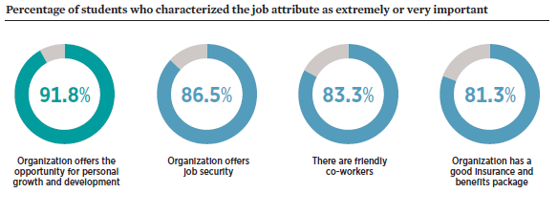
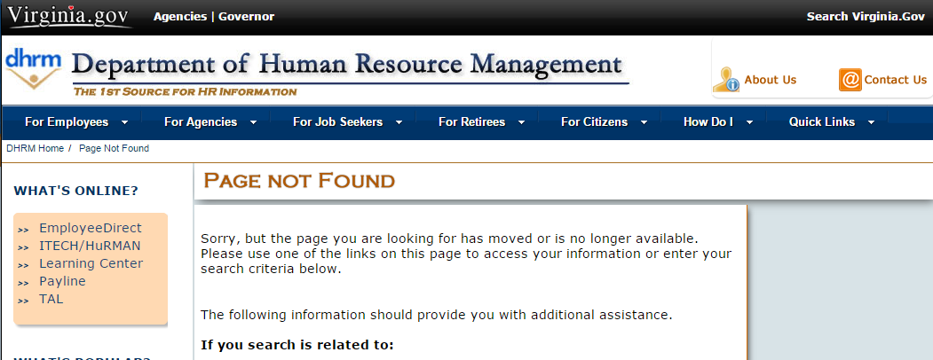
Challenge(s)
Lack of new/younger talent
Lack of professional development, education, and training
Information not easily accessible
Advanced degrees and certifications
These are highly sought-after job benefits for potential new hires
Agencies are inconsistent with how they comply for DHRM policy
DHRM Policy Number: 5.10 - Educational Assistance
Leaves significant discretion to agencies regarding:
Work schedule flexibility policies
Tuition reimbursement policies
Employee eligibility criteria
Tenure agreements for repayment requirements
This research suggests that better communication of what a career in state government can offer is needed.
Jobseekers’ #1 priority, the opportunity for growth and personal development, is probably the least understood benefit of a state government career.
Notes:
Only 4.8% of college graduates consider state or local government to be an ideal career

Slide 13
Solution(s)
Support and promote leadership development programs
Promote training and education
Standardize policies for training and education to ensure all employees have equal opportunity
Leverage DHRM Office of Personnel Management
Create partnerships with state institutions to manage costs
Hold career fairs to increase representation of minorities and women
Accelerate the hiring of qualified minority and women candidates for positions in the state government workforce
Integrate diversity training in all leadership development programs
Notes:
Only 4.8% of college graduates consider state or local government to be an ideal career

Slide 14
Challenge(s)
Lack of attractive work-life balance benefits
Lack of mentorship
Only 23% of Classified positions are eligible for Teleworking*
Only 54% of Classified positions are eligible for Alternate Work Schedules*
No assistance to state employees to subsidize costs for family care (i.e. child or elderly)
No provision for paternity leave for the birth or adoption of a child
Very few child care services available to state employees (at cost)
Notes:
Only 4.8% of college graduates consider state or local government to be an ideal career

Slide 15
Solution(s)
More Attractive work-life balance benefits
Structured Mentorship and the
formation of Affinity Groups
Augment Work-Life Balance policies and benefits
Create system of leave trading to create option of more paid leave for family/personal reasons
Increase number of positions eligible for alternate work schedules or teleworking
Provide and/or subsidize child day care services (consider also subsidizing day care services for disabled and/or elderly family members of state employees)
Notes:
Only 4.8% of college graduates consider state or local government to be an ideal career

Slide 16
From Concept to Implementation
Proclamation: Proclamation issued by the Governor which will designate April Diversity and Inclusion Month
Executive Order: Executive Order issued by the Governor which will detail his/her goal of increasing the number of minorities in state government and which will designate DHRM as the reporting agency for this initiative
Listening Tour: Statewide Listening Tour led by the Governor’s office and DHRM to capture best practices and areas of opportunity to promote and celebrate diversity and to recruit and retain diverse talent within state government
Implementation and Guidance: Initiative implementation and statewide guidance is issued by DHRM
Site Visits Arranged: Site visits to example state entities arranged by the Governor’s office and shared statewide by DHRM
Quarterly Activity and Success Story Updates: Quarterly newsletter which will highlight success stories and celebrate diversity and inclusion throughout state government
Proclamation
Executive Order
Listening Tour
Implementation Guidance Issued
Site Visits Arranged
Quarterly Activity and Success Story Updates

Slide 17
Tracking Our Efforts
Reinstate statewide training program
Provide tools to agencies to recruit more diverse candidate pools
Strengthen existing program that flag possible discriminatory employment practices
Promote use of tools available for use by agency HR departments
(ex. EEO Assessment Tool)
Utilize the Virginia Department of Human Resource Management

Slide 18
Outcomes
Culture of inclusion
Celebration of diversity
Varied perspectives
Increased productivity and problem-solving
Recognition and understanding of other cultures
Better serve the residents
of the Commonwealth
A more inclusive Commonwealth

Slide 19
Thank you.

Slide 20
Sources
Source: Partnership for the Public Service and The National Association of Colleges and Employers
Source: Partnership for the Public Service and The National Association of Colleges and Employers
Source: http://www.dhrm.virginia.gov/ff00006b-f159-6fbe-b15f-a057d091ebc6
Source: http://web1.dhrm.virginia.gov/itech/hrpolicy/pol5_10.htm
Source: https://hurman.dhrm.virginia.gov/sasweb/wpr/html/fy2017/ALL/demframe.html
Source: https://hurman.dhrm.virginia.gov/sasweb/wpr/html/fy2017/ALL/demframe.html
Source: https://hurman.dhrm.virginia.gov/sasweb/wpr/html/fy2017/ALL/demframe.html
Source: https://hurman.dhrm.virginia.gov/sasweb/wpr/html/fy2017/ALL/demframe.html
Source: http://www.dhrm.virginia.gov/docs/default-source/reports/ataglance/aag_alljune2016.pdf?sfvrsn=0
Source: http://www.ncsl.org/legislators-staff/legislators/womens-legislative-network/women-in-state-legislatures-for-2016.aspx

