Slide 1
An Approach for State and Local Partnerships – Creating A Better Citizen Experience
Presented by VEI Group 2:
Jason Bulluck Department of Conservation and Recreation Joe Cimino Marine Resources Commission Leslie English Department of the Treasury | Robert Osmond Department of Transportation Patrick Patrong Department of Emergency Management Ida Witherspoon Department of Social Services

Slide 2
LEADERSHIP CHALLENGE: The City and State Working Together
What type of partnership forms the best outcome for all citizens?
What are other cities doing that is working?
How can we build on the successes?

Slide 3
Citizen’s Government Experience
Citizens view government as a provider of essential services
“The sum is greater than the parts”
Federal
Defense
Social Wellness
State
Economic
Social Wellness
Local
Utilities & Police
Social Wellness
Notes:
From the Citizen’s point of view, Government (Federal, State, and Local) is a service provider and chartered to deliver essential services including Safety, Education, Utilities, Transportation, and Health.

Slide 4
Local/State Partnerships: MassWorks Infrastructure Program, Boston
The MassWorks Infrastructure Program supports economic development and job creation initiatives for municipalities and public entities
Notes:
The MassWorks Infrastructure Program provides support for municipalities and other eligible public entities seeking public infrastructure funding to support economic development and job creation initiatives in Massachusetts.

Slide 5
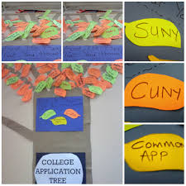
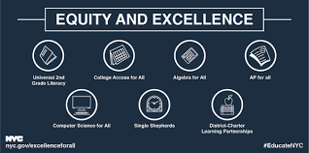
Example Partnerships: Education, NYC
The New York City Department of Education partners with the New York State Department of Education to increase college preparation for all students

Slide 6
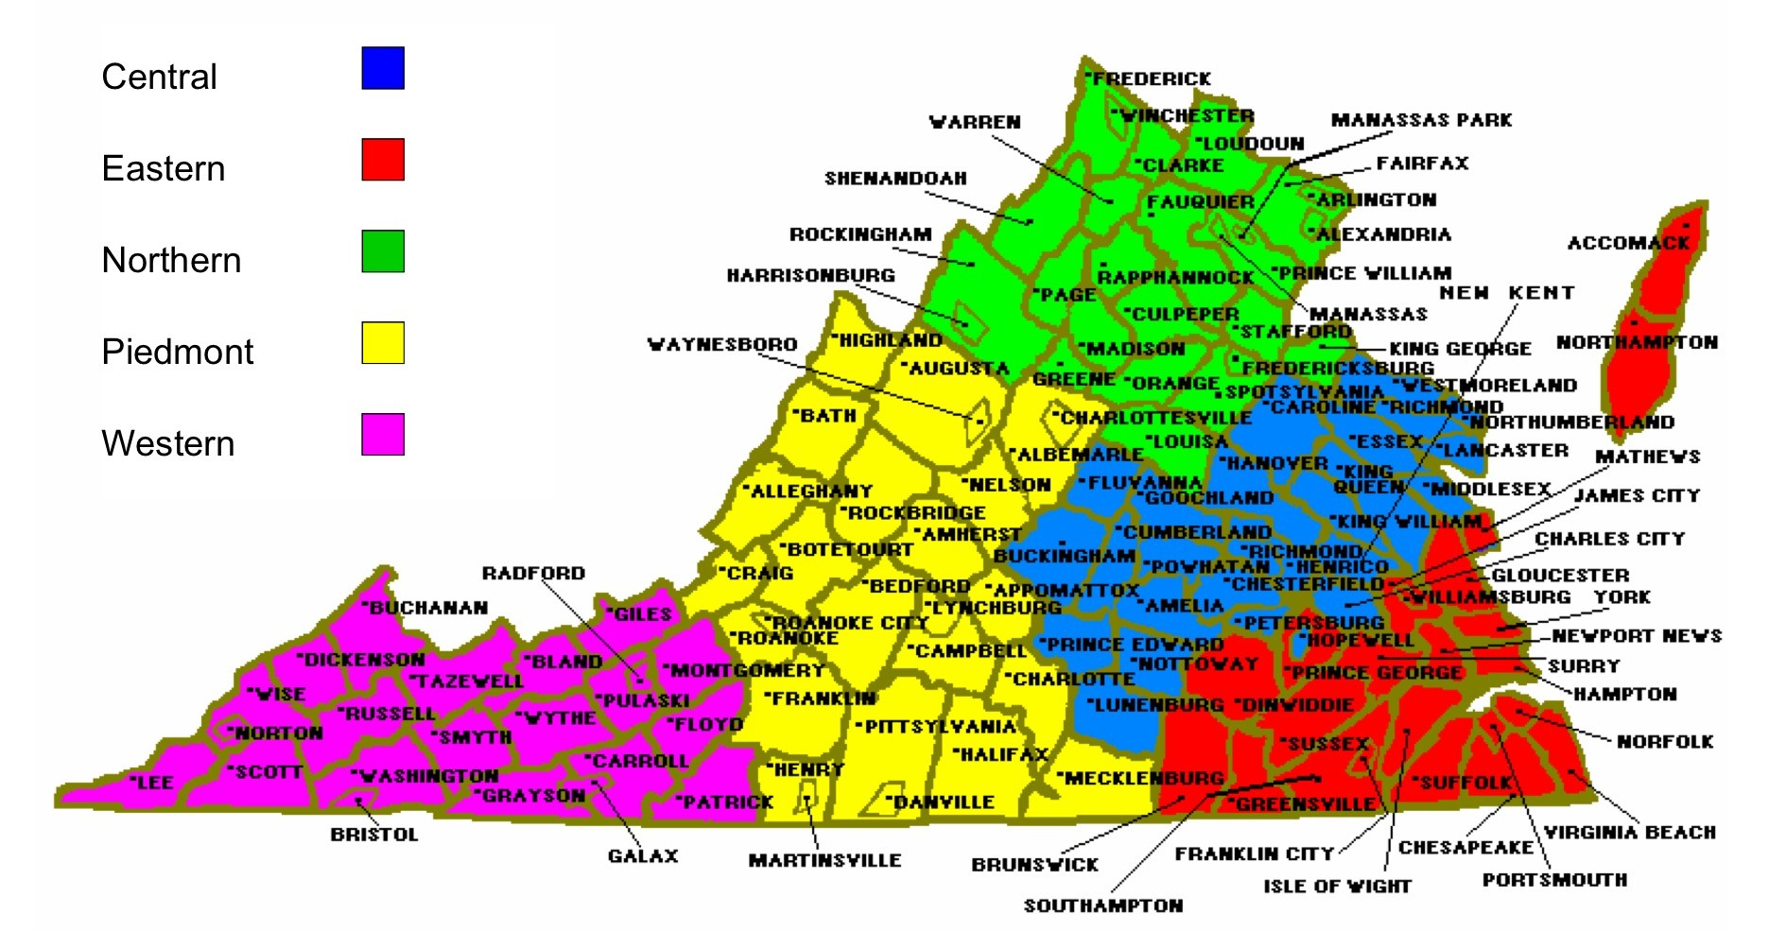
Example Partnerships: Social Services, VA
In Virginia, the social services system is state supervised and locally administered across 120 localities.

Slide 7
Lessons Learned From Best Practices: A Model for Effective State/Local Partnerships
Partnership Selection Criteria
Partnership Execution
Partnership Outcomes
Improved Citizen Benefits
Greater Government Efficiency
Enhanced Public Image
Transparency
Citizen Engagement
Strong Governance
Shared Investment
Shared Accountability
Improved Citizen Experience
State/Local Mutual Benefits
Sustainable Services
Improved Public Trust

Slide 8
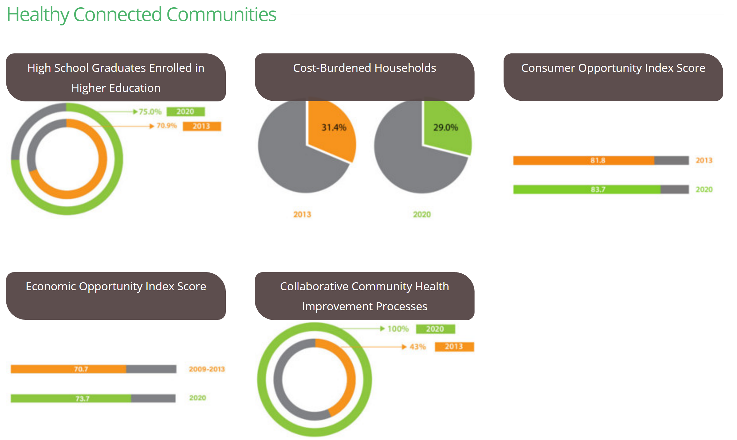
Lessons Learned From Best Practices: Applied Techniques
Dashboards
Regional Coordination
Regional Promotion
Engagement Management
Standardized Selection
Citizen Portals
Toolkits
Shared Knowledge Bases

Slide 9
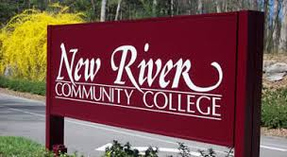
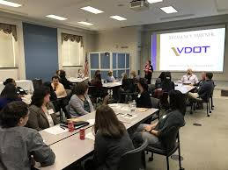
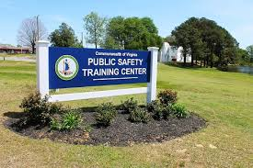
Proposed Partnerships: Statewide Training Centers
Large scale programs often undergo changes and updates
Localities need training in order to optimize participation and a single state-wide approach is preferred to avoid locality duplication
Notes:
There are numerous Federal training requirements for large scale programs like FEMA, SNAP and Medicare as they undergo changes and updates. Localities all need training in order to optimize Federal participation and a single state-wide approach is preferred to avoid locality duplication.

Slide 10
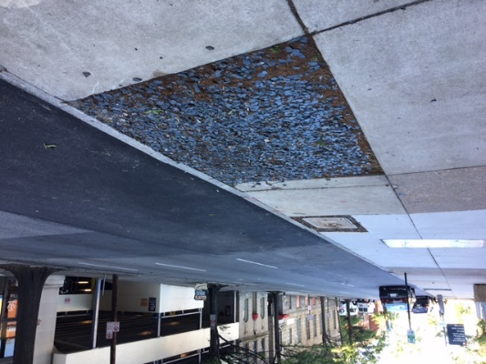
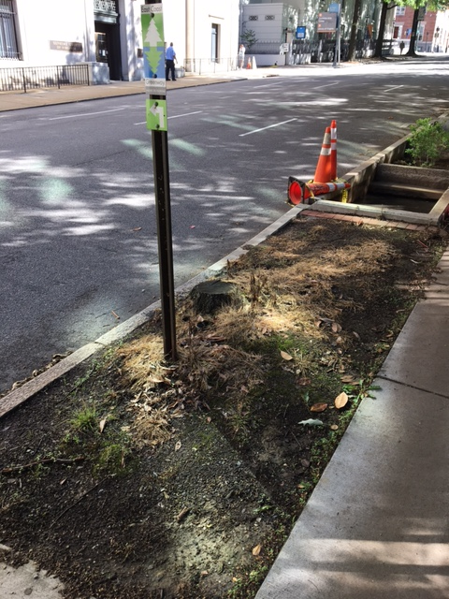
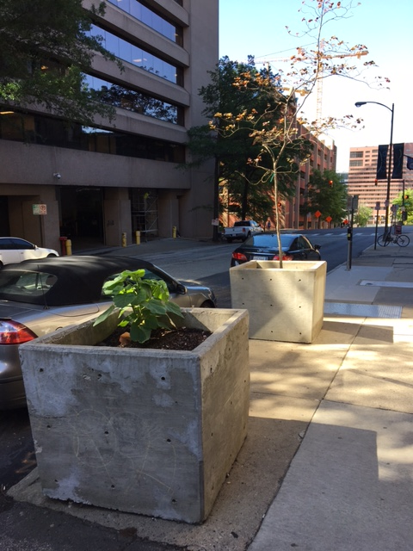
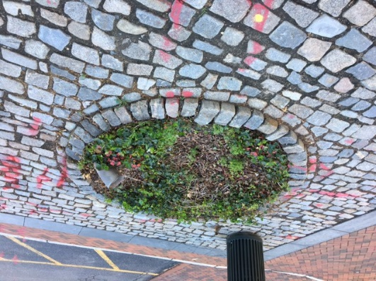
Proposed Partnerships: RVAgreen 2050 Program, Richmond, VA
State agencies provide technical assistance and support towards the RVAgreen 2050 - Tree Canopy Goal

Slide 11
Summary
When properly applied, State/Local partnerships can substantially improve the citizen’s experience
States are uniquely positioned to provide regional leadership, promote best practices, and offer a framework to optimize service delivery
Cities and localities are uniquely positioned to communicate, involve, and engage their citizens
We have provided a framework to better evaluate potential opportunities, improve government service delivery, and promote trust in our public institutions
Better Partnership Selection Criteria
Strong Partnership Execution
Improved Partnership Outcomes

Slide 12
The Beginning…

