Slide 1
Notes:
In 1619, almost 400 years ago, several historical events occurred that greatly influence the America you and I know today. For example, the first representative legislative assembly in the New World was created when men from Virginia’s eleven settlements met for the first time to plant the seed of democracy in America. In August 1619, the first recorded Africans arrived in English North America. In November 1619, 147 women were recruited to join the male settlers of Jamestown, forever shaping the development of the nation. In December 1619, the first official Thanksgiving was observed annually and perpetually thereafter.
In honor of these historical events, Virginia is planning a 2019 Commemoration, which will be called the American Evolution. American Evolution will feature three years of programs, signature events, and legacy projects intended to inspire local, national, and international engagement in the themes of democracy, diversity, and opportunity.

Slide 2
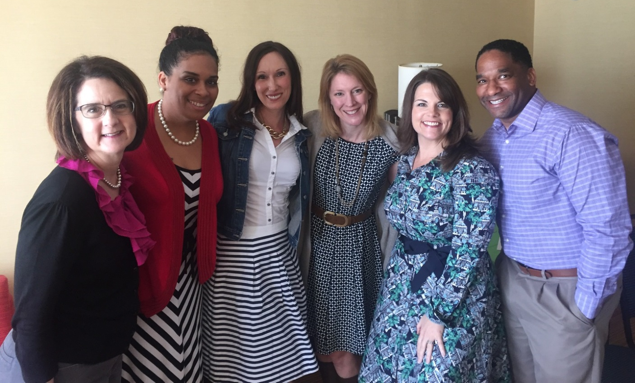
VEI GROUP MEMBERS
Jason Brown
Department of Motor Vehicles
Stephanie Agee
Department of Agriculture and Consumer Services
Meghan McGuire
Department of Behavioral Health and Developmental Services
Toni Blue Washington
Department of Social Services
Amanda Monaco
Department of Human Resource Management Marie Vargo
Department of Corrections
Notes:
Put group photo here

Slide 3
Challenge Statement
What recommendations do you have to include and encourage state workers to participate and volunteer with the commemorative activities?

Slide 4
Research
Jamestown-Yorktown Foundation
Need state employee volunteers for signature events
Desire high state employee participation in all events
Want state agency heads to promote events
Require state agency partnerships (e.g. DCR, DOE, DMV, DHRM, DOC, DBHDS, VDOT, DGS, etc.)
Virginia Tourism Corporation
Goals of 6.1 million overall tourists for 2017-2019 events
Goal of $2.3 billion in visitor spending, which equals over $100 million in sales tax revenue
45% of tourists visit Virginia because they have family and friends who are residents here
State Agencies
Must be designated a Governor’s Project for purposes of allowable time off for these events
Employees will participate when they feel needed/appreciated (e.g. invites from the Governor)
Make it easy to sign up and volunteer time and have a variety of options how to serve
Keep entrance fees free for state employees
Find ways to reach employees statewide – 70% of state workforce is outside of Metro Richmond
Utilize social media in addition to some traditional communication methods

Slide 5
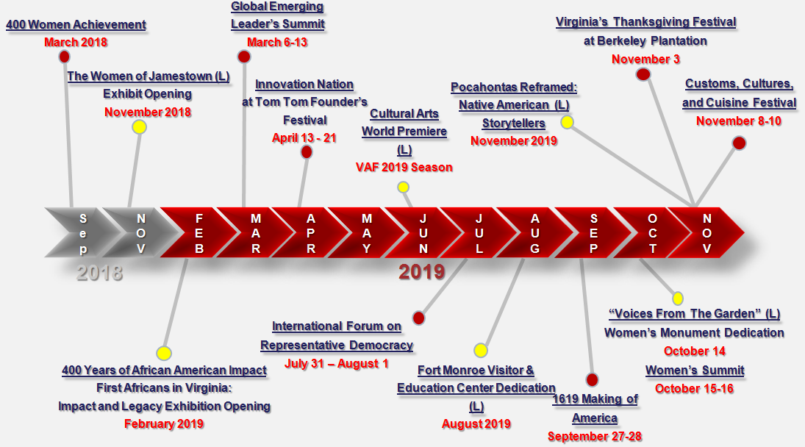
Signature Events Calendar 2018 – 2019 (draft)
Notes:
Speaker sets stage for entire presentation and describes how we broke it up into years with necessary activities listed for each year.
Take the timing of this slide off.

Slide 6
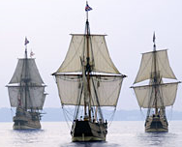
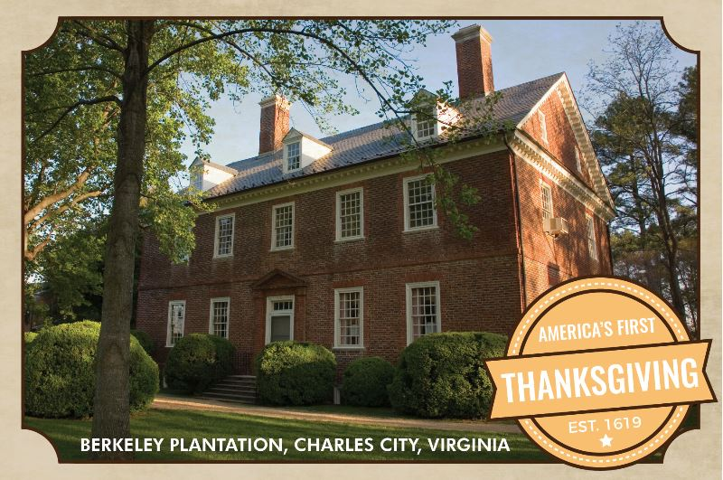
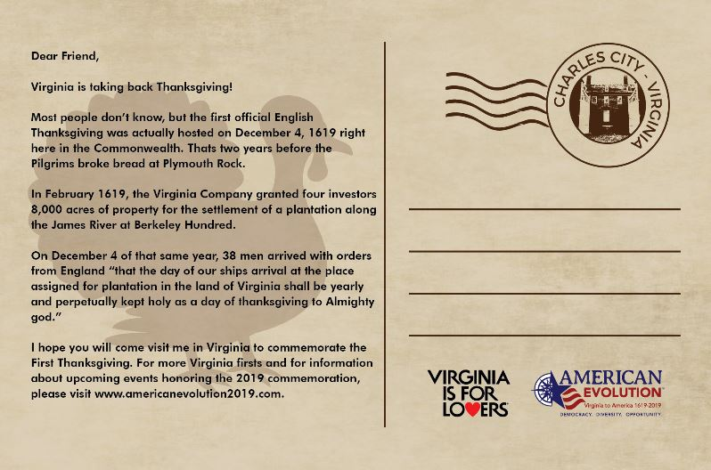
2017 - The Evolution is Coming
Governor McAuliffe designates the American Evolution an official Governor’s Project
All state employees receive an introductory email and video from Governor as the July 2017 kick off
Each Cabinet Secretary informs their agency heads about upcoming events
Begin the "Take Back Thanksgiving" postcard campaign
Disburse the VTC e-postcard to all state employees via email; include a number of printed copies for hand delivery
FRONT
BACK
Notes:
Insert a picture of what the VTC postcard will look like on the left side of this slide
Employees receive introduction to American Evolution - could be emailed letter and video from Governor to kick off, but then more details about the commemoration, what to expect in 2018, what to expect in 2019, specific menu of opportunities to participate, volunteer, attend events, visit commemoration areas, introduce them to the digital trail. Our research reflected that an email and invitation from the Governor is crucial for state employee involvement.
Start the Take Back Thanksgiving campaign with the e-postcards. In the fall conduct a CVC food drive competition between Virginia state agencies. The winning agency gets free tickets to one of the 2018 events.
Introduce postcards, both physical and digital, for employees to send to family and friends and to share on social media platforms, telling the world that Virginia is taking back Thanksgiving, this is something else the Governor and cabinet members could kick off, being the first to share their posts

Slide 7
2018 - The “I Am” Evolution Begins
Transition to New Administration
Start “I AM VIRGINIA” profile campaign
State Agency Partnerships
Start “Take Back Thanksgiving” Challenge
Notes:
The Living Journal – A way to engage state employees throughout the commonwealth. The Living Journal is a growing collection of stories that employees can contribute through directly through social media or a website submission and some are selected to be promoted by the Governor’s Office to all state employees via email. The Living Journal gives employees an opportunity to explain why they are public servants, what historical significance surrounds their agencies, and what special places in their regions should be highlighted in the Digital Trail.
Transition to New Administration
- Send quarterly email updates on events and opportunities to all state employees
New Governor plans an informational session for new cabinet secretariats and agency heads
Start “I AM VIRGINIA profile campaign
- Begin social media campaign on Facebook, Twitter, LinkedIn and Instagram and encourage reposting
- Create posters for all state agencies to display
- Encourage state employees to build upon the digital trail project and earn Passport Virginia points for the events attended and trails hiked
- Consider “I AM VIRGINIA” t-shirts to give employees who volunteer at events
- Coordinate with the GO Virginia economic development regions
- Collaborate with Virginia breweries, ciders, and vineyards and local food trucks to be present at the nine events
Recruit volunteers for the 2019 signature events
State Agency Partnerships
- Each Agency Head appoints an internal American Evolution liaison
- Contribute to “Living Journal” of state employee stories across Virginia
Utilize state offices open to the public for poster placement
Start “Take Back Thanksgiving” Challenge
- State agency food drive in October
- $0.25 per pound of food donated at agency will count towards agency’s CVC goal
- Agency with most food donations wins tickets to 2019 signature events

Slide 8
2019 - The Evolution is Alive
Encourage Participation
Express appreciation by offering State Employee weekends for the 9 signature events
Free entrance for all state employees
Include local beer, wine and ciders at the events – a portion of the sales goes to a CVC charity
Consider activities for children at each event
Fun and Easy Volunteering
Initial email from Governor asking for help
Agency liaison encourages participation internally
Allow employees to either use no time or use 2 hours per signature event without taking official volunteer leave.
Make it easy to sign up and have lots of options for how they can serve
Chief of Staff or Governor sends thank you letter
Statewide Day of Service
Take Back Thanksgiving Commonwealth Challenge
Competition with the Governor of Massachusetts
VA Governor challenges MA Governor to which state can collect the most food or cash donations for their state’s food banks in October 2019
Winning state will get bragging rights and positive publicity in The Washington Post and other national news outlets
Losing Governor does “penance”
VIRGINIA STATE EMPLOYEE INVOLVEMENT
Notes:
Discounted weekend getaways at hotels, restaurants, campgrounds, sporting events, and/or tourist attractions that are nearby. Could create an enhanced employee discount page with affordable weekend packages available or a menu of options to pick from. Make sure to send out an all-employee email regarding these State Employee Weekends well in advance.

Slide 9
The Evolution’s Next Steps
Kickoff with Governor’s letter to state employees in the summer and postcard campaign in the fall
Identify liaisons in each agency
Build campaign for state employee components of I AM VIRGINIA and the Living Journal
Create transition document: Suggestions for next Governor to make this a Governor’s project and to orient new cabinet/agency heads early in 2018

Slide 10
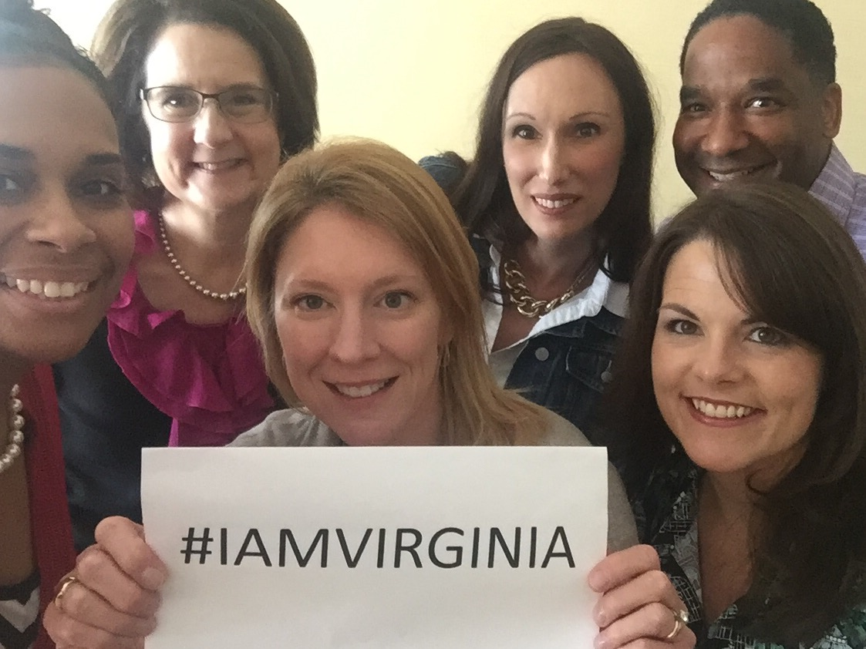
Questions

