Slide 1
Navigating Cultural Differences
and
Its Impact on the Virginia Workforce
June 7, 2019

Slide 2
VEI Group 4
Team Members
Annie Walker – Department of Veterans Services
Fernanda Crandol – Department of Forestry
Wayne Davis – Department of Motor Vehicles
Dustin Physioc – State Corporation Commission
Chung Ma – Virginia Retirement System

Slide 3
Agenda
Motivation
Impact on workforce
Best practices
Proposed solution
Defining success
Wrap-up

Slide 4
Why This Conversation?
Out of 67 terrorists incidents in 2017, 37 were tied to racist, anti-Muslim, homophobic, anti-Semitic, Fascist, anti-government or xenophobic motivations. (The Global Terrorism Database, University of Maryland)
2015 – Charleston Church shooting
2016 – Pulse Orlando Nightclub shooting
2017 – Charlottesville riot
2018 – Pittsburgh Synagogue shooting
2019 – New Zealand Mosque shooting

Slide 5
First They Came
First they came for the socialists, and I did not speak out-
Because I was not a socialist
Then they came for the trade unionists, and I did not speak out-
Because I was not a trade unionist
Then they came for the Jews, and I did not speak out-
Because I was not a Jew
Then they came for me-
and there was no one left
to speak for me
German Lutheran Pastor, Martin Niemoller (1892-1984)

Slide 6
Impacts of a Non-Diverse Workforce
Limited perspective
Limited role models
Limited employee engagement
Miscommunication
Hidden biases

Slide 7
Research Analyses of a Diverse Workforce
Better financial outcomes / value creation
Attracting talented, innovative workforce
Improved problem solving
Increased employee engagement
Enhanced productivity

Slide 8
Best Practices: Public Sector
One state agency offers:
Culturally competent customer service
Leading in a diverse workforce

Slide 9
Best Practices: Private Sector
Understand how organization is perceived with forums such as Glassdoor
Conduct “Stay Interviews” with employees after three year anniversary
What keeps you here?
What would make you leave the company?
If you could change one or two things about the organization, what would they be?

Slide 10
Proposal
Establish a Chief Diversity Officer for the Commonwealth

Slide 11
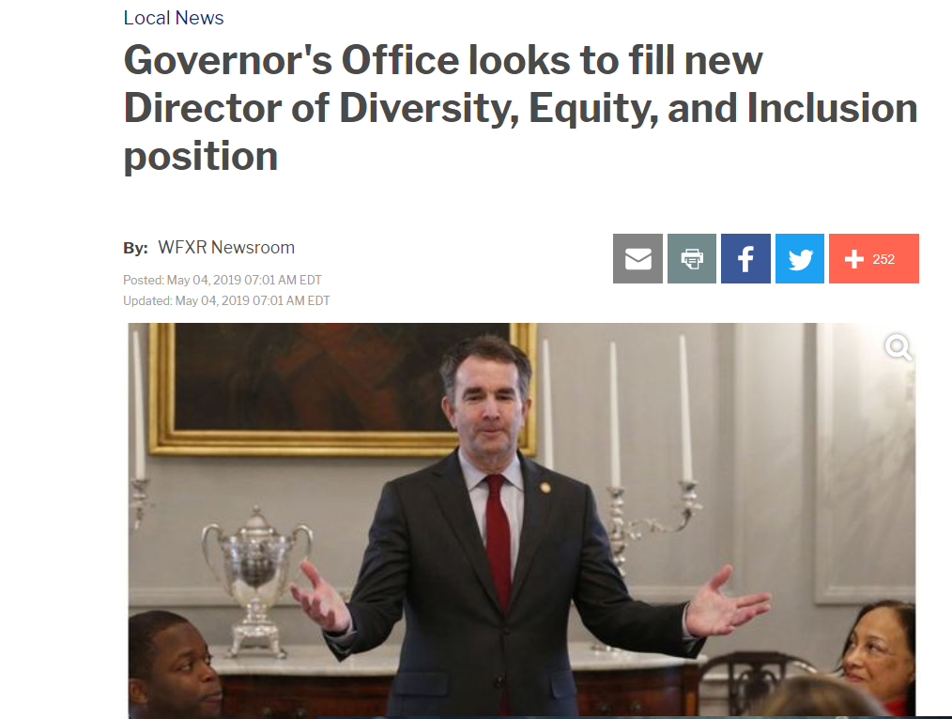
Not to be Confused with…

Slide 12
Aspirations
Position should be strategic in nature
Less emphasis on tangible measurables such as quotas
More emphasis on intangible measurables such as stimulated engagement and boosted morale
Outward focus – look beyond the bureaucracy

Slide 13
Foundational Considerations
Can the position and its goals and aspirations be codified or constitutionalized?
Part of executive branch or independent agency?
At-will or classified employee?

Slide 14
How to Define Success: A Proposed Plan
Have a clear goal
Cultural differences/diversity is a wide-ranging topic
Identify specific target areas for improvement
Empowerment and structure / reporting
Determine metrics for progress, track and analyze results
Review metrics regularly, report results, be transparent
Adjust your plan based on feedback
Notes:
What are you trying to achieve

Slide 15
Metrics for Success
Use of qualitative and quantitative measures
Qualitative – interviews, focus groups
Quantitative – surveys, data-based analyses, sentiment using artificial intelligence

Slide 16
Wrap-up
Timely conversation
Positive impact of diversity
Leverage existing models for success
Director of Diversity, Equity, and Inclusion is an effective first step
Qualitative and quantitative metrics for success

