Slide 1
Responding to the Increasing Threats of Heat Related Illness
Virginia Executive Institute, Spring 2019
Team 2: Parham Jaberi, Patricia McCullagh, Catherine O’Brien,
Tom Sawyer, Brenda Scaife, Danny Taylor
Notes:
Trish

Slide 2
Background
Heat waves have become more frequent and intense, and cold waves have become less frequent.
U.S. average temperatures have increased by 1.3°F to 1.9°F since record keeping began in 1895.
As a result, the Commonwealth must address the resulting public health and economic burden associated with high heat events.
SOURCES: NATIONAL INSTITUTE OF ENVIRONMENTAL HEALTH SCIENCES, 2017
MCMICHAEL & LINDGREN, 2011
Notes:
Tom

Slide 3
Increasing Global Temperatures
Notes:
Tom

Slide 4
Heat Index Predictions- More Dangerous Days
SOURCE: https://statesatrisk.org/virginia/all
Notes:
Tom

Slide 5
Health Impacts of Increasing Temperatures
Extreme high air temperatures contribute directly to deaths from cardiovascular and respiratory disease, including heat exhaustion and heat stroke.
More than 600 deaths per year in the United States are due to extreme heat according to the Centers for Disease Control.
Extreme heat causes many people to visit the emergency room or be admitted to the hospital.
As temperatures rise and extreme heat events increase in frequency, we can expect to see more heat-related illnesses and mortality.
SOURCES: NATIONAL INSTITUTE OF ENVIRONMENTAL HEALTH SCIENCES, 2017; USGCRP, 2016 EPA_HEAT-ILLNESS-2016.PDF
Notes:
Parham
Any person can suffer from heat stress, regardless of age, sex, or health status. Older adults and children, however, have a higher-than-average risk of becoming ill due to exposure to extreme heat.
I moved this to the notes section, because it seemed to start to overlap with our demographic slide later…

Slide 6
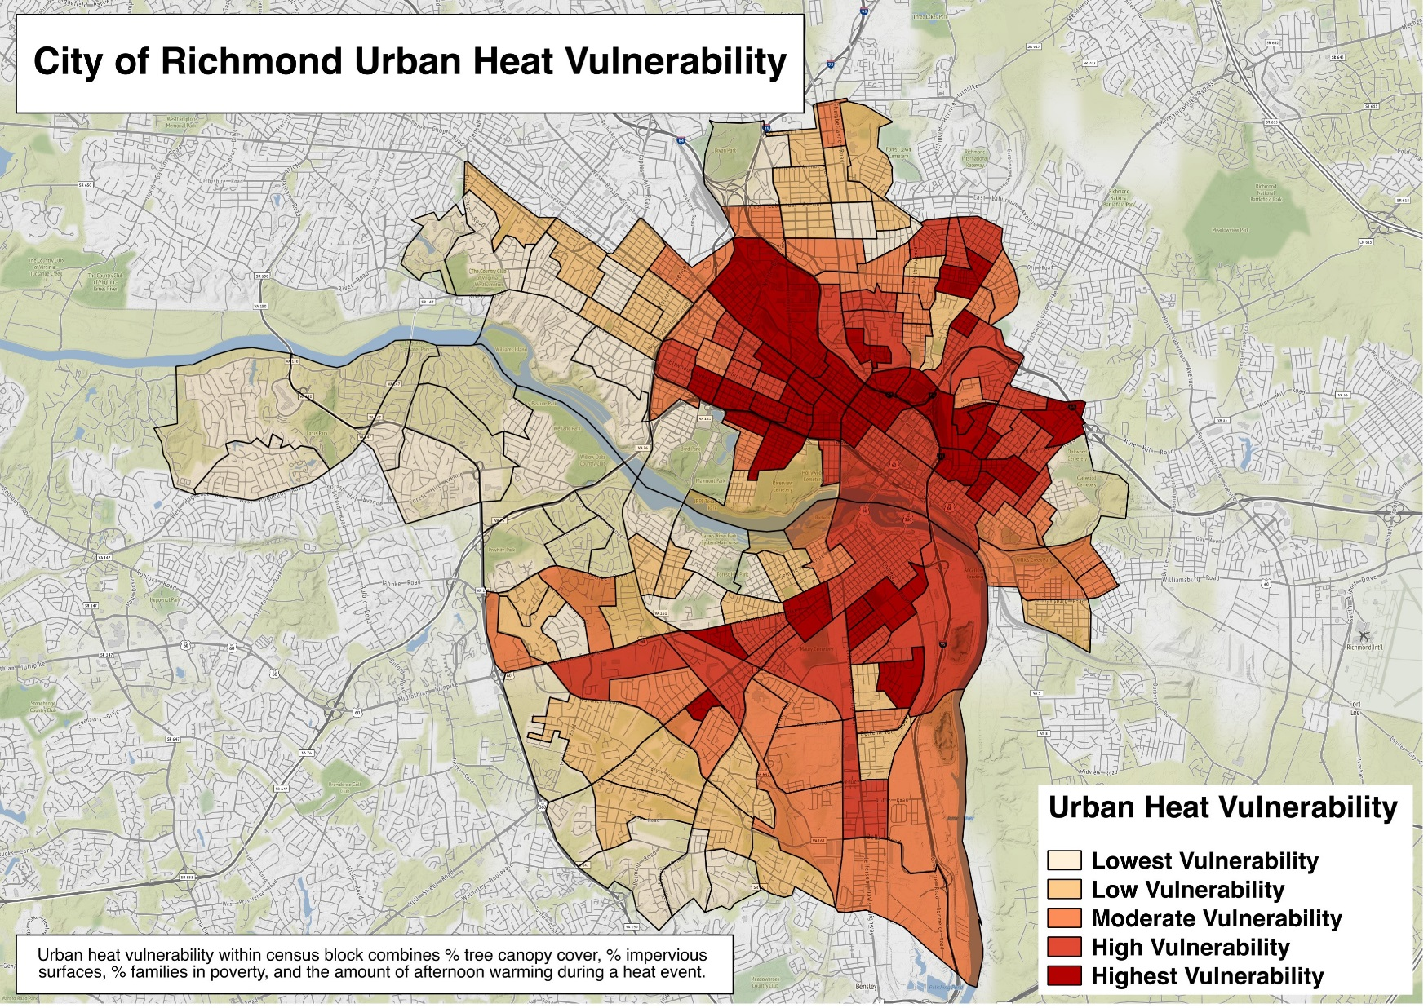
Disproportionate Health Impacts on Select Areas and Populations
High concentrations of buildings and asphalt in urban areas cause urban heat island effect, generation and absorbing heat, making the urban center several degrees warmer than surrounding areas.
Susceptible populations are also disproportionately impacted.
SOURCE: VDH ESSENCE (UCC/ED DATA), RICHMOND AMBULANCE AUTHORITY (AMBULANCE RESPONSES), AND NOAA (TEMPERATURE DATA), COMPILED BY JEREMY HOFFMAN AT SCIENCE MUSEUM OF VIRGINIA
Notes:
Parham
Susceptible Populations
The Very Young
Senior Citizens
People working outside
Those with chronic disease conditions
(e.g. cardiovascular disease, respiratory diseases)

Slide 7
Economic Impact of Heat Related Health Events
From 2002 through 2009, the health related costs of heat waves in the United States was $5.3 billion.
In 2016, health related costs in the United States were $3.3 trillion.
By the year 2028, it is predicted that heat waves and other climate change effects will add $360 billion per year in heat impact costs. Much of this is due to health costs.
Notes:
danny

Slide 8
Economic Impact of Heat Related Health Events
According to the Red Cross, in recent years, excessive heat has caused more deaths than all other weather events, including floods.
For every 10 degree Fahrenheit increase above mean ambient temperature some states have seen:
393% increase in hospitalization for heat exposure
3% increase in ischemic stroke hospitalizations
15% increase in acute renal failure hospitalizations
On an individual/family level impacts include:
Illness of a family member, loss of income,
Medical bills
Worsening of certain medical conditions (i.e. asthma)
Notes:
Danny
Asthma affects 163,000 children 554,000 adults in Virginia, according to Georgetown University’s Climate Center

Slide 9
Developing a Heat Emergency Response Plan
Though Virginia has an Emergency Operations Plan (“EOP”) to address various emergencies, there is opportunity to further develop a more robust heat emergency response plan within this EOP.
Other states may be a resource for how the Commonwealth may want to address this heat response plan (i.e. North Carolina, California).
Potential stakeholders in this heat response plan include:
State agencies
Local Governments and Municipalities
Local Emergency Management/First Responders
Notes:
Brenda
Department of Fire Programs, VDEM, VDH Virginia Department of Health, Department of Social Services, Virginia Department of Housing and Community Development, Local Governments, and Local First Responders to name a few.
There is a vast amount of information on heat related risks created by various state and federal agencies, however, we found no coordinated state-level effort to disseminate information to the communities at greatest risk of increasing heat index days, other than the weather news stations alerting the public during broadcasts. Ready.gov has an Extreme Heat Safety Social Media Took Kit.
NORTH CAROLINA EMERGENCY MANAGEMENT (NCEM)
Lead the State’s actions in the heat emergency response, communicating Heat Advisories, Heat Watches, and Heat Warnings from the National Weather Service.
b. Serve as State Liaison in discussions with federal agencies concerning the response actions to be taken.
c. Coordinate the provision of all State heat emergency response resources through NC SPARTA.
d. Consider providing a bi-weekly situation report while under Phase I (Advisory) until the State Emergency Operations Center (SEOC) is activated, then operate as directed by the SERT Leader.
e. Outreach to local emergency managers once a Heat Advisory has been issued.
f. Consider activating the State EOC to Level 3 once a Heat Watch has been issued.
g. Consider requesting an emergency declaration from the Governor’s Office once a Heat Warning has been issued.
h. Manage public information and engagement of local media at critical phases concerning the heat emergency response through the State Joint Information Center (JIC), including the dissemination of information to the Department of Public Instruction, local school systems, and athletic departments.
i. Participate as a member of the Public Health Heat Emergency Response work group.
Potential components of the plan North Carolina has a Heat Emergency Response Plan developed:

Slide 10
Proposed Plan Components
Determine Parameters for Plan Activation and Termination
Identify the Lead Agency and Supporting Agencies
Establish Communication Strategy and Prevention Messages
Consideration for Opening Cooling Shelters/Hydration Stations
Establish Necessary Training
Measurement of Plan Activation Success and Post Event Plan Revisions
Notes:
Catherine
Special training
The NC State Emergency Response Team (SERT) Leader will coordinate the response actions for State agencies, local governments, and volunteer agencies engaged in response actions.
Special training will be required for all heat emergency responders.
NORTH CAROLINA EMERGENCY MANAGEMENT (NCEM) leads the State’s actions in the heat emergency response, communicating Heat Advisories, Heat Watches, and Heat Warnings from the National Weather Service. NCEM also manages public information and engagement of local media at critical phases concerning the heat emergency response through the State Joint Information Center (JIC), including the dissemination of information to the Department of Public Instruction, local school systems, and athletic departments.
Triggers
Lead agency
When turn off
Who makes the call
Identify Plan Activation- what are the triggers? Give examples. (Is it 100 degree day? 105 degree heat index? Needs to be discussed)
Set parameters

Slide 11
Summary
Addressing heat related events will benefit both public health and economics in the Commonwealth.
The group recommends that a coordinated heat response plan be incorporated into existing platforms and tools.
Stakeholders should be identified and allowed to discuss and implement methods that will best address the needs and interests affected.
Notes:
Brenda and Catherine

Slide 12
Questions?
Notes:
Combined-as appropriate

