Slide 1
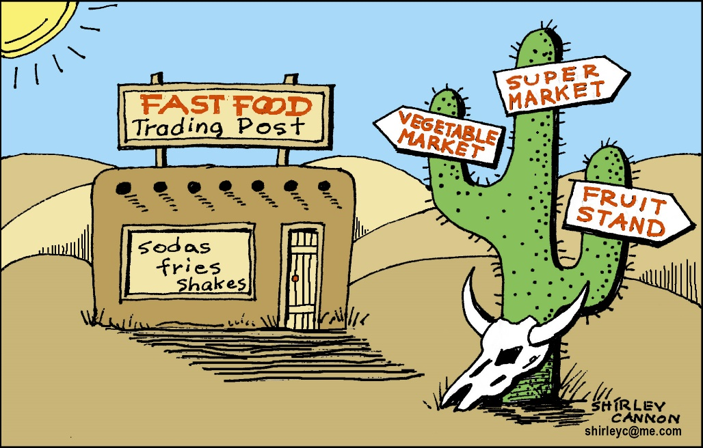
Virginia Executive Institute
An Integrated Plan to
Combat Food Deserts
VEI Fall 2017 Cohort
Jeremiah Fitz, Department of Corrections
Arleen Green, Department of Taxation
Karen Kimsey, Department of Medical Assistance Services
Scott Ridgely, Virginia College Savings Plan
Allen Wass, Department of Behavioral Health and Developmental Services

Slide 2
Definition of a Food Desert
Areas where people cannot access affordable and nutritious food
and/or
Localities with limited proximity to supermarkets combined with low rates of vehicle ownership.
Notes:
The U.S. Department of Agriculture defines “food deserts” as areas where people cannot access affordable and nutritious food. They are usually found in impoverished areas lacking grocery stores, farmers markets, and healthy food providers.
Localities with limited proximity to supermarkets, low rates of vehicle ownership along with high poverty rates makes simple shopping more difficult than in better-served areas regardless of rural or urban designation.
In densely populated urban areas, other population characteristics such as racial composition and unemployment are also of consideration.

Slide 3
Health Concerns of a Food Desert
Food deserts contribute heavily to our nation’s obesity epidemic
Major contributor of childhood obesity
Increasing health care costs
Notes:
Food deserts provide a wealth of processed, sugar, and fat laden foods options that are known contributors to our nation’s obesity epidemic.
There are significant concerns with children diets and childhood obesity in food deserts and carrying these concerns into adulthood.
There is a strong correlation between obesity and increased health care cost. A significant contributor to the rising cost of public health is the obesity epidemic that is connected to low affordable and healthy food access and low income. “Centers of Disease Control and Prevention 2013

Slide 4
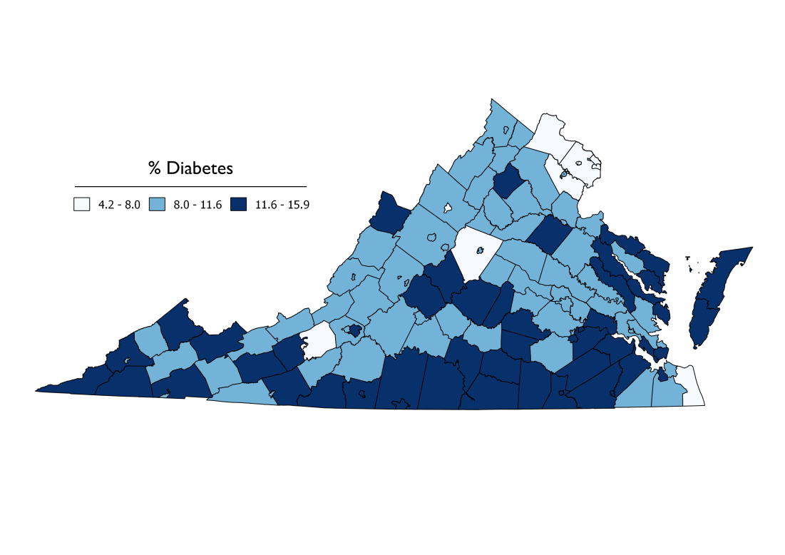
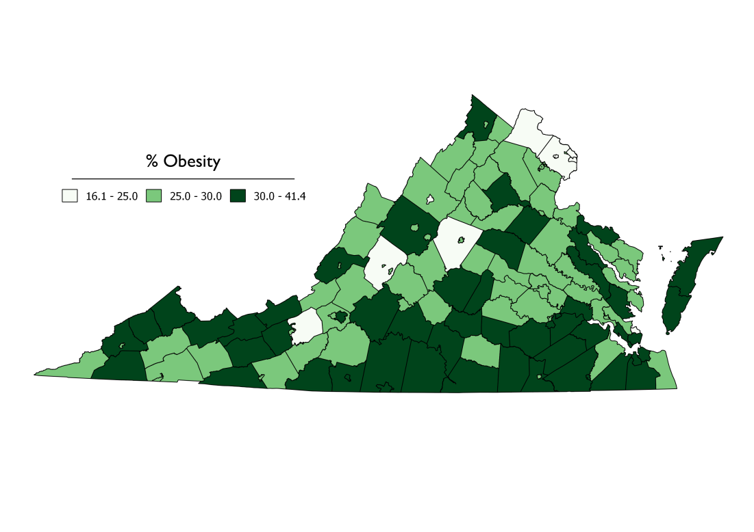
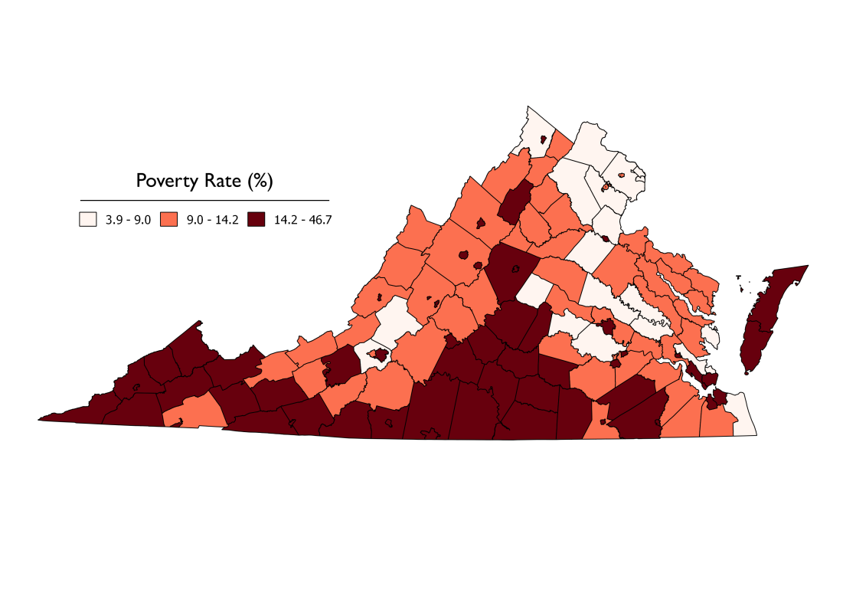
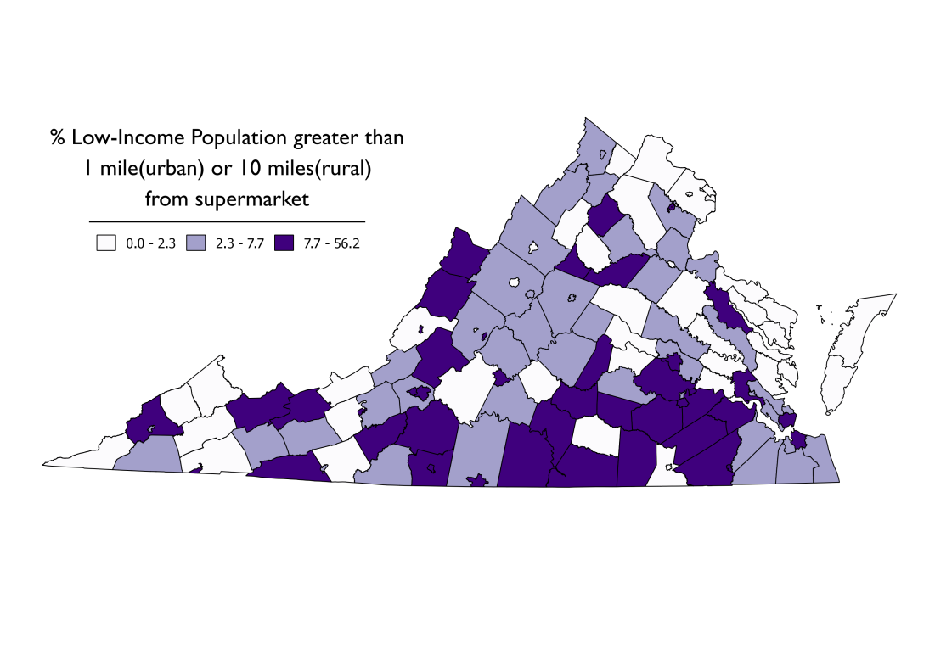
Disease Prevalence Across Virginia

Slide 5
Food Desert Facts
23.5 million
Americans live in areas with little to no access to fresh affordable foods.
17.8 %
1.7 million Virginians live in areas of limited supermarket access.
22%
Households in low income urban areas live ½ to 1 mile from supermarkets with no access to a vehicle.
20%
Of rural households live more than 10 miles from the next supermarket.
Notes:
The commonwealth overall has a low food-access rate of 17.8 percent (1,423,483 individuals), the low-access rate for Lynchburg, for example, is 26.4 percent (19,952 individuals). This is low compared to some other states however Virginia’s rate exceeds the national low-access rate of 7.3 percent.
The limited access to supermarkets not limited to low income urban or rural areas, even in the Northern region, which is considered more affluent, there are pockets of low or limited access.
Imagine a senior or disabled citizen having to walk over a mile to the nearest supermarket and then having to carry the bags back, it is compounded when excess heat or cold is factored in. Or imagine having to ride your bike 10 miles one way and tying the grocery bags to your bike handle or some other creative method to transport your goods home. It is a struggle.

Slide 6
What’s the Impact?
Health
Financial
Virginia Ranked No. 1 in childhood obesity for ages 2 to 4 among low income households
As of June 2017 – reported in the Richmond Times Dispatch
By 2030 more than 1 million diabetes cases and 2 million cases of heart disease are anticipated
Taxpayers left paying for more government spending on health care and less on the core functions of government
Notes:
There’s an impact to not having access, do we want to be No. 1 in childhood obesity, of course not. Nor do we want to be in the stats of trending growth of diabetes and heart disease.
All of this equates to a financial and social impact. We can’t wait for the Walmarts, Publix or other known brands to fix the problem. There are some innovative solutions that have worked in other areas that need to be implemented.

Slide 7
Primary Research into Food Deserts
Interview with administrators in rural areas to gauge problems in Southwest Virginia
Survey conducted amongst teachers in Richmond’s Public School system to better understand the issues facing students in Urban areas
Video summary of findings from survey

Slide 8
Food Desert Recommendations
Explore a Collaborative Effort between VADOC, VADOE and VADOH to combat this crisis
VADOC has the Farmland that can be utilized to harvest the crops
VADOE can strategically place drop off sites for fresh produce in schools/communities where the food desert exist
VADOH can help provide community education on the healthy living implications of eating “right”
Combining resources and an emphasis on strategic planning that includes food deserts as a health crisis from an inter-agency perspective

Slide 9
Food Desert Recommendations
Declare the elimination of food deserts a strategic plan priority for key agencies to incentivize companies to participate
e.g., Virginia Development Economic Partnership
Promotes enhanced collaboration among the Secretariats
Expanded development private/public partnerships
Education, strategic planning and support to local grocers
Amazon – delivers to homes through USPS
Local grocery stores now starting delivery options (Publix, Kroger, Wal-Mart)

Slide 10
Food Desert Recommendations
Automatically enroll eligible Medicaid beneficiaries into the SNAP program, with a simplified renewal process

Slide 11
Discussion?

Slide 12
Appendix - Survey Questions
Overall, what impact do you believe lack of nutritious foods have on students ability to learn?
Extremely Impactful
Somewhat Impactful
A small impact
No Impact at All
Which of the following best describes your knowledge of working with children or adults who routinely live in an area that would be classified as a “food desert”?
Extremely Knowledgeable
Somewhat Knowledgeable
Have some indirect knowledge
No Knowledge at all

Slide 13
Appendix - Survey Questions
What would you say is the biggest impact on learning or educational opportunities for individuals who live in areas that are food deserts?(choose one)
Lower attention spans
Irritability
Poor testing performance
High rate of Absences
Poor Interpersonal Skills
In your experience have you seen efforts to combat food deserts?
Yes
No

Slide 14
Appendix - Survey Questions
If you answered yes to question 4, please list some of the efforts that you have witnessed?
Do you have any suggestions or ideas centered around the idea of combating food deserts that you would like to offer:

Slide 15
Appendix – References and Definitions
http://americannutritionassociation.org/newsletter/usda-defines-food-deserts
http://plan4health.us/defining-food-deserts/
https://www.ers.usda.gov/webdocs/publications/45014/30939_err140_reportsummary.pdf?v=41156
http://www.besthealthmag.ca/best-you/diabetes/5-health-conditions-that-are-caused-by-diabetes/
https://www.cdc.gov/healthyweight/effects/index.html

Slide 16
References – The Numbers
http://virginiafoodsystemcouncil.org/wp-content/uploads/2014/02/Food-DesertvSa.pdf
https://www.pressreader.com/usa/richmond-times-dispatch-weekend/20170604/282273845330148

