Slide 1
The “Living Wage”
Should Virginia Be AN early adopter?

Slide 2
Group 3
Lori Snider Department of Transportation
Charles Kennington Senate Finance Committee
Stephanie Jennelle Radford University
K.C. Howell Virginia Retirement System
Cindy Davis Department of Housing and Community Development
Shane Caudill Department of General Services

Slide 3
Minimum Wage vs
Living Wage

Slide 4
Outside of Virginia
Baltimore, Maryland
Minimum wage increase- 3 year plan
2016: $8.75 2017: $9.25 2018: $10.10
Living wage rate currently $11.66
Applicable to service contracts allowed by Code
The fight for $15 minimum wage rate goes on

Slide 5
Outside of Virginia
Austin, Texas
Federal Minimum Wage Rate $7.25
Living wage rate currently $13.50
Applicable to regular and temporary city employees

Slide 6
Virginia
$7.25
FEDERAL MINIMUM WAGE
$9.79 to $15.70
VIRGINIA’S LIVING WAGE¹
Expenses
Food
Child care
Medical
Housing
Transportation
Virginians Impacted
1 million earn less than $12/hour
1.4 million earn less than $15/hour²
4,500 state employees earn less than $15/hour³

Slide 7
Recent Legislative Efforts in Virginia
Year | Bill No. | Raises the Minimum Wage To:
2017 | SB 978 | $10 in 2017, $13 in 2018, and $15 in 2019
2017 | HB 1444 | $10 in 2017, $12.50 in 2019, and $15 in 2021
2017 | HB 1771 | $10.10 in 2018, indexed to inflation in 2020
2017 | HB 2309 | $11 in 2017, $15 in 2019, indexed to inflation in 2020
2017 | SB 785 | $8 in 2017, $9 in 2018, $10.10 in 2019, $11.25 in 2020; tipped employees not less than half minimum
2016 | HJ 78 | Resolution encourages employers to pay a ‘living wage’
2016 | HB 597 | $10 in 2016, $13 in 2017, $15 in 2018

Slide 8
Considerations
Economics – Supply and Demand
Impact on Low-Wage Employment & Hours
Substitution Effect Capital over Labor, Automation Impact
Regional Cost-of-Living Variations
Leads us to regional, not statewide solution
Notes:
(1) Minimum Wage Increases, Wages, and Low-Wage Employment: Evidence from Seattle Ekaterina Jardim, Mark C. Long, Robert Plotnick, Emma van Inwegen, Jacob Vigdor, and Hilary Wething NBER Working Paper No. 23532 June 2017 JEL No. H7,J2,J3 (2) Lydia DePillis, "Minimum-Wage Offensive Could Speed Arrival of Robot-Powered Restaurants," Washington Post, Aug. 16, 2015 (3) Congressional Budget Office, "The Effects of Minimum-Wage Increase on Employment and Family Income," cbo.gov, Feb. 2014

Slide 9
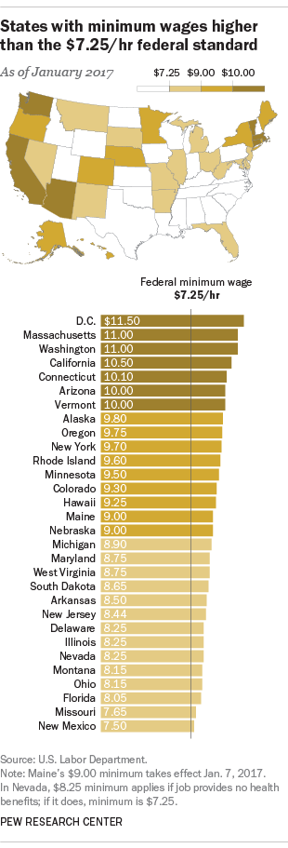
Considerations Cont’d
Affected: 786,000 citizens of the Commonwealth (20.2% of workforce).
The preponderance of research finds that raising the minimum wage does not cause job losses.
Four of the top ten states rated by Forbes as “best states for business” have state minimum wages at least $1.00 an hour higher than the federal minimum wage.
Notes:
http://www.epi.org/publication/15-by-2024-would-lift-wages-for-41-million/
From the Economic Policy Institute, an independent, nonprofit think tank that researches the impact of economic trends and policies on working people in the United States…786,000 citizens of Virginia or over 20% of the workforce would benefit from a living wage.
The preponderance of research finds that raising the minimum wage does not cause
job losses. Many academic studies have examined the question, using data going back to
1990. They “suggest that the effects of minimum wage increases on employment have
historically been slightly negative, negligible, or sometimes even positive.”
Economists cite several reasons why increases in the minimum wage, which raise
employers’ cost, generally do not cost jobs. Increased pay adds money to workers’
pocketbooks and allows them to buy more goods and services, creating higher demand,
which in turn requires hiring more workers. The higher wage may make it easier to
attract applicants and results in less turnover of workers, lowering costs of employers
To counter the argument that it may affect Virginia’s business climate, the Dept of Labor statistics, Five of the eight top states in Job growth had wages higher than the federal minimum wage. Virginia, with a supposedly good business climate and yet ranked 48 out of 50 states in job growth. Clearly something other than wages make the case for attracting businesses and jobs.

Slide 10
Considerations Cont’d
Paying a living wage results in increased efficiency and productivity.
Living wage policies result in decreased employee turnover.
And finally….
Notes:
FROM the PEW Research Center:
A study of home-care workers in San Francisco found that turnover fell by 57% following implementation of a living wage policy.
• A study of the Los Angeles ordinance found that absenteeism declined, and the decrease in turnover offset 16% of the total cost of the living wage ordinance.
• A study of the San Francisco airport found that annual turnover among security screeners fell from 95% to 19%, as their hourly wage rose from $6.45 to $10.00 an hour.

Slide 11
“not raising the minimum wage substantially entails the risk of leaving many workers "without the ability to afford a decent life, despite working hard at a full-time job. Aside from being fundamentally unjust in a rich society, this situation also fuels the kind of social frustration and unrest that we have seen break out in various ways over the past few years.“
- Steven Fazzari, Washington University in St. Louis
Notes:
Steven Fazzari, Distinguished Professor of Economics at Washington University in St. Louis and a member of the Academic Council of the Institute for New Economic Thinking.

Slide 12
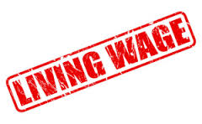
Options/Strategies
Working citizens of the Commonwealth should be able to live above the poverty line
The science is unsettled
The issue is divisive
Notes:
Definition - a wage that supports the purchase of goods and services that together provide a standard of living that exceeds the poverty level that is appropriate in a given society at a particular point in time.
Calculation methodology - costing out a market basket of goods and services that are normally consumed by residents in a particular area. These items typically include housing, transportation, food, energy, education, and health care.

Slide 13
Options/Stratgies
Bipartisan Effort
Attempt to make progress towards addressing the issue
Further Study
Implement for State Employees Only
Explore a Local Option
Notes:
Definition - a wage that supports the purchase of goods and services that together provide a standard of living that exceeds the poverty level that is appropriate in a given society at a particular point in time.
Calculation methodology - costing out a market basket of goods and services that are normally consumed by residents in a particular area. These items typically include housing, transportation, food, energy, education, and health care.

Slide 14
References
Glasmeier, Amy K. Living Wage Calculator. Department of Urban Studies and Planning, Massachusetts Institute of Technology. 2017. http://livingwage.mit.edu/ (accessed October 1, 2017).
“Few Rewards: An Agenda to Give America’s Working Poor a Raise.” Oxfam and Economic Policy Institute. 2016. https://www.oxfamamerica.org/explore/research-publications/few-rewards/ (accessed October 9, 2017).
Virginia Department of Planning and Budget. Fiscal Impact Statement for Senate Bill 978. 2017. https://lis.virginia.gov/cgi-bin/legp604.exe?171+oth+SB978F122+PDF (accessed October 9, 2017).
http://www.epi.org/publication/15-by-2024-would-lift-wages-for-41-million/
http://www.nber.org/papers/w23532.pdf - Recent study of Seattle’s wage increase found negative impact on total payroll of low wage jobs
http://retirementcommission.virginia.gov
https://civilrights.baltimorecity.gov/wage-commission/wages

Slide 15
QUESTIONS

Slide 16
Living Wage in Virginia
Source: Glasmeier, Amy K. Living Wage Calculator. Department of Urban Studies and Planning, Massachusetts Institute of Technology. 2017. http://livingwage.mit.edu/ (accessed October 1, 2017).

