Slide 1
Mental Health Care for the Citizens of the Commonwealth: System complexities
VEI Fall 2017
Group 1
Leslie “Moose” Fleming – DOC Suzanne Gore – DMAS Brooke Henderson – DHRM
Phil Pippert – VITA Megan Seibel – Dep .Sec. – Ag & Forestry Mike Taylor – OSIG

Slide 2
Agenda
Why do we care?
DOC: Case Study on Change
A broader view

Slide 3
Is VA’s Mental Health System in CRISIS?
VA Tech – April 16, 2007
Gus Deeds – November 19, 2013
Jamychael Mitchell – August 19, 2015
High profile tragedies grab big headlines but don’t tell the whole story

Slide 4
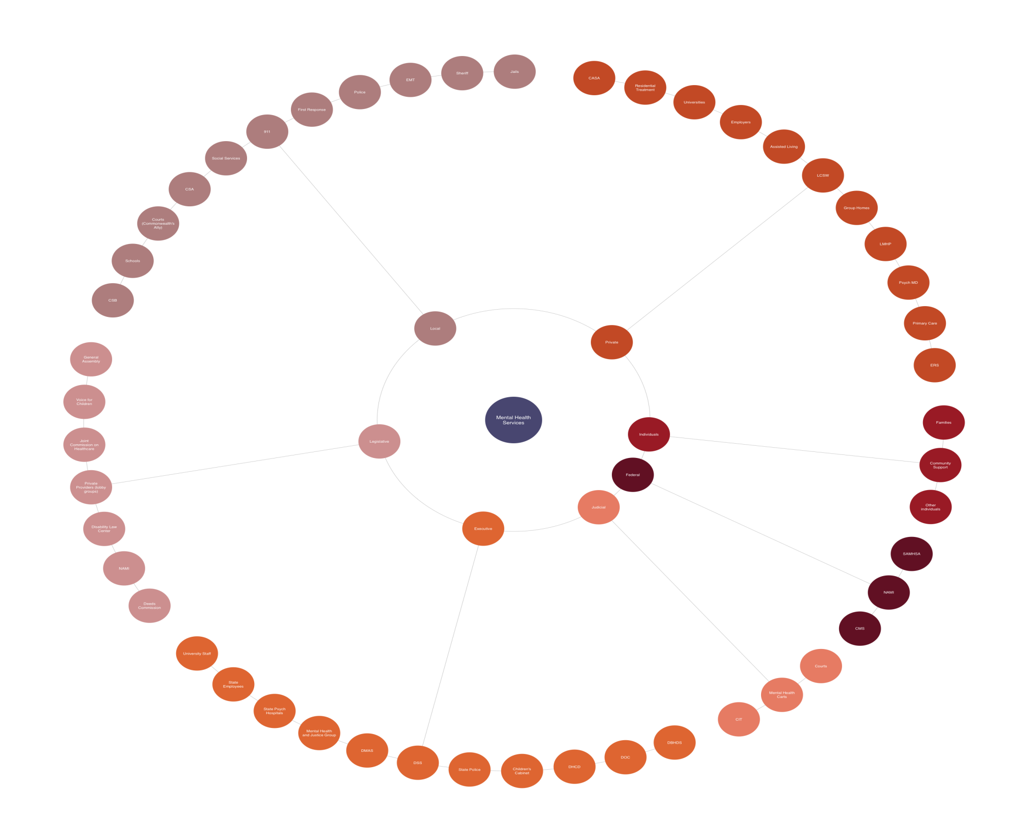

Slide 5
DOC’s Secure Diversionary Treatment Program (SDTP)
Approx. 27% of offender population requires some level of mental health service. DOC has a continuum of services to meet the needs of offenders both while incarcerated and assist with aftercare once released.
Traditionally the Seriously Mentally Ill (SMI) offender has been housed in segregated units devoid of social learning with little to no activity or programming – limiting mental stimulation. These offenders often destabilize and are more likely to display disruptive behavior.
The Secure Diversionary Treatment Program (SDTP) will provide a pathway for SMI offenders to break the General Population/Segregation cycle and receive appropriate mental health treatment services and programs based on an effective mental health evaluation and assessment.

Slide 6
Show a significant reduction in the use of Segregation for SMI offenders
Provide SMI offenders with successful self-management of daily activities within a facility
Increase the level of treatment services available for those confined in correctional facilities
Increase the level of interaction of SMI offenders with CCIT certified staff
Meet the robust goal of public safety while providing more intensive programming to restrictive housing offenders assessed as SMI
Meet the ACA standard of not placing an offender with SMI in Extended Restrictive Housing (no longer than 30 days)

Slide 8
https://www.youtube.com/watch?v=IpgKDKAhwBQ&feature=youtu.be

