Slide 1
Net Neutrality
VEI Group 6
May 2018
Notes:
Kelly

Slide 2
Team Members
Kelly Hiers, Virginia Retirement System
Debbie Howe, Department of Human Resource Mgmt.
Mike O’Berry, Virginia Commonwealth University
Ann Bevan, Department of Medical Assistance Services
Terri Rose, Virginia Lottery
Hikmet Gursoy, Virginia Tech
Notes:
All

Slide 3
Introduction
In 2017, the Federal Communications Commission (FCC) voted to repeal America’s net neutrality rules
History
Advantages & Disadvantages
State Responses
International Perspective
Conclusion
Notes:
Kelly
The Federal Communications Commission, the FCC, voted to repeal America’s net neutrality rules late last year. The process of dismantling the net neutrality rules began in April of this year.
The broadband industry promised that the internet experience would not be negatively impacted, but critics argued that the net neutrality rules are necessary to preserve an open Internet and prevent broadband providers from having the power to censor internet content.
Over the next few minutes, we will provide you with additional information to expand upon these arguments, including a brief look at the history of, advantages, and disadvantages of net neutrality. We will also look at how the issue is being handled around the United States and across the globe.
Our goal is to provide an objective analysis of net neutrality, which includes its advantages and disadvantages, implications of the repeal of its Federal regulations and its potential effects on the citizens in Virginia.

Slide 4
Net Neutrality Defined
What is net neutrality?
The principle that Internet service providers should enable access to all content and applications regardless of the source, and without favoring or blocking particular products or websites.
“How should a network’s owner treat the traffic that it carries? What rights, if any, should a network’s users have versus its owners?” – Timothy Wu
How The FCC'S Net Neutrality Plan Breaks With 50 Years Of History, Retrieved (2017, December 6) from
https://www.wired.com/story/how-the-fccs-net-neutrality-plan-breaks-with-50-years-of-history/
Notes:
Kelly
Before we get too far along, let’s stop to talk briefly about what net neutrality actually is. It is simply the principle that internet service providers should enable access to all content and applications regardless of the source. And they should do so without favoring or blocking particular products or websites.
The argument around net neutrality can be summed up in two questions. 1) How should a network’s owner treat the traffic that it carries? And 2) What rights should the network’s users have versus its owners?
Keeping those two questions in mind, I’ll turn it over to my colleague, Debbie Howe.

Slide 5
History
Communications Act of 1934 established the FCC
By 1976, the FCC distinguished between basic and enhanced communication services
In 2004, FCC Chair Michael Powell gave a speech regarding the Four Internet Freedoms
In 2015, the FCC reclassified the internet as a common carrier which are covered under Title II of the Communications Act
In 2017, the FCC repealed the Open Internet Order of 2015
Notes:
Debbie

Slide 6
Advantages
U.S. proponents believe that keeping the internet free and unrestricted in access is essential for society and critical in affording a multitude of opportunities. Net neutrality allows:
Control of data
Fostering of free speech
Increased user tolerances
Promotion of competition and innovation
Preservation of internet standards
Promotion of investment of quality services
Notes:
Ann
Overview-Who are the supporters?
o Proponents of net neutrality regulations include consumer advocates, human rights organizations
o Online companies and some technology companies
o Many major Internet application companies are advocates of neutrality- Yahoo!, Vonage,^{[59]} eBay, Amazon,^{[60]} IAC/InterActiveCorp, Microsoft, Reddit, Twitter, Tumblr, Etsy, Daily Kos, Greenpeace, along with many other companies and organizations, have also taken a stance in support of net neutrality
o Cogent Communications, an international Internet service provider, has made an announcement in favor of certain net neutrality policies
· Net neutrality as a concept is good, it's about fairness.
· Net neutrality as a practice is problematic.
· It's more political than it is technical.
Control of data-
· Gives consumers control of what they get and use and not ISPs;
· ISPs should not create gateways, which influence discovery of sites, giving preference to some sites over others. You don't want your Internet access to become as limited as your Cable TV service
· Being neutral allows the customer to control data, and not ISPs which could become corrupt as demonstrated in countries like India
Fostering of free speech-
· Without it Internet Service Providers (ISP) could exploit customers;
· Potentially can monitor everything you do and sell to advertisers;
· Can block tweets that are negative for the ISP;
· Our laws have always said that two-way communications networks must be nondiscriminatory
· One group espouses that the open internet allows people of color to tell their own stories and organize for racial justice. When activists are able to turn out thousands of people in the streets at a moment’s notice, it’s because ISPs aren’t allowed to block their messages or websites. The open internet allows people of color and other vulnerable communities to bypass traditional media gatekeepers. Without Net Neutrality, ISPs could block speech and prevent dissident voices from speaking freely online. Without Net Neutrality, people of color would lose a vital platform.
Increased user tolerances
· Sites should be accessible at the same speed. This means no speeding up of certain sites because of business deals
· Users have become accustomed to unfettered access and high speed internet
· They will not tolerate going from fast connectivity slower access and abandon sites or programs that appear too slow for their needs
Promotion of competition and innovation
· If small businesses have access, they can promote products, ideas etc.
· If repealed, they would not be able to afford the potential extra and high costs placed by ISPs
Preservation of internet standards
Advocates have sponsored legislation claiming that authorizing ISPs to override transport and application layer separation on the Internet would signal the decline of fundamental Internet standards and international consensus authority. Further, the legislation asserts that bit-shaping (encoding that changes the distribution of signals to improve efficiency) the transport of application data will undermine the transport layer's designed flexibility.
Promotion of investment of quality services- without the threat of throttling or the similar, companies can focus on developing quality services versus paying ISPs for more speed

Slide 7
Disadvantages
Large ISP’s like Comcast and Verizon & telecommunications giant AT&T are against net neutrality rules under Title II and believe the repeal of net neutrality benefits their businesses and consumers
Networks can’t afford to grow
ISP’s are unable to assign priorities
Government Bureaucracy
Priority Treatment
Notes:
Networks can’t afford to grow
Services like Netflix require more bandwidth than the average person (⅓ bandwidth in US), but pay the same as other users under net neutrality
ISP’s could afford to improve and expand their networks and focus on new technology if they could charge more for high end users. This could allow for competition between ISP’s and allow the consumer choices and the ability to negotiate their contracts and pricing.
Accessibility to Restricted Content
ISPs could charge a premium for access to restricted sites
Government Bureaucracy
Net Neutrality is government regulation under Title II
It may help small innovators to stay alive, but it will likely slow down internet innovation
Priority Treatment:
Companies can no longer lobby for exemptions to force ISP’s to prioritize their traffic under net neutrality.

Slide 8
States Supporting Net Neutrality
The FCC’s repeal has produced a variety of reactions across the country. 28 states are currently proposing one or more bills to support net neutrality.
22 states attorneys general are suing the FCC – all Democrats. The suit, led by New York’s attorney general, is one of the most prominent challenges to the repeal.
The FCC says its action pre-empted any attempts by states to pass net neutrality legislation.
Notes:
Terri –
Options for states
Do nothing: this is pretty self-explanatory, and a popular choice
Pass a resolution: basically a formal plea from the state government urging either Congress and/or the FCC to reconsider the decision
Sue the FCC: a lawsuit filed by 22 state attorneys general, which is currently being pursued
Have the Governor sign an executive order: this option is a shortcut to establishing requirements that might otherwise be passed through state legislature, as in options 5 and 6
Pass a bill on state contracts: this kind of bill would enforce net neutrality on any ISP that has, or wants, a contract with the state
Pass a bill on all ISPs: this, the most comprehensive approach, would establish a law requiring all ISPs in the state to abide by net neutrality principles, including not throttling or prioritizing content

Slide 9
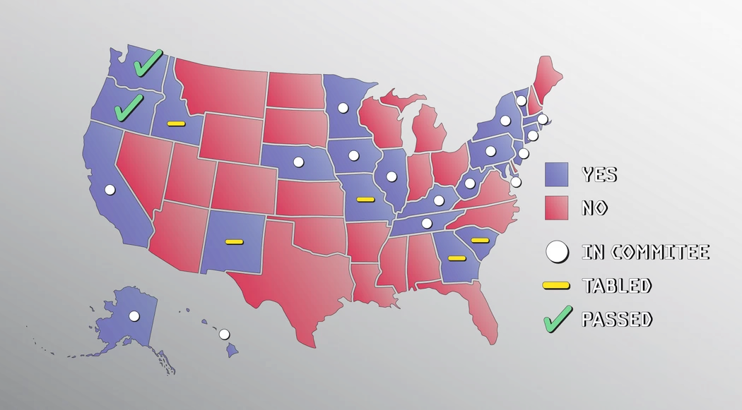
States Supporting Net Neutrality
Image: Xavier Lalanne-Tauzia /Motherboard
Notes:
Terri
Washington and Oregon are the only two that have passed legislation so far.
The governors of five states — Montana, New Jersey, New York, Hawaii, and Vermont — have signed executive orders to preserve the rules. States issuing executive orders have said they won’t do business with a company that doesn’t abide by net neutrality to combat the FCC’s action
28 in total are pursuing one or more bills.

Slide 10
International Perspective
The Internet has no centralized governance in either technological implementation or policies for access and usage
Each country manages its own internet environment independently.
Other countries are also facing similar dilemmas about how to deal with today’s digital realities
General consensus is that an open internet is good for consumers and for civil society
Notes:
Hikmet
The Internet is a global system of interconnected computer networks. By design it has no centralized governance. Each country manages its own internet environment independently. Just like the US, other countries are also facing similar dilemmas about how to deal with today’s digital realities. Many highly industrialized and developing countries share a general consensus that an open internet is good for consumers and for civil society.

Slide 11
International Perspective
The European Union
Approved strong rules in 2015
Requiring companies that provide internet access to handle all traffic equally
Traffic can only be restricted when network is at its maximum capacity
Proactively monitoring compliance with net neutrality rules
Somewhat stronger consumer protection for EU residents
Australia
Has no net neutrality laws
Internet service is regulated by the Australian Communications and Media Authority
ISPs regularly offer zero-rated content
Strong consumer protection laws
Throttling or blocking competitors’ content is not allowed
ISPs have to be transparent in their policies
Russia
Heavy online censorship
Passed net neutrality laws in 2016
Non-discriminatory access to content not censored by the government
Government can still block access to internet sites
In most cases net neutrality isn’t the whole issue
Notes:
Hikmet
Here are some examples of net neutrality being adopted by the international community. The European Union approved strong net neutrality rules in 2015, requiring companies that provide internet access to handle all traffic equally, traffic is only restricted when network equipment is operating at its maximum capacity. EU rules also allow traffic restrictions to protect network security and handle emergency situations. They recognized that quality of service could vary, but no specific applications should be discriminated against. In 2017, they highlighted the importance proactively monitoring compliance with net neutrality rules, rather than waiting for violations to happen before reacting. This gives European residents somewhat stronger consumer protection.
Russia, despite practicing heavy online censorship, passed net neutrality laws in 2016. Russian legislation focuses on non-discriminatory access to content—that is, the content not censored by the government. Russia’s regulation demonstrates that in oppressive societies net neutrality isn’t the whole issue. A neutral approach to data doesn’t mean any data is permissible, and a government can choose to block access to large number of internet sites.
Australia has no net neutrality laws, and it’s unlikely to change any time soon. Internet service in the country is regulated by the Australian Communications and Media Authority. Across the country, ISPs regularly offer zero-rated content through partnerships with content providers. zero-rated content means that data from specific apps or websites aren’t counted toward a user’s monthly data limit, allowing providers to forge partnerships with particular apps and websites. The system works because of the large number of ISPs (63 according to the Australian Bureau of Statistics), strong consumer protection laws to prevent ISPs from throttling or blocking competitors’ content, and rules mandating that ISPs have to be transparent in their policies.

Slide 12
Conclusion
To protect Virginia consumers:
Content and application discrimination should not be allowed
Laws need to be put in place to prevent competitors from throttling and blocking content
ISPs should have transparent policies related to content delivery
Notes:
Hikmet
Recommendations: In light of all the information we have researched and presented: Our recommendations for Virginia are: Rules should be put in place for internet service providers to enforce substantial protections against content and application discrimination. Companies providing internet service should not be able to block or throttle data based on content, sender, receiver, protocols or user equipment. ISPs should be transparent with customers about hidden fees, consequences of exceeding data caps, network performance and how they manage their networks. These requirements were part of the net neutrality rules and are being eliminated with the repeal. We believe repeal will not end the discussions regarding how the internet is being managed in the US. Discussions on state level are just beginning and many states are taking action to ensure equal access to the internet. There are also many individuals s who are very passionate about net neutrality and we think they will be keeping a close tab on ISP’s and content providers.

