Slide 1
Is Change Coming? Considerations regarding the legalization of marijuana
Presented by:
Carnell Bagley, Virginia Auditor of Public Accounts
Tom Fitzpatrick, Virginia Department of Criminal Justice Services
Carol Mawyer, Virginia Alcoholic Beverage Control Authority
Lisa Pride, Virginia Department of Transportation
Cleon Ross II, Virginia Department of Corrections – Correctional Education

Slide 2
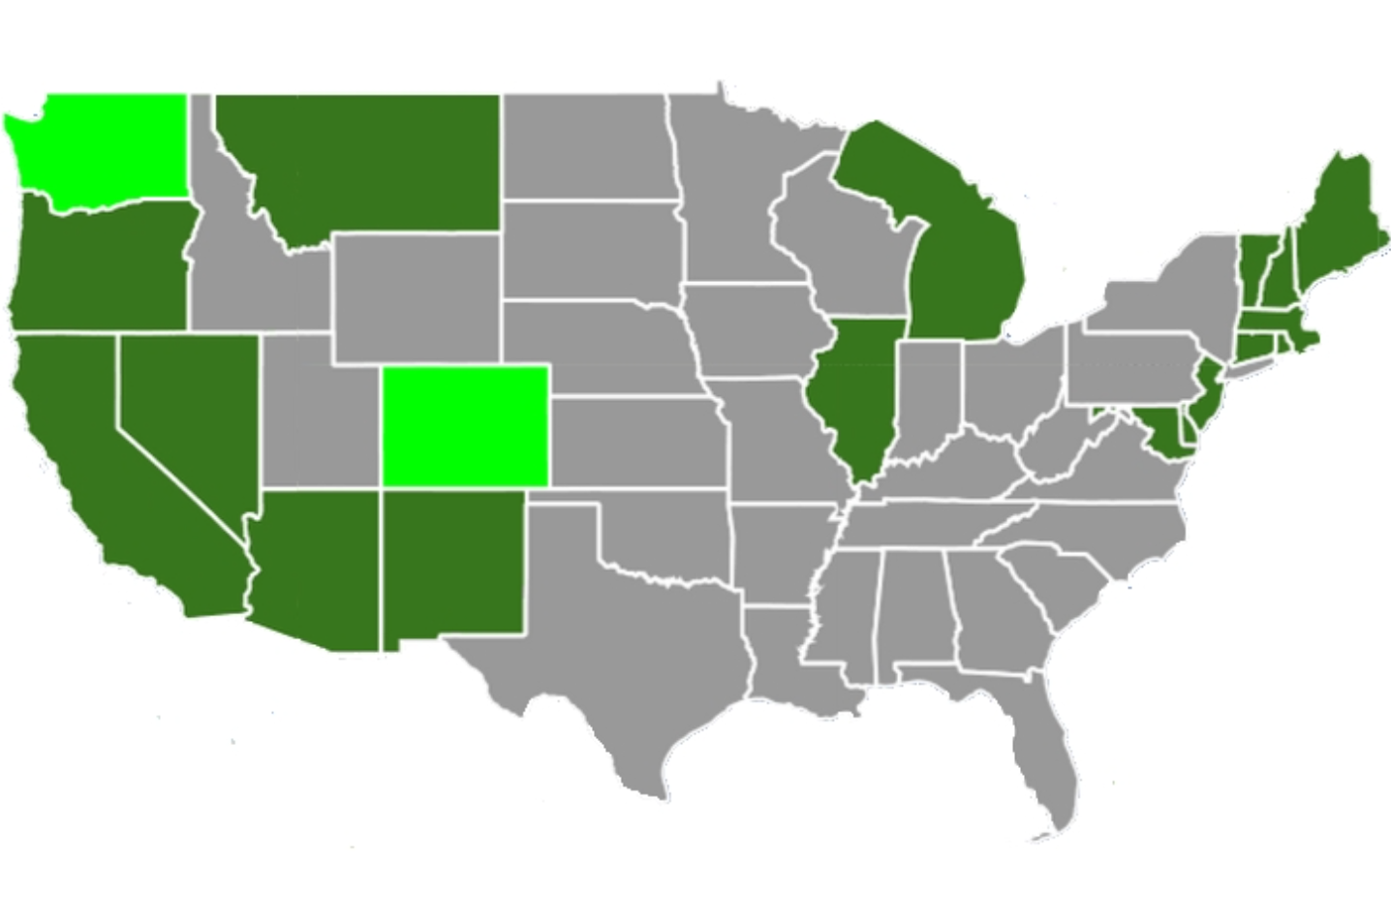
A Changing Landscape for Marijuana Legalization - 2015

Slide 3
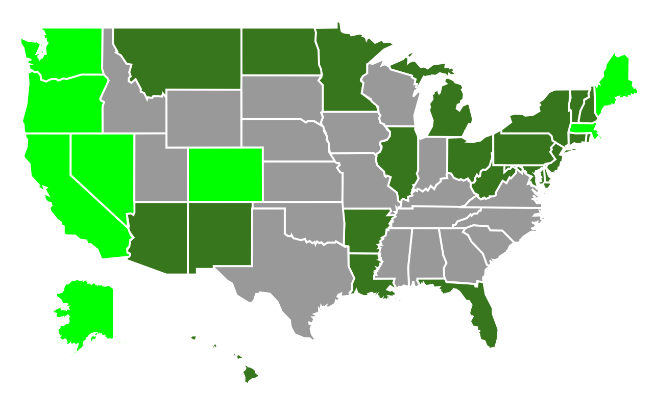
Today’s Landscape

Slide 4
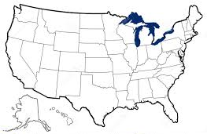
The Future Landscape
?

Slide 5
Key Issues Virginia’s Leaders Will Need To Address
Public Health
Revenue
Public Safety

Slide 6
Impact On Public Health
Dependent upon four factors
prevalence of use
frequency and intensity of use
modalities of both use and sales
risk associated with marijuana use

Slide 7
Impact On Health
Total Harm =
Harmfulness × Intensity × Prevalence

Slide 8
What Are The Risks?
Acute Health Risks
Fatal Overdose
Accidental Poisoning
Anxiety
Cognitive Impairment
Accident Risks
Chronic Health Risks
Dependence
Respiratory Health
Cardiovascular Health
Cancer
Brain Development
Long-Term Cognitive Impairment
Mental Illness

Slide 9
Medical Benefits
Cancer
Multiple Sclerosis
Symptoms such as
spasticity
chronic pain
muscle and
bladder-related problems
insomnia
The verdict is still out on epilepsy, dementia and schizophrenia.

Slide 10
Financial Impact On The Commonwealth
Broad categories of marijuana legalization
medical use
decriminalization of personal use by adults
retail sales

Slide 11
Potential Revenue Streams

Slide 12
Examples of Other States
YEAR LEGAL | STATE | EXCISE TAX (CY 2017) | SPECIAL TAX (CY 2017) | SALES TAX | TOTAL FY17 REVENUE (millions) | ALLOCATION | OVERSIGHT
2014 | Colorado | 15% | 10% | 2.9% (medical) | $210.4 | School Infrastructure Behavioral Health | Colorado Dept. of Revenue – Marijuana Enforcement Division (NEW)
2014 | Washington | 37% | n/a | 8% | $315 | Substance Abuse Higher Education | Liquor and Cannabis Board (EXPANSION)
2016 | Massachusetts | 10.75% | n/a | 6.25% | TBD | Areas with Adverse Drug Convictions | Cannabis Control Commission (NEW)
Registration fees
License fees

Slide 13
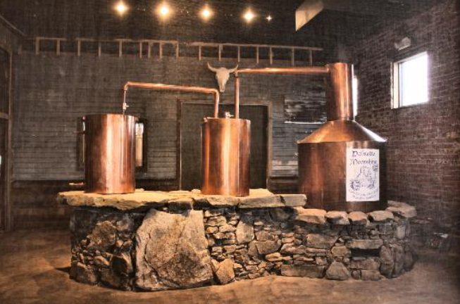
Grey/Parallel Market
grey market
comparison markets
public safety impact
cash market vulnerability
Notes:
There are Many that believe that legalizing marijuana would eliminate the impact on the public safety sector of state government. One of the main impacts is the elimination of the black market and the emergence of the grey or parallel market.
What is the Grey or Parallel market? It is the sale of goods that are legal goods but distributed through unauthorized channels at often a lower cost and often to avoid paying taxes or fees.
These markets much like alcohol bootlegging and the sale of cigarettes purchased in large quantities and sold in other jurisdictions with higher taxes. This market can often be every bit as dangerous as the black market that legalized Marijuana sales would replace. It is critical to continue to research these markets in other states to understand how they function and the safety concerns that they could create.
Another key concern related to the grey market is the use of a cash as its primary means of transaction. Cash is the primary vehicle for transactions due to federal financial institutions not allowing funding for marijuana sales regardless of any state law changes. This potentially large cash business could attract other crime elements including burglary and armed robbery. More research must be done with other states with current marijuana law changes on the rise of these crimes.

Slide 14
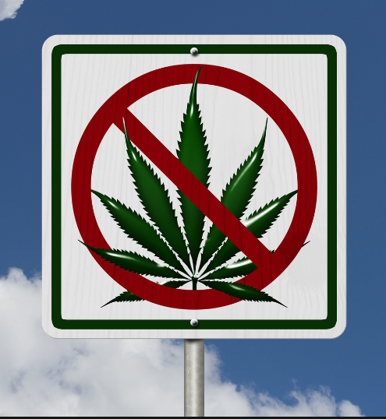
Assuring Road Safety
testing for marijuana – THC
limitations
standards
public media campaign
training law enforcement

Slide 15
Conclusion & Questions
Thank You
Carnell Bagley, Virginia Auditor of Public Accounts
Tom Fitzpatrick, Virginia Department of Criminal Justice Services
Carol Mawyer, Virginia Alcoholic Beverage Control Authority
Lisa Pride, Virginia Department of Transportation
Cleon Ross II, Virginia Department of Corrections – Correctional Education

