Slide 1
Economic Growth in Virginia: Investing in Virginia’s Future Workforce through Social and Physical Security in Schools
Olga Lopez, DOC
Europai Parker, DDS
Antonio Terry, TAX
Elizabeth Seward, VHDA
Craig Nicol, DEQ
VEI – 2018 Leadership Presentation Group 4
Notes:
Read in Spanish

Slide 2
¿se cumplen sus necesidades básicas?
¿Cómo se sentiría usted si todo el día escucha sólamente este idioma y no tiene muchas personas con quien socializarce?
Amistades: Sentimiento de Pertenencia
Seguridad Fisica y Emocional
Conección Emocional
Ambiente Social
Comunicación
Aceptación
Notes:
Read in Spanish
How would you feel if you only listen to this language all day and don't have many people to socialize with?
Are your basic needs being met?
• Communication
• Friendships
• Participation
• Understanding
Emotional connection

Slide 3
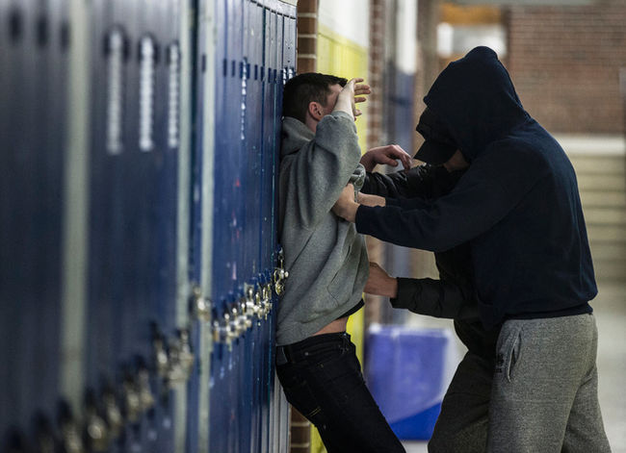
The Challenge
Notes:
Active Slide – Need to progress forward to see each image
How can our children become a successful future workforce if they are constantly under the Gun of Hunger, Physical Safety , Bulling, Social Acceptance

Slide 4
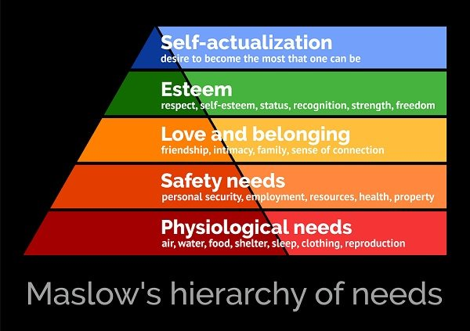
If our students are going to be successful in the 21st Century and become a productive modern workforce they need a positive and safe learning environment
Notes:
Active Slide – Need to progress forward to see each image
Maslow’s hierarchy provides a model for how students are motivated to learn. Without the lowest layer of the hierarchy met, students cannot reach the next level. Each level allows students the ability and motivation to increase. Each student can move up in the hierarchy with the proper support of the teachers and school staff who must focus on Maslow’s hierarchy of needs in teaching and education.

Slide 5
Nourishment
A nourished child is a better:
learner
test-taker
participant in school
More likely to:
be at school
arrive on time
behave
be attentive in class

Slide 6
Nourishment Equality
Eliminate the road blocks:
Ability to pay
Demonstration of need
Lunch line embarrassments
Programs:
Community Eligibility Provisions (CEP)
Universal Free School Lunch Program

Slide 7
Physical Safety
A safe, supportive learning environment is essential
School violence negatively impacts both the teaching and learning environment
Students need to feel connected to school and their educational experience

Slide 8
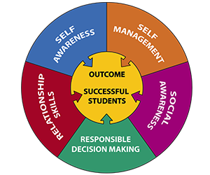
Emotional Safety
Improve learning environment
through social and emotional
education
Social and emotional skills impact:
Long-term health
Academic outcomes
Economic outcomes
Notes:
According to the National Center on Safe Supportive Learning Environments, socially and emotionally competed children and youth are skilled in five core areas
Self-aware
Regulate their emotions
Socially aware
Good relationships
Responsible decision making
CASEL (Collaborative For Academic, Social, and Emotional Learning)
According to the National Center on Safe Supportive Learning Environments, socially and emotionally competed children and youth are skilled in five core areas
Self-aware
Regulate their emotions
Socially aware
Good relationships
Responsible decision making

Slide 9
Belonging & Esteem
Sense of Connection
Navigating the social ecology of school
Teachers respect them
School’s culture
Diversity in school reading materials
Dress codes
Teachers capacity to relate to them individually
Notes:
Sense of Connection
Student sense that their teacher respects them
Student perception of the school’s culture (do I feel like I belong?)
Diversity in school reading materials
Dress codes
Teachers capacity to relate to them individually
School’s culture (do I feel like I belong?)
Diversity in school reading materials
Dress codes
Teachers capacity to relate to them individually

Slide 10
WHEN The basics are Missing
THE FACTS:
Declining public investment
School violence impacts the
educational environment
Continual growth in childhood poverty
Need long term strategies to improve labor market outcomes

Slide 11
When The basics are Present
Provide for Opportunity
Expand focus on school safety beyond just physical safety to ensure today’s students are equipped with in-demand skills that will advance Virginia’s future economy
Notes:
Labor market’s slow recovery from the recession is driving research in to long term strategies to improve labor market outcomes
Best practice: 21st century learning must take place in contexts that promote interaction and a sense of community that enable formal and informal learning

Slide 12
Realignment
Classroom Culture
Friendship
Sense of connection
Esteem
&
Belonging
Physical Safety
Health
Safety
Food
Water
Shelter
Physiological
21st Century Learning Environment
Notes:
Create a 21st Century learning environment Alignment

Slide 13
Recommendations
Align existing external programs for physiological needs, safety and belonging within the four walls of our schools
Implement school district wide programs that utilize USDA’s best practice for expanding school food programs to remove the stigma of free meals
Establish governance structure at the state and regional level to require integration and operation of external programs

Slide 14
Recommendations (cont.)
Utilize a rapid results methodology to align goals and outcomes across sectors (e.g. Ending Veteran Homelessness)
Develop and implement a model for diversity and inclusion in schools
Provide framework that allows for one-on-one teacher student time to promote mentoring and feeling the pulse of the individual and student body

Slide 15
The real question
Are we willing to write a new chapter in Virginia’s social and economic future?
Do we have the commitment?

Slide 16
Questions

Slide 17
References
Evaluation of Demonstration Projects to End childhood Hunger: Interim Evaluation Report. https://www.fns.usda.gov/evaluation-demonstration-projects-end-childhood-hunger-edech-final-interim-evaluation-report
Universal Free School Meals -Ensuring that All Children Are Able to Learn By Madeleine Levin & Jessie Hewins From our 2014 March - April issue http://povertylaw.org/clearinghouse/articles/meals
Community Eligibility Provisions https://www.fns.usda.gov/school-meals/community-eligibility-provision
The Community Eligibility Provision http://vahungersolutions.org/cep/
CEP Serving up success http://vahungersolutions.org/wp-content/uploads/2016/04/CEP_Toolkit_20

Slide 18
References
Food Nutrition Why not just give all students free breakfast and lunch? Posted By Daniel Walters on Mon, Jun 2, 2014 at 12:11 PM https://www.inlander.com/Bloglander/archives/2014/06/02/why-not-just-give-all-students-free-breakfast-and-lunch
Free Lunch for all Hungry students https://www.newamerica.org/education-policy/edcentral/free-lunch-for-hungry-students/ (students don’t feel singled out)
Fighting the stigma of free lunch: Why universal free school lunch is good for students, schools, and families Amy, Brown, New York 2014-2015. Photo Credit: Simon Luethi ©Ford Foundation. Janna Bilski Amy Brown, Senior Program Officer, Civic Engagement and Government Janna Bilski, Hedge Fund Investments 29 SEPTEMBER 2017 https://www.fordfoundation.org/ideas/equals-change-blog/posts/fighting-the-stigma-of-free-lunch-why-universal-free-school-lunch-is-good-for-students-schools-and-families/ New York

Slide 19
References
https://www.edweek.org/ew/articles/2017/06/21/belonging-at-school-starts-with-teachers.html
http://sguditus.blogspot.com/2013/02/maslows-hierarchy-of-school-needs-steve.html
https://www.edweek.org/ew/articles/2017/06/21/belonging-at-school-starts-with-teachers.html
https://www.psychologytoday.com/us/blog/hide-and-seek/201205/our-hierarchy-needs

