Slide 1
A PLACE TO CALL HOME:
Addressing Housing Insecurity in Virginia
Virginia Executive Institute
Spring 2018

Slide 2
A PLACE TO CALL HOME
Dr. Meir Amar – Department for Aging and Rehabilitative Services
Angela Bartlett – Department of Motor Vehicles
Sandra Gill – Department of General Services
Lisa Hernandez – Department of Corrections
Tara Ragland – Department of Social Services
Greer Saunders – Virginia Community College System
Group 3 members

Slide 3
A Place to call home
Virginia has one of the highest rental rates in the nation, causing many families to live in pay-by-the-week motels or in overcrowded housing. Housing insecurity makes it more difficult for families to move out of poverty. What are the existing and possible new initiatives to help these families gain and remain in permanent housing?
Introduction
Current Efforts
Barriers
Permanent
Housing
Promising
Practices
Conclusions
Data

Slide 4
A Place to call home
Virginia has one of the highest rental rates in the nation, causing many families to live in pay-by-the-week motels or in overcrowded housing. Housing insecurity makes it more difficult for families to move out of poverty. What are the existing and possible new initiatives to help these families gain and remain in permanent housing?
Introduction
Current Efforts
Barriers to Permanent Housing
Permanent
Housing
Introduction
Promising
Practices
Conclusions
Data

Slide 5
WHAT IS HOUSING INSECURITY?
The Department of Health and Human Services defines housing insecurity as:
High housing costs in proportion to income
Poor housing quality
Unstable neighborhoods or “multiple moves”
Overcrowding
Homelessness
Expanded definition includes:
Chronically late on rent payments
Being evicted

Slide 6
WHY SHOULD WE CARE?
Adverse mental health, educational, and behavioral outcomes in children
Diminished physical and mental health in adults
Often associated with other forms of instability in families, schools, and communities
We all pay for the effects of housing insecurity

Slide 7
Data

Slide 8
DATA
Over the course of a year, half a million people stayed in shelters or temporary housing, such as motels.
Number of renters who pay more than 30% of their income on housing is rising.
13% of Virginia households pay more than 50% of income on housing.
Across Virginia, an estimated 3,000 school-age children live in motels.
5 out of the top 10 cities with the highest eviction rates in the country are in Virginia.
1
2
3
4
5

Slide 9
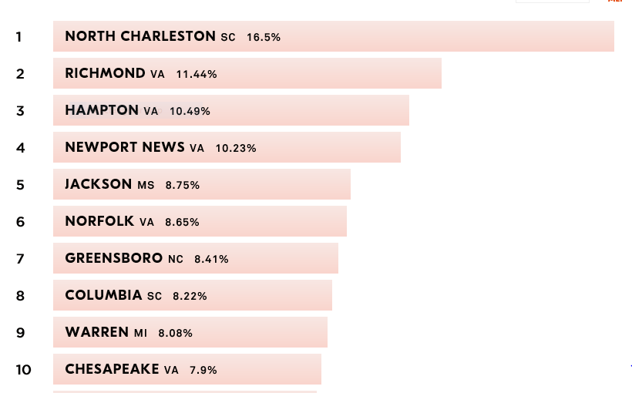
National Eviction Rates by City

Slide 10
Out of Reach 2017, National Low Income Housing Coalition

Slide 11
Barriers

Slide 12
Barriers
Insufficient supply of affordable housing
Low credit score
Prior eviction(s)
Prior conviction(s)

Slide 13
Current Efforts

Slide 14
Current efforts
Efforts to increase affordable housing units and decrease evictions in Virginia include:
Programs administered by the Virginia Department of Housing and Community Development
Programs administered by the Virginia Housing Development Authority
Non-profit initiatives and public-private partnerships

Slide 15
Promising Practices

Slide 16
PROMISING PRACTICES
Landlord/Tenant liaisons: Continuums of care in some communities promise to pay for any damages incurred for tenants with poor rental history.
Housing broker teams: Communities encourage landlords to provide affordable housing. Brokers pay security deposits, late fees, and rental arrears.
Eviction diversion: Pro bono attorneys mediate with landlords to avoid judgments against tenants for non-payment of rent.
HomeBASE Program: Statewide program in Massachusetts that provides financial assistance, such as first and last month’s rent, security deposits, or help paying utility bills.

Slide 17
Conclusions

Slide 18
conclusions
A review the Virginia Residential Landlord Tenant Act is necessary to determine how it may contribute to the high rate of evictions.
Education and awareness of tenants’ rights could lead to greater use of legal protections.
Access to information on available assistance should be more easily available.
More attention to the “hidden homeless” is required.

Slide 19
QUESTIONS
A PLACE TO CALL HOME
Virginia Executive Institute
Spring 2018

