Slide 1
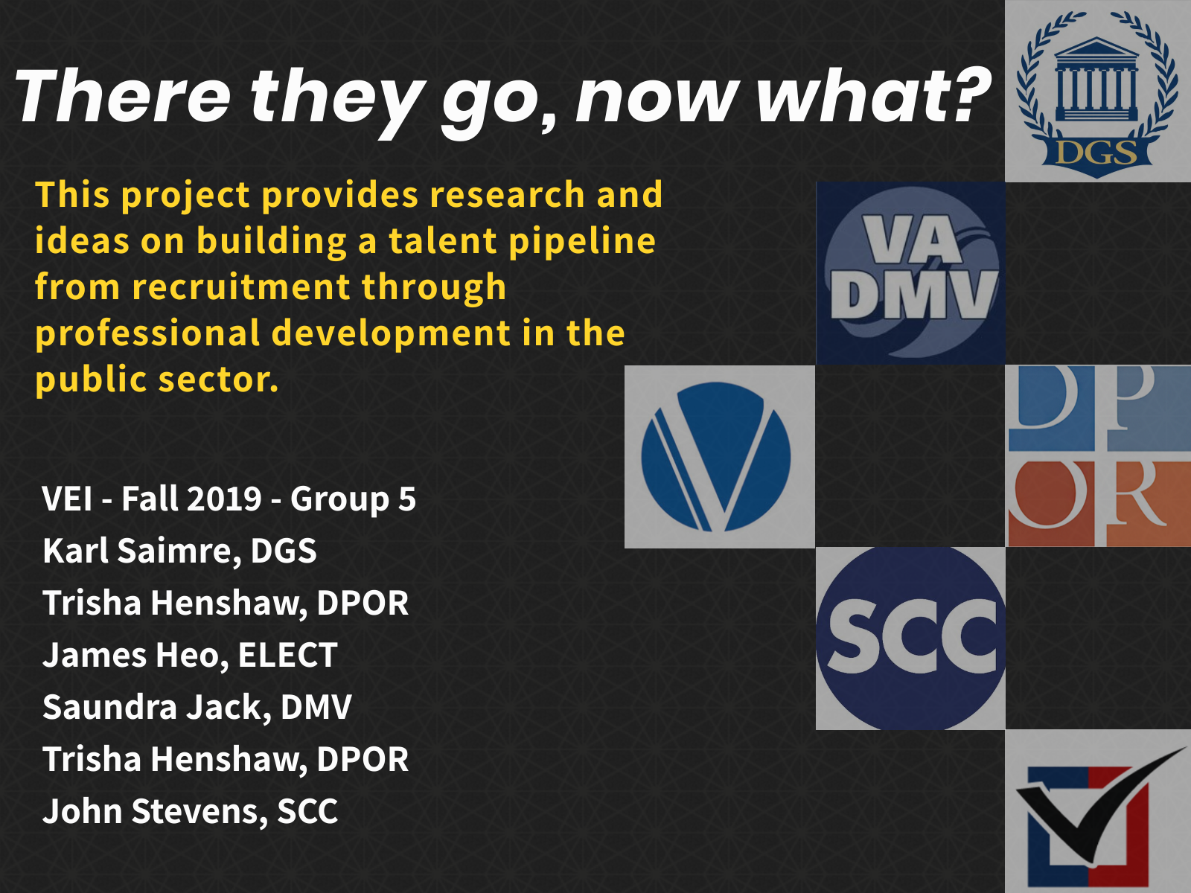

Slide 2
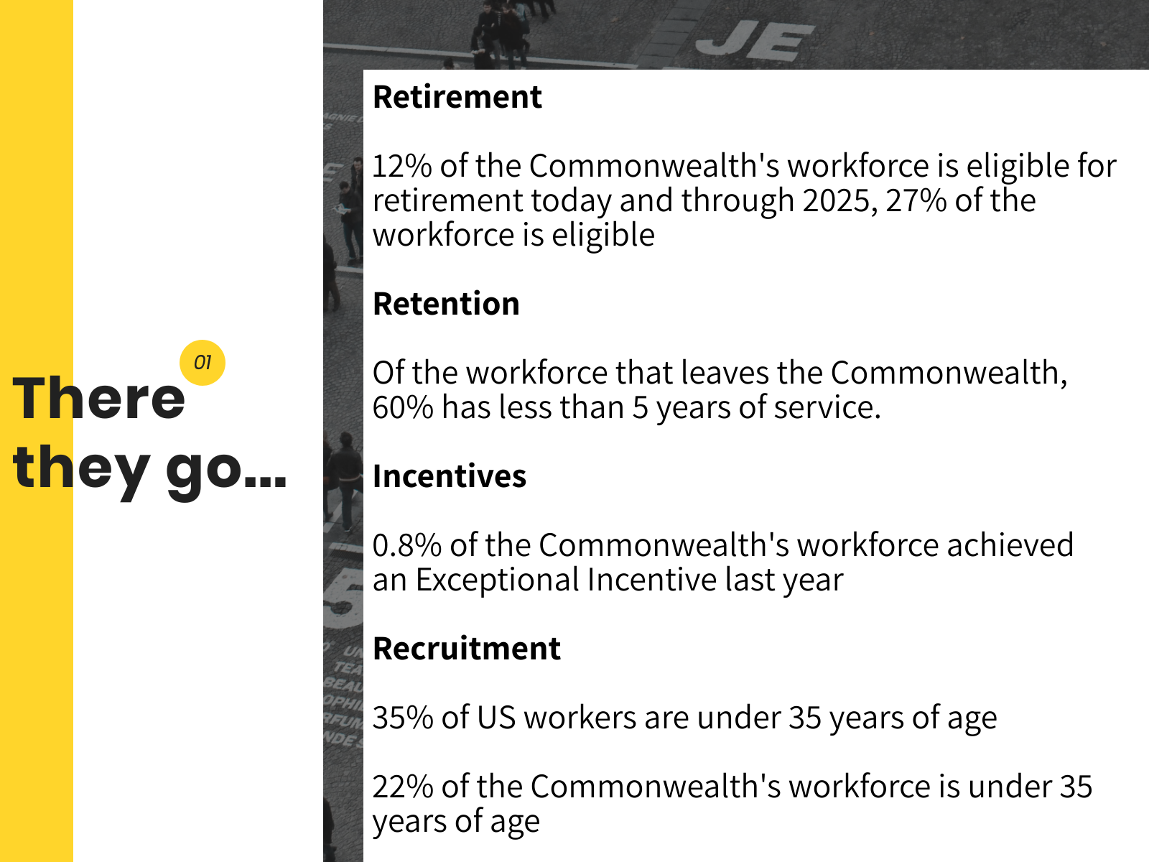
Notes:
Sources
http://www1.dhrm.virginia.gov/redir/getinfo.aspx?id=1044
https://www.bls.gov/cps/cpsaat11b.htm
Other references
Interview with Catey Dickensheet, Director of Human Resources, Virginia Department of Motor Vehicles, 9/27/2019
Interview with Dr. Denise Toney, Director of the Division of Consolidated Lab Services, Virginia Department of General Services. 10/01/2019

Slide 3
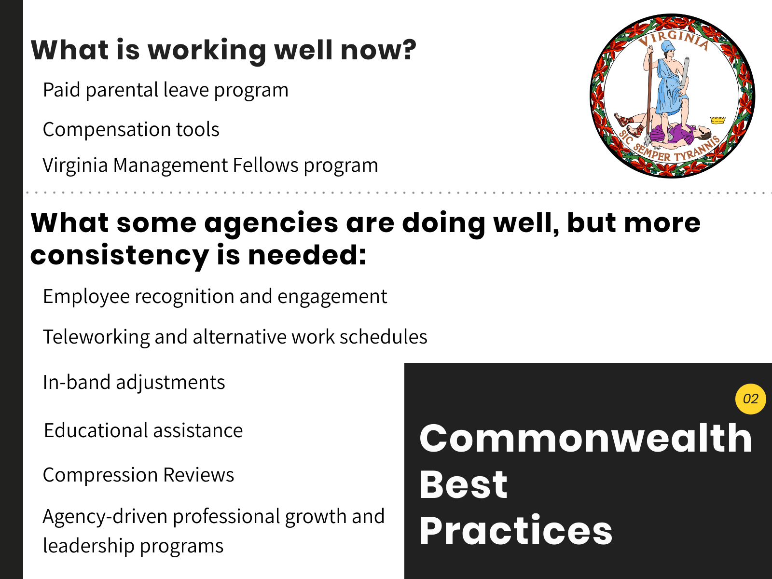
Notes:
What is working well now?
Paid parental leave program, in addition to other leave benefits
Compensation tools: Contributions to Virginia 529 accounts, student loan repayment bonus, public service student loan forgiveness, employment equity initiatives to remove unconscious bias from application process and base salaries on experience, competencies, and credentials
Virginia Management Fellows program to develop future government leaders
What some agencies are doing well, but more consistency is needed across agencies
Employee recognition and engagement: allows up to $5,000/FY and up to 40 hours recognition leave (dependent on agency funding); service awards
Teleworking and alternative work schedules (often limited to certain positions)
In-band adjustments for obtaining job-related training, education, certification, and licensure
Educational assistance to include work schedule options and tuition payment (dependent on agency funding)
Compression reviews to ensure employees with more years of service are not undercompensated compared to new hires (not consistently performed in all agencies)
Agency-driven professional growth and leadership programs (DMV executive leadership program; staff progression plans within pay bands/roles)
Sources
www.dhrm.virginia.gov.

Slide 4
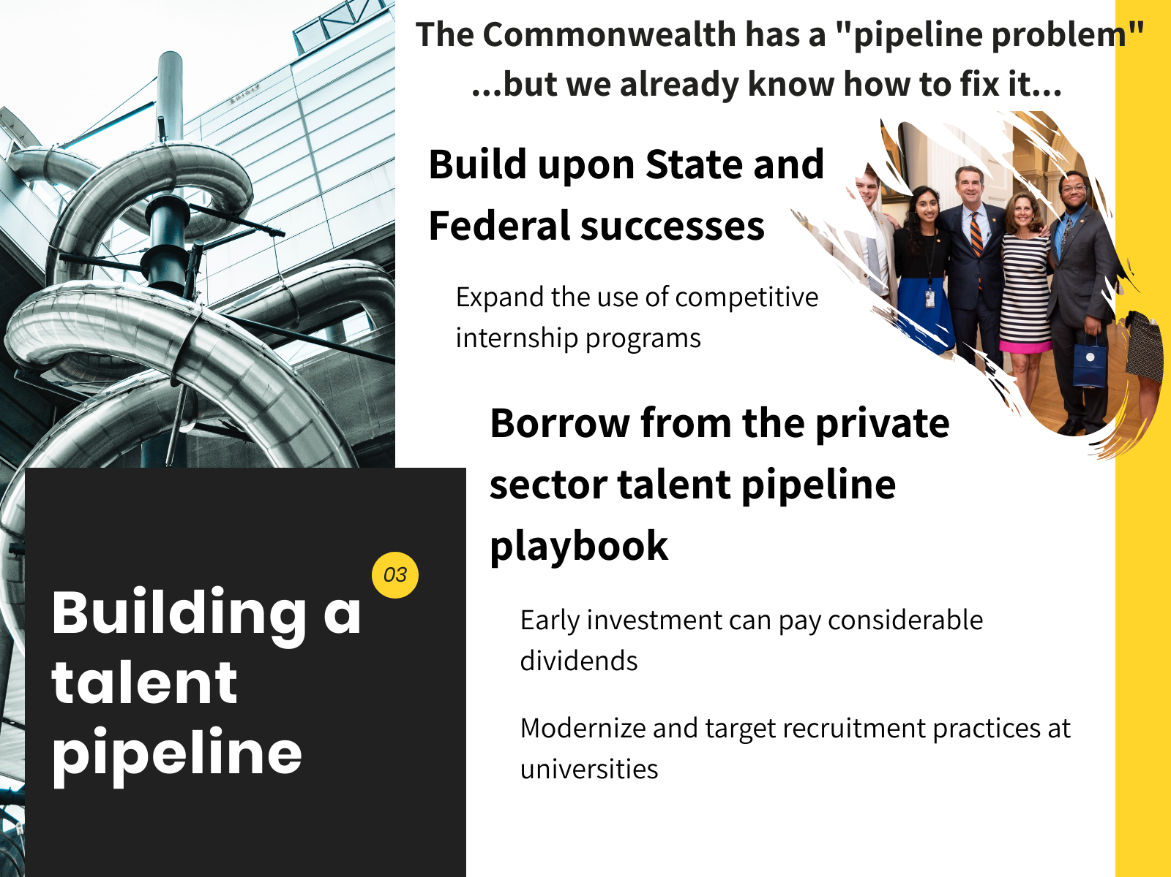
Notes:
Borrow from Federal successes in converting interns into permanent positions by potentially expanding or retooling the Governor’s fellows program or other high profile internships
In 2009, the Partnership for Public Service study, Leaving Talent on the Table, revealed that less than 10 percent of federal interns were being converted into permanent hires. In stark contrast, the average conversion rate of interns in private industry is between 55-60 percent.
In response, OPM was authorized to create the Pathways for students and recent graduates to federal careers program, which has so far been very successful.
In addition, 93 percent of Pathways Programs appointees surveyed plan to remain at their current agencies or continue to work in the Federal Government in the immediate future. Thus, agencies appear to be managing successfully the retention of their Pathways appointees
Borrow from private sector successes
Intuitively people focus on recruitment but a study in the Harvard business review found that recruitment does not necessarily have a great ROI.
Instead the practice of making early investments and creating a pipeline has paid out better dividends
For example, the private sector has been working to identify feeder schools for future employees.
They use non HR professionals that are alumni of these institutions to make the case to these students to come join a specific company.
Sources
https://www.ere.net/recruiting-against-the-private-sector-what-government-can-do-to-better-to-compete-for-talent-from-campus/
https://www.opm.gov/policy-data-oversight/hiring-information/students-recent-graduates/reference-materials/report-on-special-study-of-the-pathways-programs.pdf
https://www.usds.gov/report-to-congress/2016/hiring-talent/
https://slge.org/resources/state-and-local-government-workforce-2018-data-and-10-year-trends
https://bg.hbr.org/2019/05/recruiting#your-approach-to-hiring-is-all-wrong

Slide 5
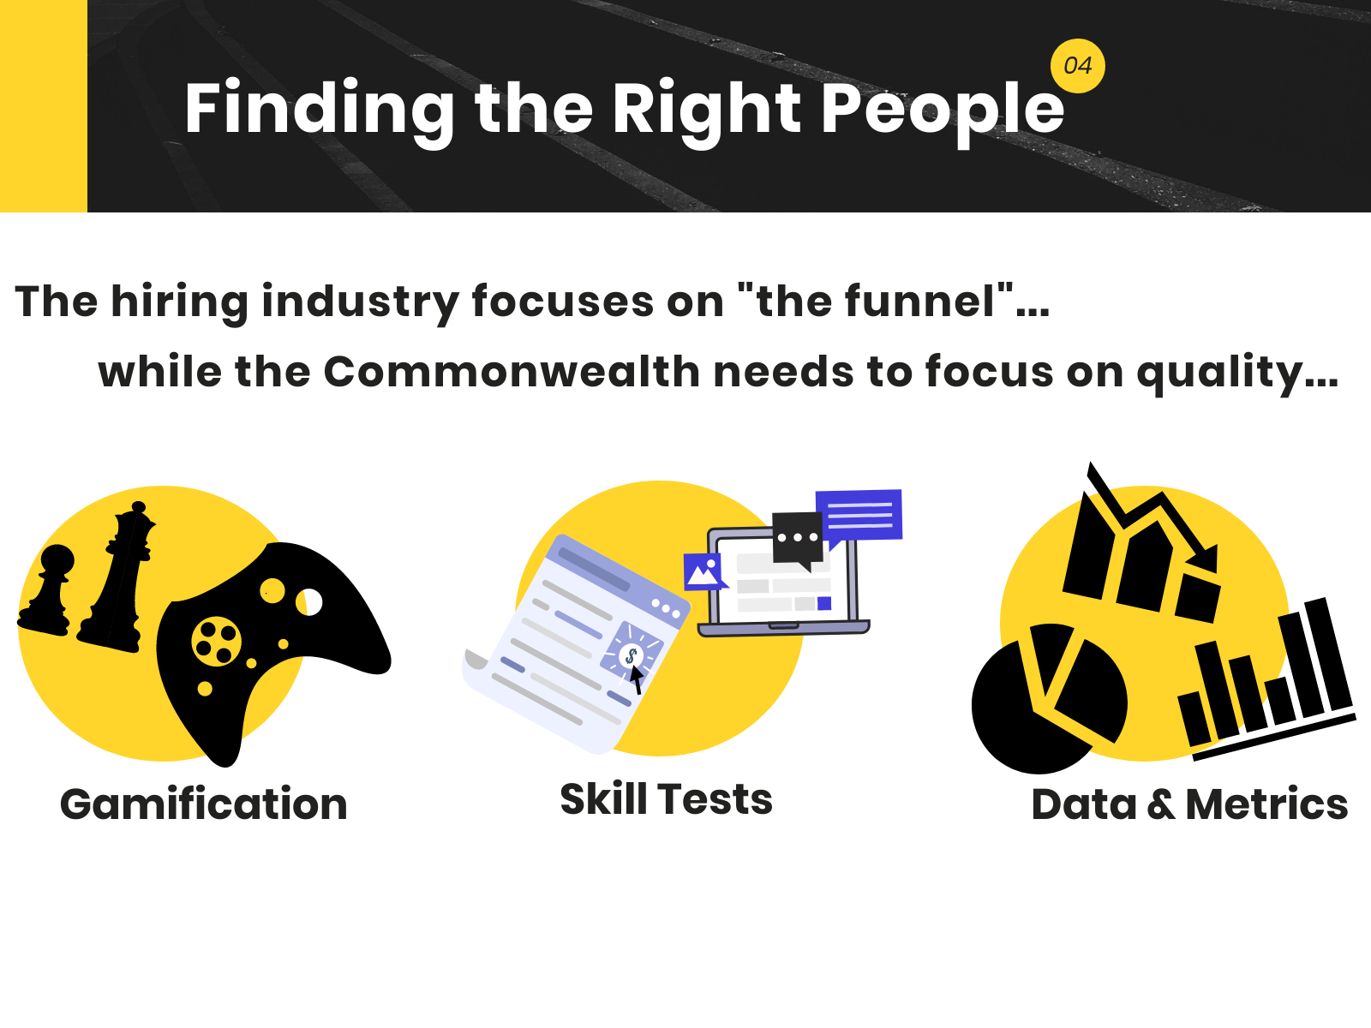
Notes:
Hiring industry focuses on “the funnel.” Money is spend on increasing the number of applicants rather than the quality of applicants.
Gamification
The private sector is starting to refine applicant pools by gamifying the application process.
This is both a cost saving measure by allowing HR departments to spend less time vetting unqualified candidates and it allows the application process to target candidates who are best suited for positions.
This practice has been utilized by companies like Google and Marriot. Additionally, it has been utilized by the DOD.
Skills test
Requiring skills testing allows potential employers to get an accurate sense of a candidates capabilities.
Sometimes relying on just resumes and references, doesn’t provide enough insight into a candidate’s proficiency in a specific skill set.
Data & Metrics
The state can’t really evaluate what practices actually are working because we collect considerable meta data, but we need to do a better job of expanding the data we collect.
HR should be treated like a business unit and every practice should be logged and evaluated to determine the ROI
Sources
https://www.ere.net/recruiting-against-the-private-sector-what-government-can-do-to-better-to-compete-for-talent-from-campus/
https://www.opm.gov/policy-data-oversight/hiring-information/students-recent-graduates/reference-materials/report-on-special-study-of-the-pathways-programs.pdf
https://www.usds.gov/report-to-congress/2016/hiring-talent/
https://slge.org/resources/state-and-local-government-workforce-2018-data-and-10-year-trends
https://bg.hbr.org/2019/05/recruiting#your-approach-to-hiring-is-all-wrong

Slide 6
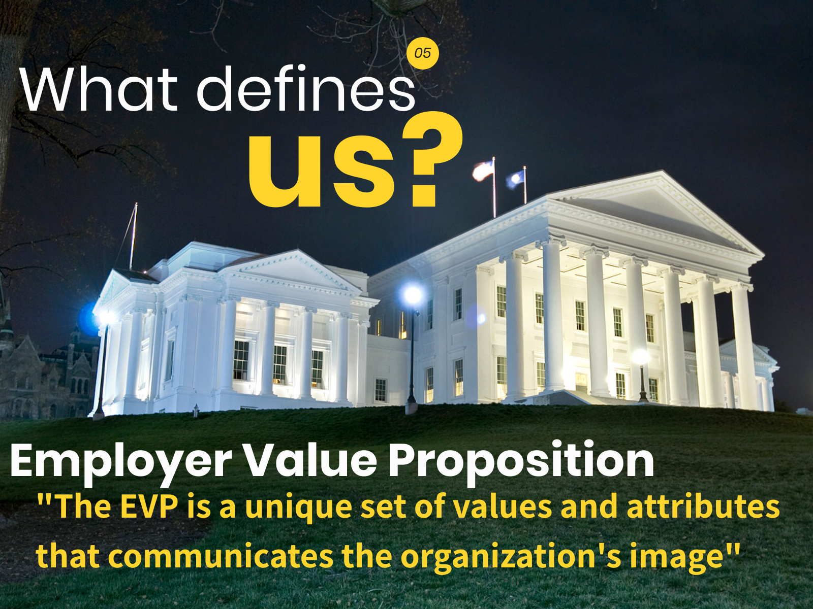
Notes:
Despite the often negative connotation associated with government workers, the opportunity to work at the state level of government often offers the “opportunity to build a meaningful career with wide impact” and “enterprise-level experience.”
(https://business.linkedin.com/talent-solutions/blog/recruiting-strategy/2018/4-ways-the-government-of-hawaii-modernized-its-hiring-process-to-attract-tech-talent).
The EVP is a unique set of values and attributes that communicates the organization's image to its target audiences.
Creating an employer value proposition allows potential employees to see the potential for a career path with personal and professional growth rather than just a job.
Recommendation: Government employers should develop a positive EVP to attract employees interested in building a career and contributing to their community.
Recommendation: Individual agencies should develop an employer brand that highlights the unique benefits of working in that agency environment, including the agency’s mission, values and vision of leadership.

Slide 7
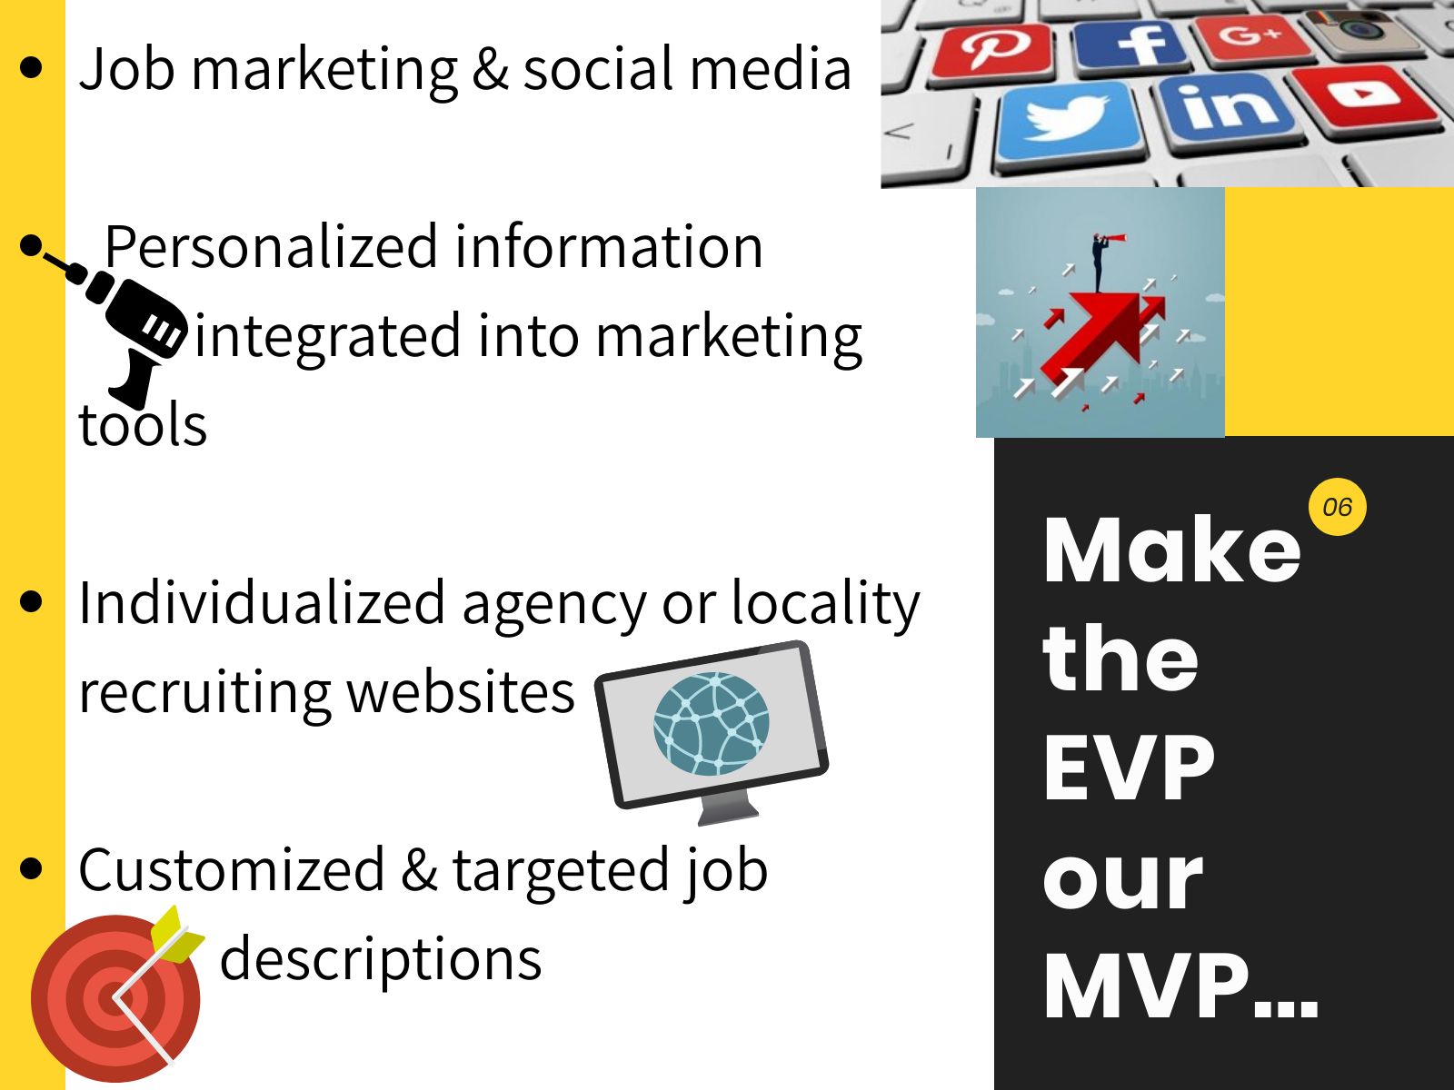
Notes:
Recommendation: Personalized information about the mission of the agency and what it is like to work within the department should be integrated into marketing materials to show the positive work environment and opportunities for future growth.
Recommendation: As younger and more diverse workers enter the job market, government agencies should consider advertising opportunities beyond the state jobs website. Local governments are increasingly using social media to advertise, such as LinkedIn and Facebook ads, YouTube videos, and info graphs in advertising.
The City of San Antonio features a job of the week on Facebook and LinkedIn with people describing the job. San Antonio also hosts a “chat with a recruiter” once a month on Facebook to answer individual job questions.
Hawaii created dozens of “scrappy and engaging videos” showing employee teams, the team members’ humor, and new technologies.
(https://business.linkedin.com/talent-solutions/blog/recruiting-strategy/2018/4-ways-the-government-of-hawaii-modernized-its-hiring-process-to-attract-tech-talent).
Recommendation: Agencies may also choose to create individualized recruiting websites to highlight the unique agency brand. The sites should highlight innovative projects and media coverage of exciting news for the agency.
Recommendation: Government entities may also choose to customize job descriptions to focus on the unique brand of working in government. Johnson County in Kansas includes in each job description “the county’s pillars of performance, which describe the county’s leadership philosophy, mission, vision, and values.”
(https://hrdailyadvisor.blr.com/2018/10/19/strategies-for-effectively-recruting-government-workers/)
“The EVP promise comes to life through heavy investments into professional development” of employees.
(https://business.linkedin.com/talent-solutions/blog/recruiting-strategy/2018/4-ways-the-government-of-hawaii-modernized-its-hiring-process-to-attract-tech-talent).

Slide 8
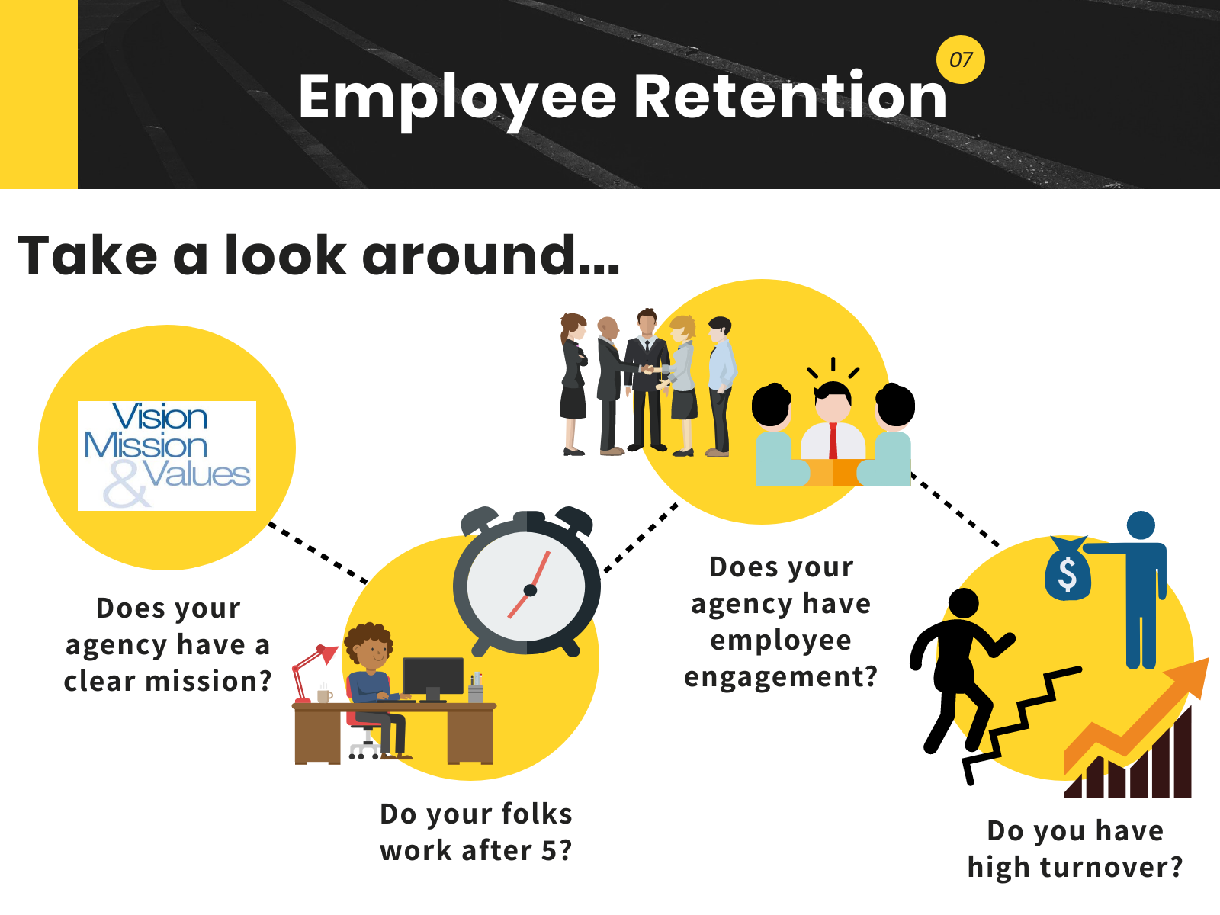
Notes:
Sources
https://www.snacknation.com/blog/how-to-retain-employees/
https://www.yourerc.com/blog/post/workplace-culture-what-it-is-why-it-matters-how-to-define-it
https://www.thebalancecareers.com/culture-your-environment-for-people-at-work-1918809

Slide 9
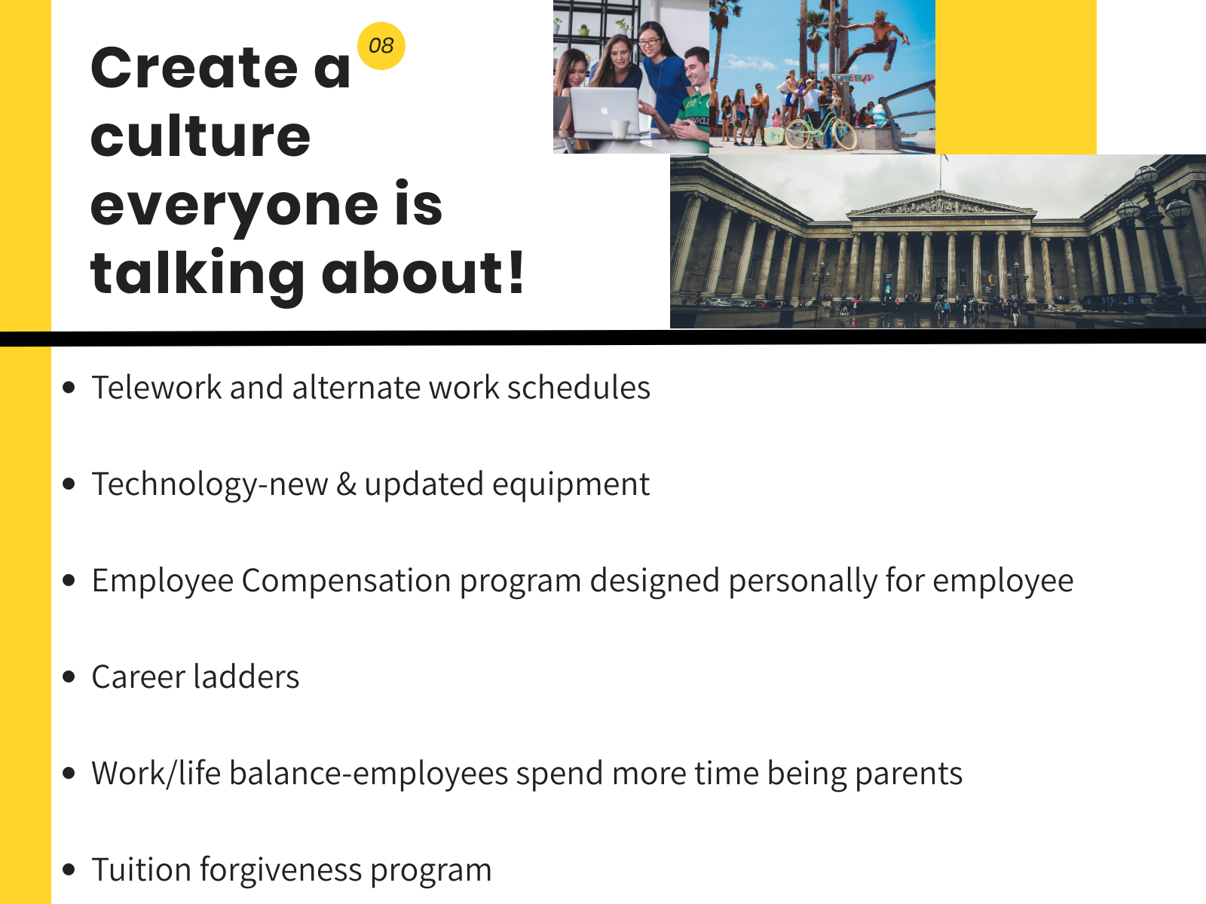
Notes:
Sources
https://www.snacknation.com/blog/how-to-retain-employees/
https://www.yourerc.com/blog/post/workplace-culture-what-it-is-why-it-matters-how-to-define-it
https://www.thebalancecareers.com/culture-your-environment-for-people-at-work-1918809

Slide 10
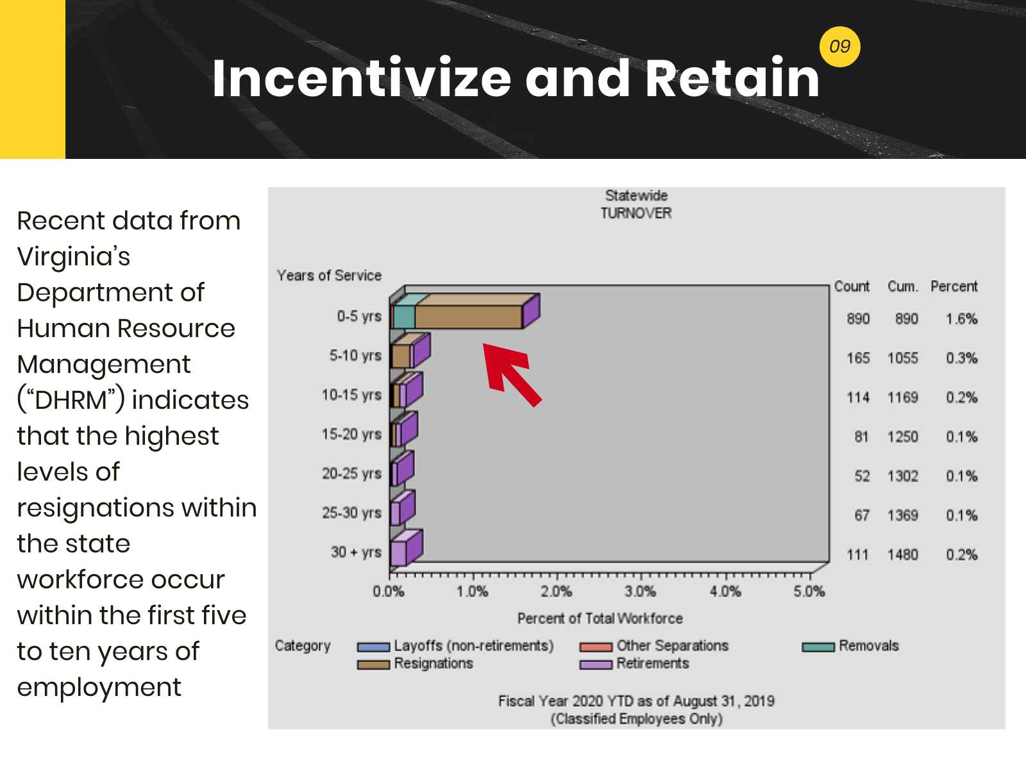
Notes:
Sources
http://www1.dhrm.virginia.gov/redir/getinfo.aspx?id=1044

Slide 11
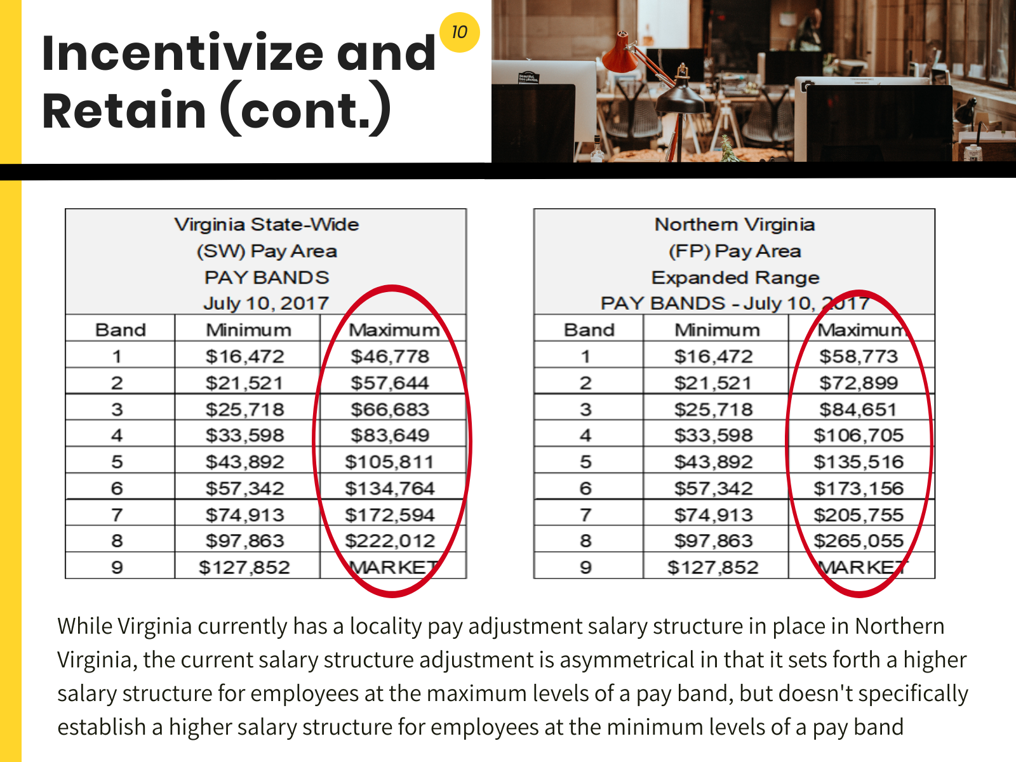
Notes:
Sources
http://www1.dhrm.virginia.gov/redir/getinfo.aspx?id=1044

Slide 12
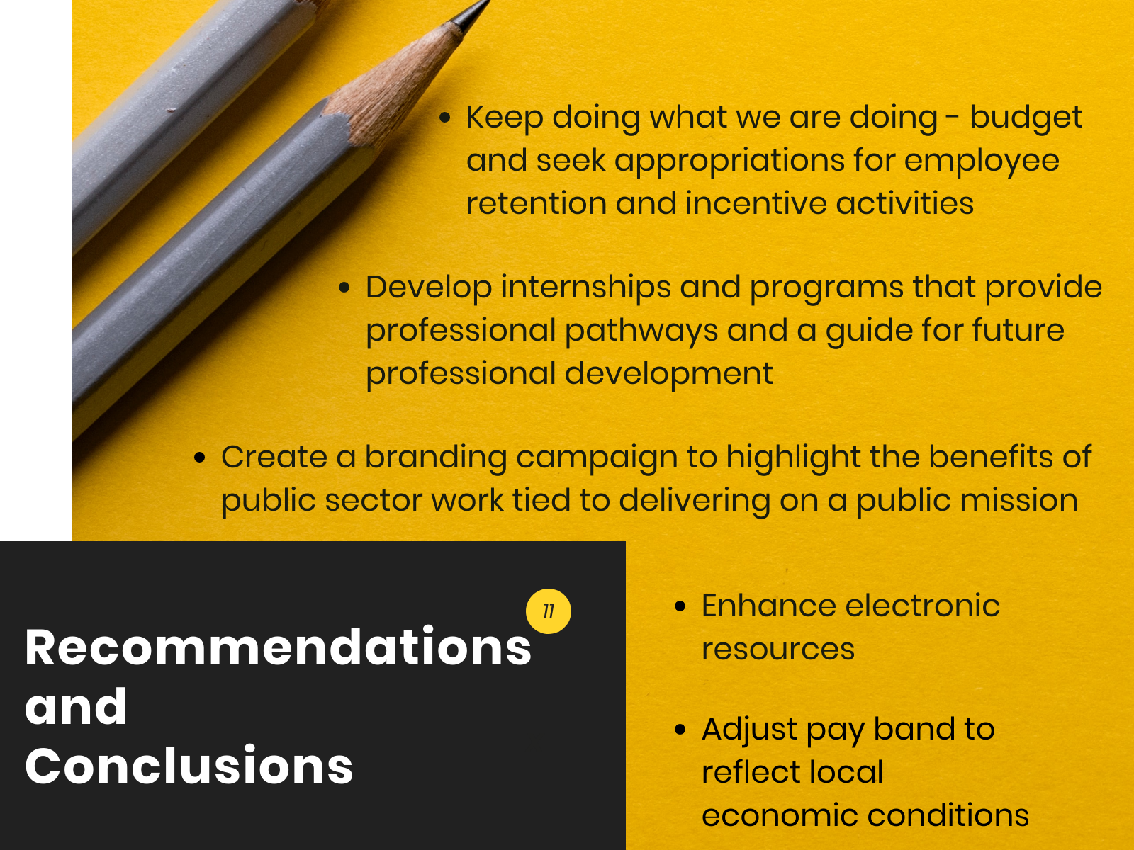

Slide 13


