Slide 1
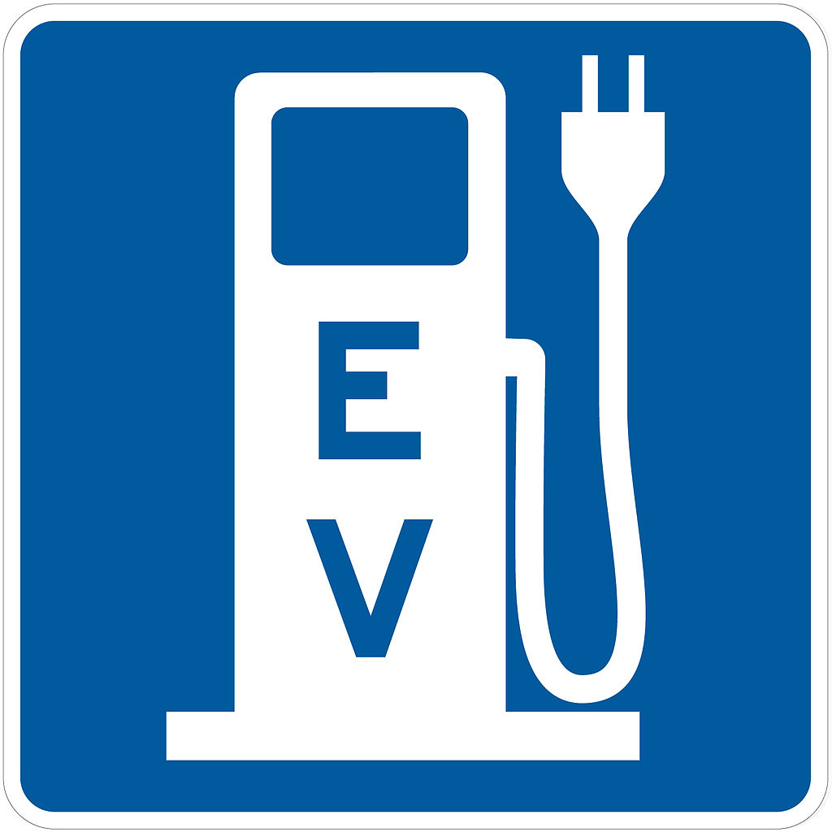
Evaluating the Costs and Benefits of Transitioning to Electric Vehicles (EVs) in the State Fleet
A Leadership Challenge
Rodney Berry
Matthew James
Neil Boege
Rick Brooks
Patrick Bridge

Slide 2
Current Initiatives
Virginia
Governor Northam Announces $20 Million Electric School Bus Initiative
“Each electric school bus can save districts nearly $2,000 a year in fuel and $4,400 a year in reduced maintenance costs, saving tens of thousands of dollars over the lifetime of a bus.
The City of Alexandria to test feasibility of electric police cars

Slide 3
Operating Cost Advantage
According to the Department of Energy it costs half as much to fuel an electric vehicle per year
Assuming current gas and electricity prices, $800 - $1000 less per year to power an EV
Maintenance Costs are lower
Electric vehicles do not require oil changes and regenerative braking limits brake pad wear, $100 - $200 less per year in maintenance cost

Slide 4
Operating Cost Advantage
Estimated savings per vehicle replacing gas car with an EV:
Savings of over $1000 per year

Slide 5
Up-front Costs are Higher
EVs are more expensive…
Longer range mid-size EVs are currently approximately $10,000 more expensive than mid-size gas-powered cars
Suggests a 10-year break-even period to gas car costs factoring in lower fuel and maintenance costs

Slide 6
Future EV Total Cost of Ownership
According to the Department of Energy, EV battery costs (33% of EV vehicle cost in 2019) are expected to halve over the next decade, which is expected to result in close to parity up-front pricing with gas cars
Cost Advantage of EVs will grow over time

Slide 7
Range of EV on Full Charge
National average daily driving distance = 30 miles/day
Typical EV distance (full charge) = 200 miles
Using Richmond as the center, a 100 mile drive could reach:
Location | Distance from Richmond
Charlottesville | 75 miles
Emporia | 70 miles
Fredericksburg | 60 miles
Norfolk | 95 miles
Williamsburg | 60 miles

Slide 8
Charging Stations – Public Use Cost
Total number of charging stations in Virginia: 549
Location | Level 2 Public Charging Stations
Charlottesville | 9
Emporia | 1
Fredericksburg | 6
Norfolk | 13
Williamsburg | 10

Slide 9
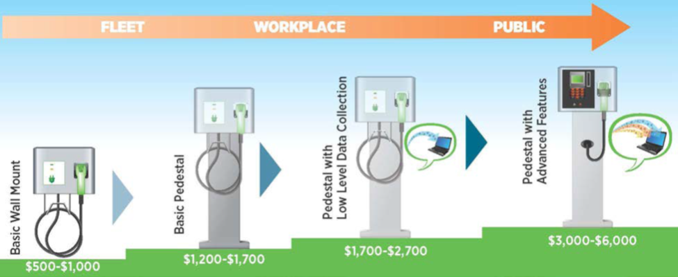
Charging Stations – State Infrastructure Cost
Cost of Level 2 charging station for fleet garages: $1,000 - $3,000 / station
Minimum of 3 charging stations for selected state garages housing EVs

Slide 10
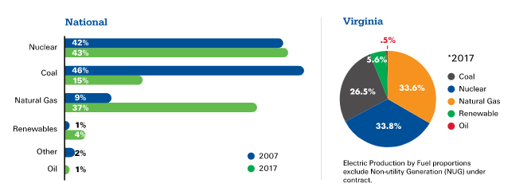
Environmental Impact
Fully battery electric vehicles have zero direct emissions
However, supply sources of electric power do have emissions (https://www.dominionenergy.com/company/making-energy)

Slide 11
Environmental Impact: Emissions
EPA introduced the “MPGe” (miles per gallon of gasoline-equivalent
Electric cars are 3 to 4 times more fuel efficient that gasoline cars
EVs have 25% - 33% of the environmental impact of gasoline cars
Year/Make/Model | Combined MPGe | City/Hwy MPGe
2018 Chevy Bolt | 119 MPGe | 128 city/110 hwy
2018 Chevy Spark | 34 MPG | 30 city / 38 hwy
2018 Ford Focus Electric | 107 MPGe | 118 city / 96 hwy
2018 Ford Focus | 35 MPG | 30 city / 40 hwy

Slide 12
Environmental Impact: Reusing EV Batteries
EV batteries have 80% storage capacity after normal automobile lifespan
Can be used for less demanding tasks:
Storing electricity from solar panels
Conserving power from electrical grid during peak hours
Provide backup power for its data center (GM)
Nissan is marketing “The Reborn Light” for street light uses

Slide 13
Implications for State Workforce
Demand Factor:
Increased critical mass will require new/revised workforce training programs focused on the "transitional" industry cluster needs.
Strategies:
Develop partnership opportunities with transitional industry cluster members on new requirements such as skill set, location, supply chain needs, etc.
Explore resource leveraging opportunities with
state/local/industry clusters on emerging training
needs such as first providers, safety training, etc.

Slide 14
Implications for State Workforce
Supply Factor:
Increased critical mass will require a new/retrained workforce in this industry cluster
Strategies:
Get in front of skill gap challenge
Labor Market Participation Rate versus
Unemployment Rate

Slide 15
Implications for State Workforce
Higher participation rate + Higher employment
=
New Revenue to the Commonwealth!

Slide 16
EVs considered safer than gas cars
NHTSA rate EVs just as safe or safer to drive than gas cars
Absence of engine block improves forward crumple zone
Battery location lowers center of gravity – reduced rollover risk
No flammable liquids!
Pedestrian safety – still a challenge

Slide 17
Conclusions and Recommendation
Recommend limited/targeted introduction of vehicles and fleet lot charging stations
Perhaps 10-15 EVs introduced into state agency service in the Richmond area
Gain valuable knowledge of EV driving habits, infrastructure, advantages, and limitations to inform future transition initiatives

Slide 18
RESOURCES / REFERENCES
(https://www.energy.gov/eere/electricvehicles/saving-fuel-and-vehicle-costs)
https://www.electricchoice.com/electricity-prices-by-state/),

