Slide 1
Access to Services In Rural Southwest Virginia:
A Transportation Issue

Slide 2
Lucinda Childs-White, Department of Corrections
Brian Moyer, Department of Game and Inland Fisheries
Cherrey Wallace, Department of Corrections
Tom Herthel, Department of Veterans Services

Slide 3
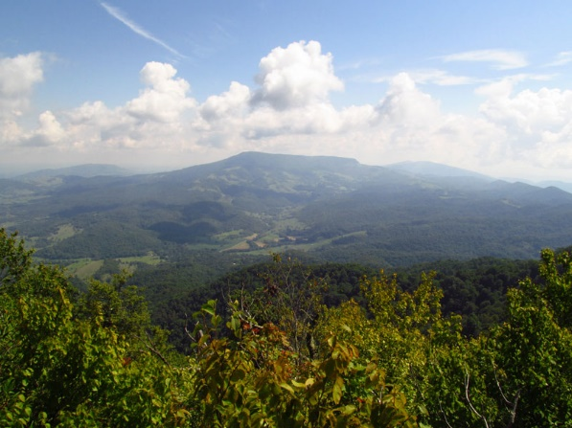
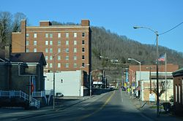
Issue: Access to Services
Lots of services exist in Southwest Virginia
Medical (with limits)
State-provided services
Still, services are “unavailable” unless citizens have the means to access and benefit from them
Access is the gap which we address

Slide 4
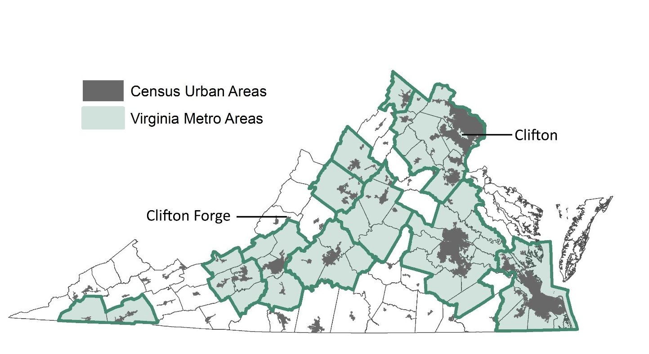
Rural Virginia
Multiple Definitions of “Rural”
Census Bureau: “Any place outside a town, city, or ‘urban cluster’ with more than 2,500 residents.”

Slide 5
Rural Southwest Virginia
SW Virginia is Mostly Rural – population of 392,112
65 residents per square mile (compared to 202 per square mile state-wide)
White Areas = Rural Areas in Virginia

Slide 6
Limiting Factors – Access
Cost of Car Ownership - $9K Annually
Single Vehicle Homes
No Vehicle Homes
Financial Limitations – Insurance, Gasoline
No License:
Elderly
Substance Abuse (Opioids / Alcohol)
Severe Disability

Slide 7
Limiting Factors – Distance & Weather
Narrow and Winding Roads
Tazewell to Salem – 121 Miles (2 hrs); RT gas $18-$36
Clintwood to Abingdon – 60 Miles (1 hr 22 mins); RT gas $10-$18
Grundy to Roanoke – 178 Miles (3 hrs); RT gas $27-$52
Jonesville to Johnson City – 67 Miles (1 hr 22 mins); RT gas $10-$20
https://www.distance-cities.com

Slide 8
Limiting Factors-Medical Shortage
SW Virginia has a health care workforce shortage
Critical shortage of behavioral health providers
Requires traveling long distances to access specialty health care

Slide 9
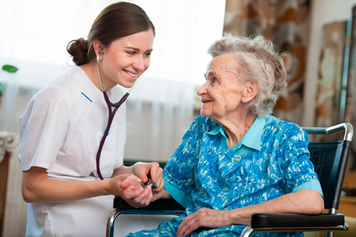
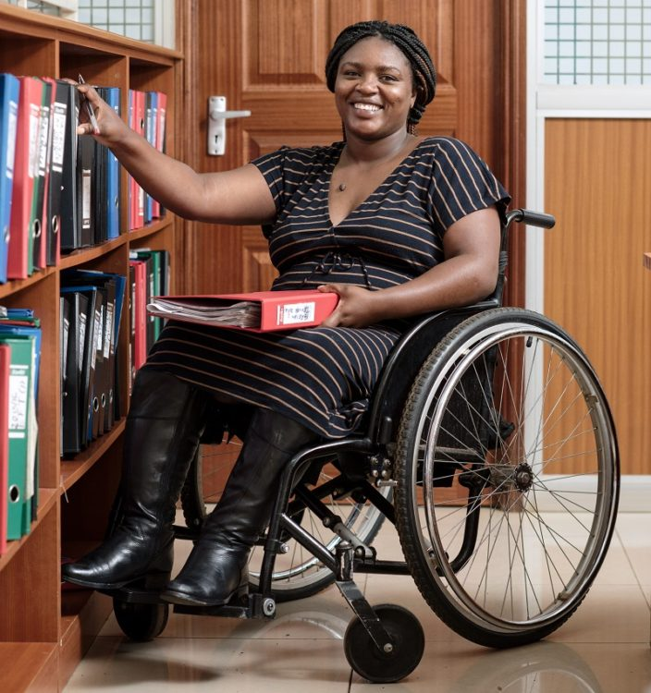
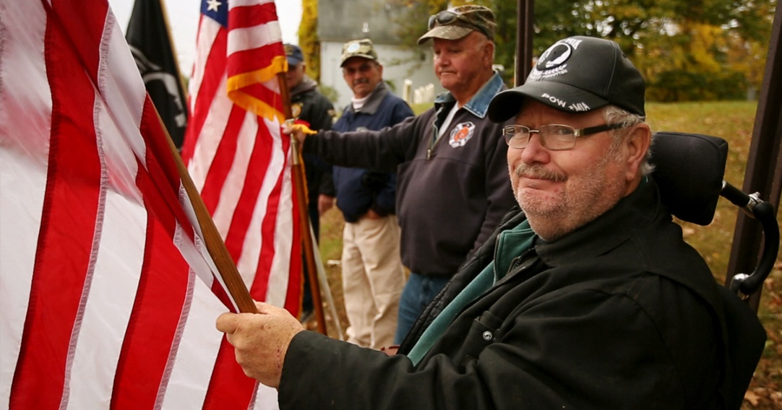
Impact On:
The Elderly
Disabled Citizens
Low-Income Individuals and Families
Veterans

Slide 10
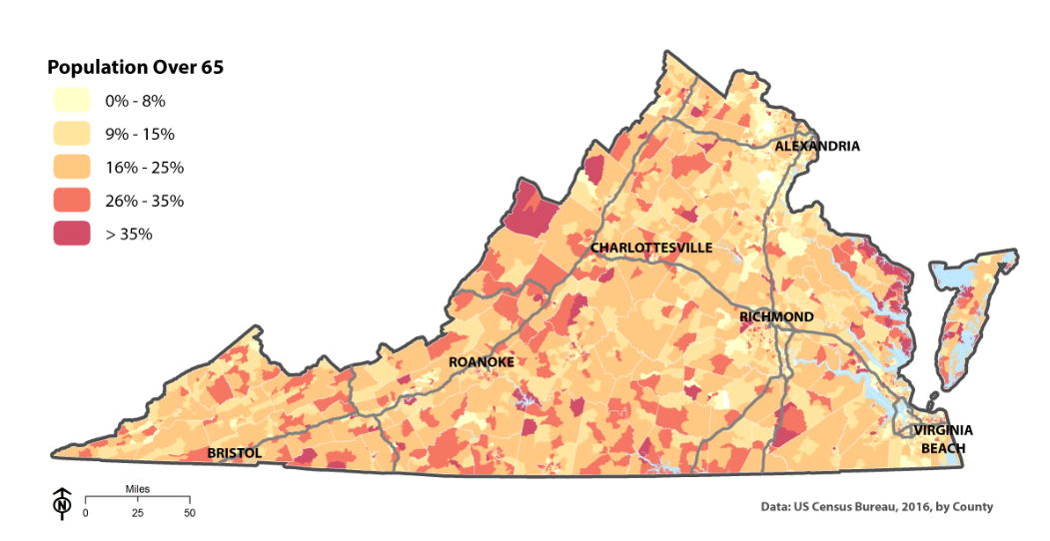
Impact On: Elderly

Slide 11
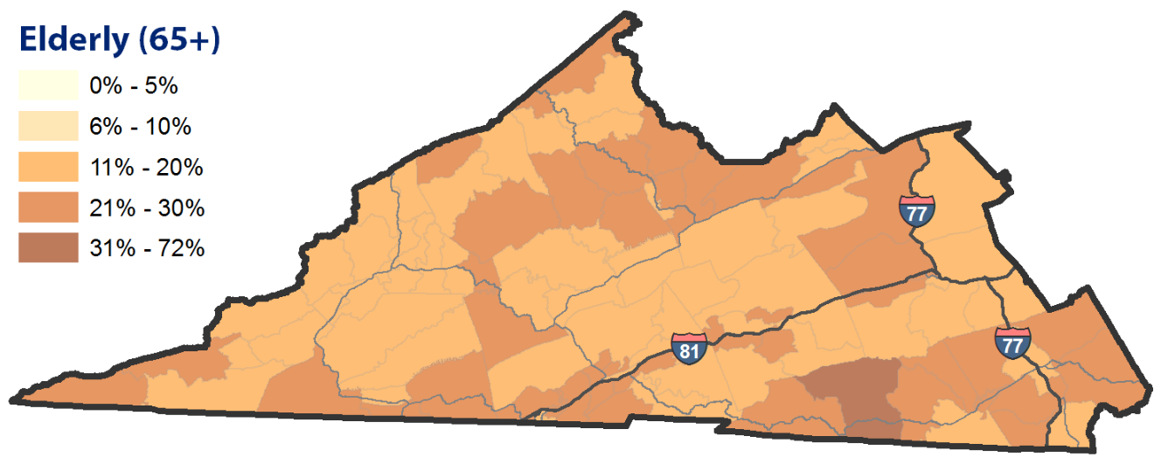
Impact On: Elderly
SW Virginia: 78,442 (20%)

Slide 12
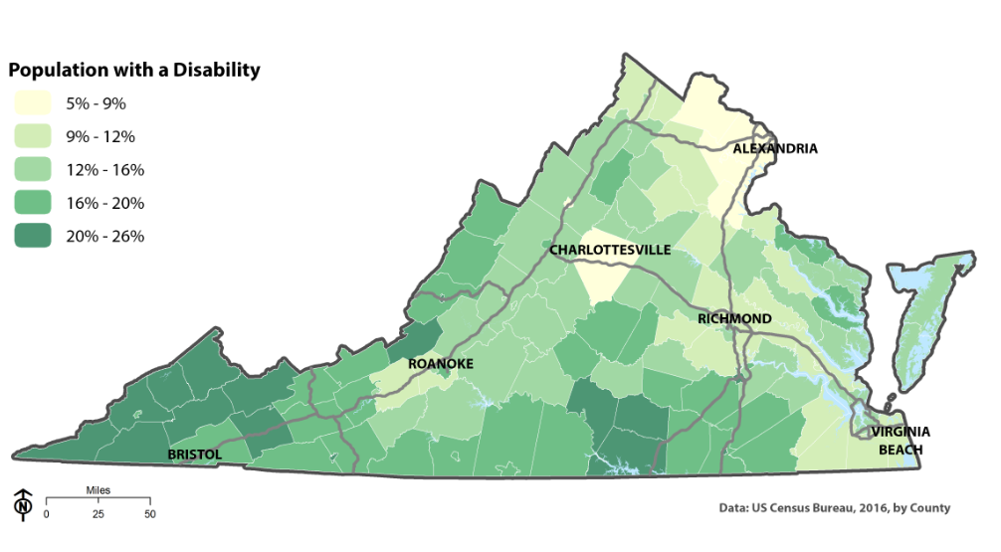
Impact On: Disabled

Slide 13
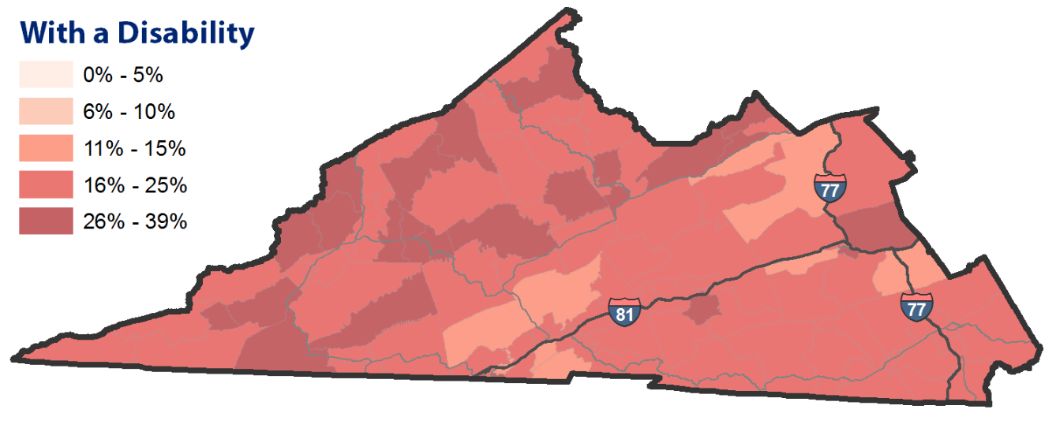
Impact On: Disabled
82,343 (21%)

Slide 14
Impact On: Poverty

Slide 15
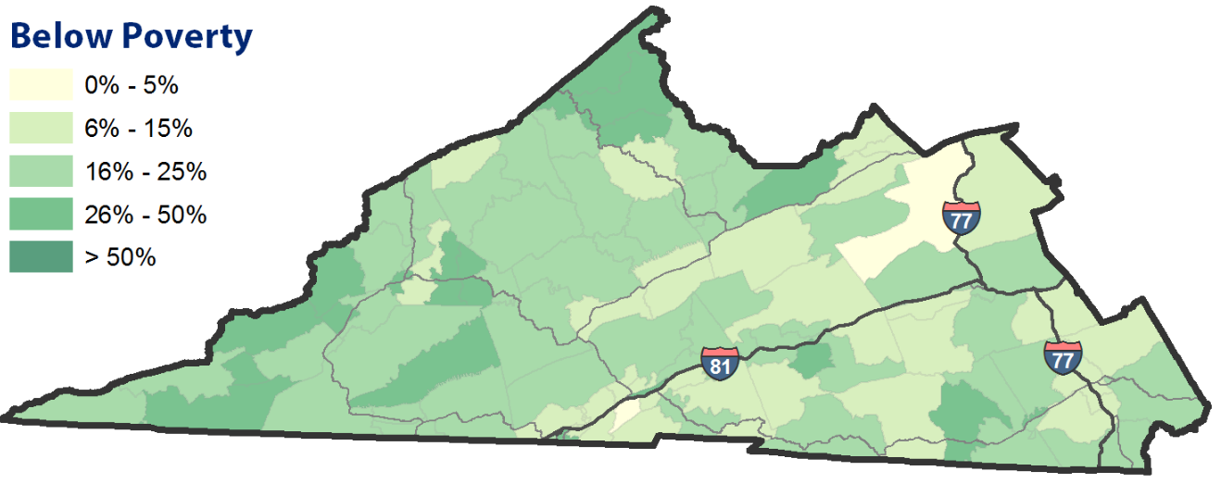
Impact On: Poverty
71,000 (18%)

Slide 16
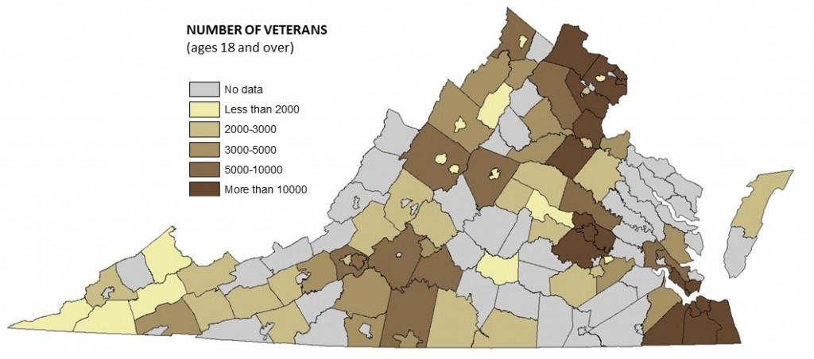
Impact On: Veterans
Approx. 25,000 (6.4%) in SW Virginia

Slide 17
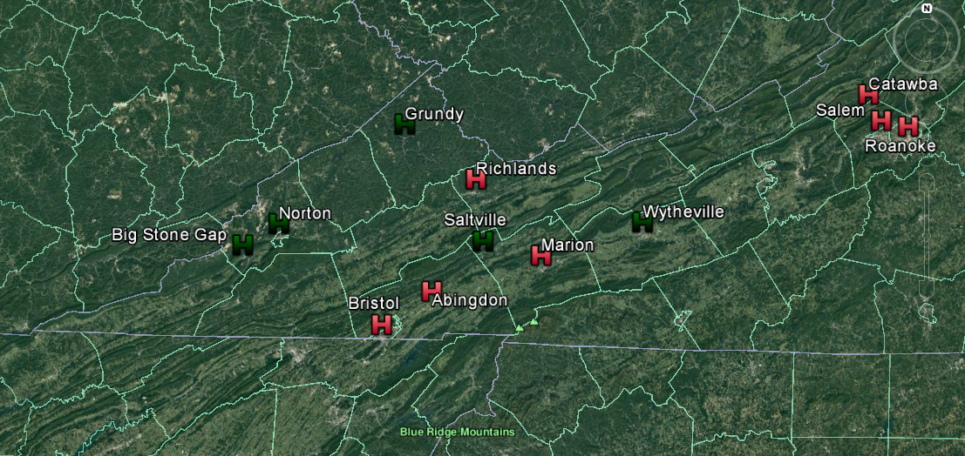
Local Community and Specialty Care Hospital Locations in Southwest Virginia
Green – local community hospital
Red – Specialty services hospital

Slide 18
Specialty Care Hospitals
Location | Hospital | Specialties
Roanoke | Carilon Roanoke Memorial Hospital | Cancer treatment, cardiology & heart surgery, diabetes & endocrinology, gastroenterology & GI surgery, geriatrics, gynecology, nephrology, neurology & neurosurgery, orthopedics, pulmonary & lung surgery, urology
Salem | Lewis-Gale Medical Center | Cancer treatment, diabetes & endocrinology, gastroenterology & GI surgery, nephrology, neurology & neurosurgery, orthopedics, urology
Abingdon | Johnston Memorial Hospital | Gastroenterology & GI surgery, geriatrics, nephrology, orthopedics, pulmonary & lung surgery
Catawba | Catawba Hospital | Psychiatry
Marion | Southwest Virginia Mental Health Institute | Psychiatry
Richlands | Clinch Valley Medical Center | Pulmonary & lung surgery, urology
Bristol | Rehabilitation Hospital of Southwest Virginia | Rehabilitation
No hospitals listed for specialty treatment of:
Ear, Nose & Throat (ENT)
Long term care
Ophthalmology
Rheumatology
https://health.usnews.com/best-hospitals/area/va/southwestern-virginia

Slide 19
Veterans Care Facilities
Larger county populations
Beckley VAMC, WV
VA Medical Centers
Craig
VA Community Based Outpatient Clinic (CBOC)
CBOCs
Jonesville
Marion
Norton
Tazewell
Vansant
Wytheville
Giles
Buchanan
Salem VAMC
Tazewell
Mont-
gomery
Roanoke
Dickenson
Bland
Tazewell
Pulaski
Russell
Wise
Smyth
Wythe
Abingdon
Washington
Lee
Scott
Grayson
Mt Home
VAMC, TN

Slide 20
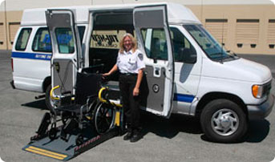
Current Transportation Options
Personal Transportation
Public Transportation – Limited in Scope
Private Transportation – Taxis/Uber
Community Based:
VA Reimbursement and Vans (Limited)
Medicaid Reimbursement
Vanpools - Churches & Community Organizations

Slide 21
Filling the Gap
Incentivize community facilities to provide transportation
Vouchers or Tax Breaks
Encourage local governments to expand public transportation
Establish a partnership with private industry – Uber?
More reliance on NGOs – Churches and VSOs
Future Technologies – Self-drive Vehicles
Develop alternatives to transportation
Telehealth Services (Broadband infrastructure improvements)
Grow local delivery options similar to Amazon and Uber Eats

Slide 22
Many Available Resources

Slide 23
Available Resources
Special Thanks to :
Carole Pratt, Department of Health
Brittany Voll, Virginia Department of Rail and Public Transportation
DRAFT 2019 Coordinated services Mobility Plan http://www.drpt.virginia.gov/media/2895/draft-2019-virginia-drpt-coordinated-human-service-mobility-plan.pdf

Slide 24
Recommendation
Create a state-funded grant to organize all stakeholders – local and state – to identify and consolidate available transportation assets and develop low cost solutions to “fill the gaps.”
State Government: DRPT, VDH, DMAS, DARS, DVS, DBHDS
Local Governments
Medical Providers
Local Colleges and Universities
Chambers of Commerce
NGOs – Churches, VSOs, etc

Slide 25
Questions

