Slide 1
Addressing Revenue Shortfalls from Hybrid and Electric Vehicles
Presented by: Ellen Bolen, MRC; Dennis Cyphers, VCE; Penny Hall, DSS; David Henderson, VHDA; Michelle Schmitz, DHP

Slide 2
Gasoline tax revenues fund road construction and maintenance in Virginia. An increase in electric and hybrid vehicles will reduce gasoline tax revenues. However, electric and hybrid cars are an important part of the fight against climate change. How can the Commonwealth incentivize electric and hybrid vehicles without sacrificing the funds needed to build and maintain roads?

Slide 3
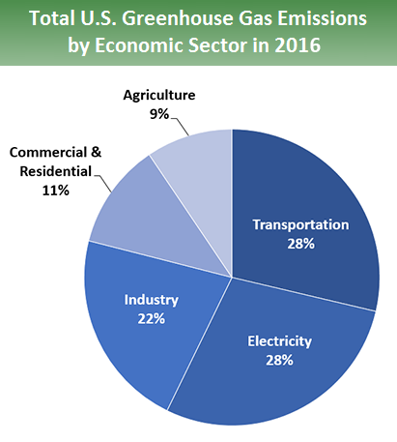
Source: U.S. Environmental Protection Agency, Sources of Greenhouse Gas Emissions.
Notes:
A recent report from The world’s leading climate scientists have warned there is only a dozen years for global warming to be kept to a maximum of 1.5C, beyond which even half a degree will significantly worsen the risks of drought, floods, extreme heat and poverty for hundreds of millions of people.
“Emissions increased by 2.5 percent annually between 2010 and 2015, and over the past half century the sector has witnessed faster emissions growth than any other,” it said, “suggesting major challenges for deep decarbonisation.” (https://www.scientificamerican.com/article/the-u-s-has-1-million-electric-vehicles-but-does-it-matter/)
VA is particularly vulnerable to sea level rise and coastal flooding and ocean acidification which could threaten VA’s vibrant shellfish industry,

Slide 4
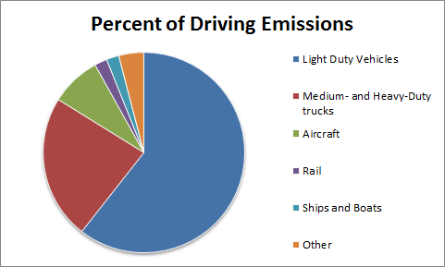
Notes:
The average consumer has the most influence on light-duty vehicles, including cars, SUVs, vans etc. This may not seem impressive, but light-duty vehicles actually make up 16.2% of the United States’ total emissions, giving consumers incredible power to help fight global warming.
Switching to electric vehicles or hybrids is an actionable step consumers can take to decrease their carbon footprint, while minimizing lifestyle changes

Slide 5
“Nearly 80% of the global auto market is pushing toward a phase-out of petroleum cars and adoption of electric vehicles.”
John Le Sage, September 12, 2017 “China’s Petrol-Powered Car Ban Could Cripple the Oil Market” OilPrice.Com
Notes:
- Around the world, various countries have announced efforts to restrict the use of cars powered only by gas or diesel fuel. Norway, France, the United Kingdom, the Netherlands, and India have all announced plans to phase out combustion engine cars. Just this month, the European Parliament voted to impose a requirement that by 2030, 35% of all vehicles must be “clean” vehicles.
- China is the world’s largest new vehicle market. China has not yet set a deadline for the end of combustion engine cars, but half of the world’s electric vehicles are in China, and China has announced a goal of having 20% of the cars on its roads electric by 2025.
- In the US, California and nine other states, including Maryland, have set goals to reduce vehicle emissions to zero by the year 2050. Through state regulations, they are requiring automakers to sell a certain percentage of zero emission vehicles each year.

Slide 6
“ZEVs [Zero Emission Vehicles] will likely be as ubiquitous in 2040 as smartphones are today.”
Next 10 & Beacon Economics, January 2018 “The Road Ahead for Zero-Emission Vehicles in California, Market Trends & Policy Analysis”
Notes:
- Today, electric vehicles are only about 1% of the new vehicle market in the US. However, sales have made a slow but steady climb since 2011, with a 95% increase in sales in the past year. Sometime this month, the US is expected to hit the milestone of 1 million electric cars sold. (Scientific American)
- The “Road Ahead” report cited on the slide also notes that zero-emission vehicles are following the same pattern as other advanced technologies, where adoption of a new technology may start slow, but then it hits a tipping point and suddenly grows exponentially. The cost of electric vehicles is decreasing, and mandates from various governments around the world are pushing automakers to invest in the new technology.
- At the Automotive News World Congress in January 2018, Mike Jackson, the CEO of AutoNation Inc., the nation’s largest new-vehicle retailer, predicted that electric vehicles will make up 15 to 20 percent of the market share by the year 2030. Auto manufacturers worldwide are making announcements about their investments in electric vehicles. Ford says it is investing 11 billion in electric vehicles in the next 5 years, and will debut its new electric Sport Utility Vehicle, the Mach 1, in 2020. Toyota & Mazda are teaming up to build a new hybrid and electric car manufacturing plant in the US by 2021. Mercedes-Benz plans to offer electric versions of all its car models by 2022. GM has announced its long-range plan to completely phase out gas-powered cars for an “all-electric future”, and is rolling out 20 new electric vehicle models by 2023.
- Ready or not, we are going to see more electric cars on Virginia roads.

Slide 7
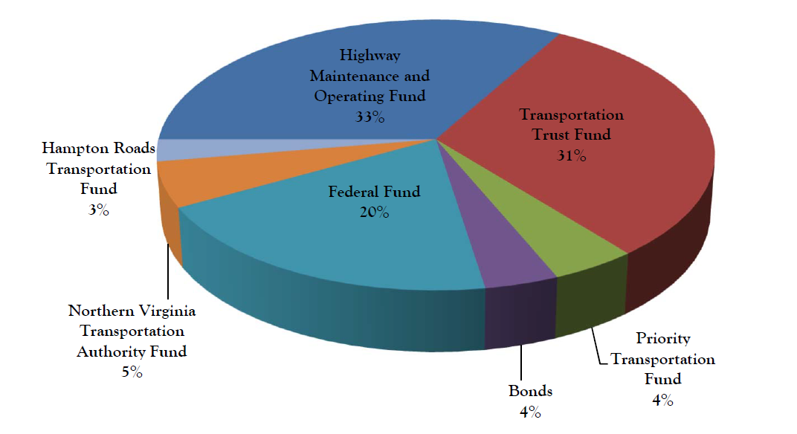
Total Revenue FY 2018
Commonwealth Transportation Fund (CTF) Reports $6.1 Billion in Revenues.
Source: Virginia Department of Transportation, Fiscal Year 2018 Commonwealth Transportation Fund Budget.
Notes:
- There are over 70,000 miles of roads that comprise Virginia’s highway system that need to be maintained.
- As electric vehicles become more prevalent, the demand for fuel will decrease, therefore affecting fuel tax revenues.
- The Commonwealth Transportation Fund (CTF) reports that there are $6.1 billion in revenues in Virginia.
- Of this $6.1 billion in transportation revenues, approximately one-third or $2 billion comes from the highway maintenance fund. The revenues from this fund support highway maintenance, operations, and administration.

Slide 8
Current Revenues from Fuel Taxes
 | FY 2018 | FY 2017 | Percent Change
Motor Fuel Taxes | $857,217,000 | $872,247,000 | -1.7 %
Decline percentages | Amount
5 percent | ($42,861,000)
10 percent | ($85,722,000)
15 percent | ($128,583,000)
20 percent | ($171,443,000)
Notes:
- The motor fuel tax growth rate for FY 2018 fell short of the forecasted rate of 0.5% (five tenths of one percent), coming in at only 0.1% (one tenth of a percent).
In FY 2017, motor fuel taxes were $8.72 billion and in FY 2018 were $8.57 billion, representing a 1.7% decrease in FY 2018.
- If a 5% revenue decline occurred, this would result in a $42.8 million dollar loss.
- If a 10% revenue decline occurred, this would result in an $85.7 million dollar loss.
- If a 15% revenue decline occurred, this would result in a $128.5 million dollar loss.
- If a 20% revenue decline occurred, this would result in a $171.4 million dollar loss.
- As the number of electric vehicles increases, these projected revenue declines become a reality, furthering the need to look to other revenue sources.

Slide 9
Recommendations
Step 1: The Commonwealth should commission a Transportation and Revenue study. Don’t just add or increase a revenue source. Study the issue and incorporate all the stakeholders affected.

Slide 10
Recommendations
Step 2: With the results of the commission, develop an overall deployment strategy and communicate it as an initiative to all divisions and stakeholders affected by the strategy.

Slide 11
Recommendations
Possible Options
More toll roads / Use E-ZPass
Increase the gas tax
Add fee to auto registration
Add a tax to the electrical usage
Direct Usage paid at inspection (Road Tax)
Carbon Credits

Slide 12
Questions?

Slide 13
Sources
ConsumersUnion. (2018, September 26). “What YOU can do to fight climate change!” The Advocacy Division of Consumer Reports. Retrieved from https://consumersunion.org/tag/cars/
Joselow, Maxine. (2018, October 12). “The U.S. Has 1 Million Electric Vehicles, but Does It Matter?” Scientific American. Retrieved from: https://www.scientificamerican.com/article/the-u-s-has-1-million-electric-vehicles-but-does-it-
Le Sage, John. (2017, September 12). “China’s Petrol-Powered Car Ban Could Cripple the Oil Market”. OilPrice.Com. Retrieved from https://oilprice.com/Alternative-Energy/Renewable-Energy/Chinas-Petrol-Powered-Car-Ban-Could-Cripple-The-Oil-Market.html
Lutz, Hannah. (2018, January 16). “Auto industry has historic opportunity, AutoNation CEO says”. Automotive News. Retrieved from http://www.autonews.com/article/20180116/OEM09/180119748/autonation-jackson-autonomous-cars
Marshall, Aarian. (2018, January 17) “Ford finally makes its move into electric cars”. Transportation. Retrieved from https://www.wired.com/story/ford-electric-cars-plan-mach-1-suv

Slide 14
Sources
Muoio, Danielle. (2017, October 23). “These countries are banning gas-powered vehicles by 2040”. Business Insider. Retrieved from www.businessinsider.com/countries-banning-gas-cars-2017-10/
Next 10 & Beacon Economics. (2018, January). “The Road Ahead for Zero-Emission Vehicles in California, Market Trends & Policy Analysis”. Retrieved from https://consumersunion.org/tag/cars/
U.S. Environmental Protection Agency. (2018, October 9). Sources of Greenhouse Gas Emissions. Retrieved from https://www.epa.gov/ghgemissions/sources-greenhouse-gas-emissions
Virginia Department of Transportation. (2018, January). Fiscal Year 2018 Commonwealth Transportation Fund Budget. Retrieved from http://www.virginiadot.org/projects/reports-budget.asp
Virginia Department of Transportation. (2018, February 13). Virginia’s Highway System. Retrieved from http://www.virginiadot.org/about/vdot_hgwy_sys.asp
Williams, Bret (2017, October 3). “If it seems like every carmaker is going electric, that’s because they are”. Mashable. Retrieved from https://mashable.com/2017/10/03/electric-car-development-plans-ford-gm/#TNujBr5Oqiqk

