Slide 1
Artificial Intelligence – Meet Your New Co-Worker
Long term impact on the workforce, tax revenues and state as a whole
October 19, 2018

Slide 2
Artificial Intelligence – Meet Your New Co-Worker
Mike Bednarski – DGIF
William Childress – MVDB
Stephanie Jones – VRA
Adam Rosatelli – SFC
Keven Wright – Tax
Image source: https://blogs.cfainstitute.org/investor/2018/01/26/artificial-intelligence-the-next-step-in-corporate-governance/

Slide 3
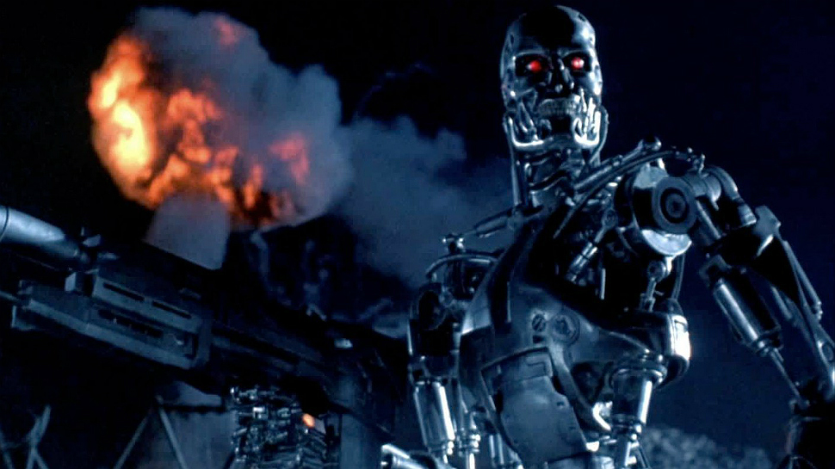
Agenda
Background and Overview
Opportunities – Present and Future Applications
Challenges – Potential Impact on the Workforce and Revenue Base
Policy Options for Consideration
Questions
https://nerdist.com/james-cameron-and-deadpools-tim-miller-look-to-make-a-new-terminator-movie/

Slide 4
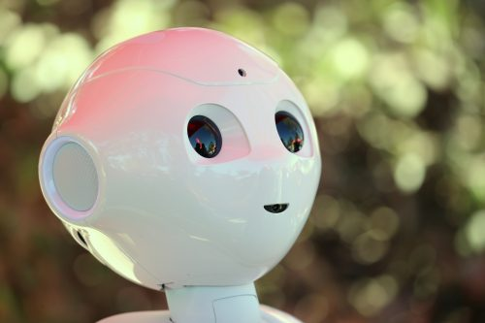
Background and Overview
What is Artificial Intelligence?
“…when a machine mimic’s ‘cognitive’ functions humans
associate with other human minds such as “learning” and
‘problem solving’”
-Wikipedia

Slide 5
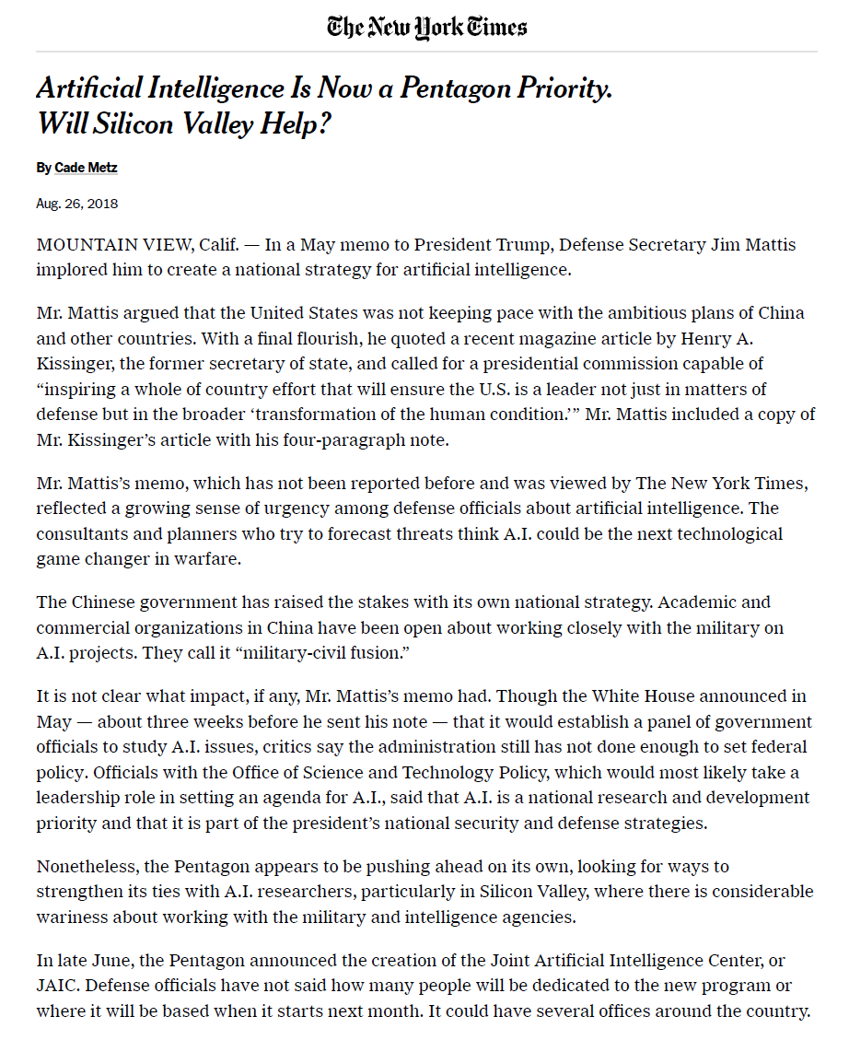
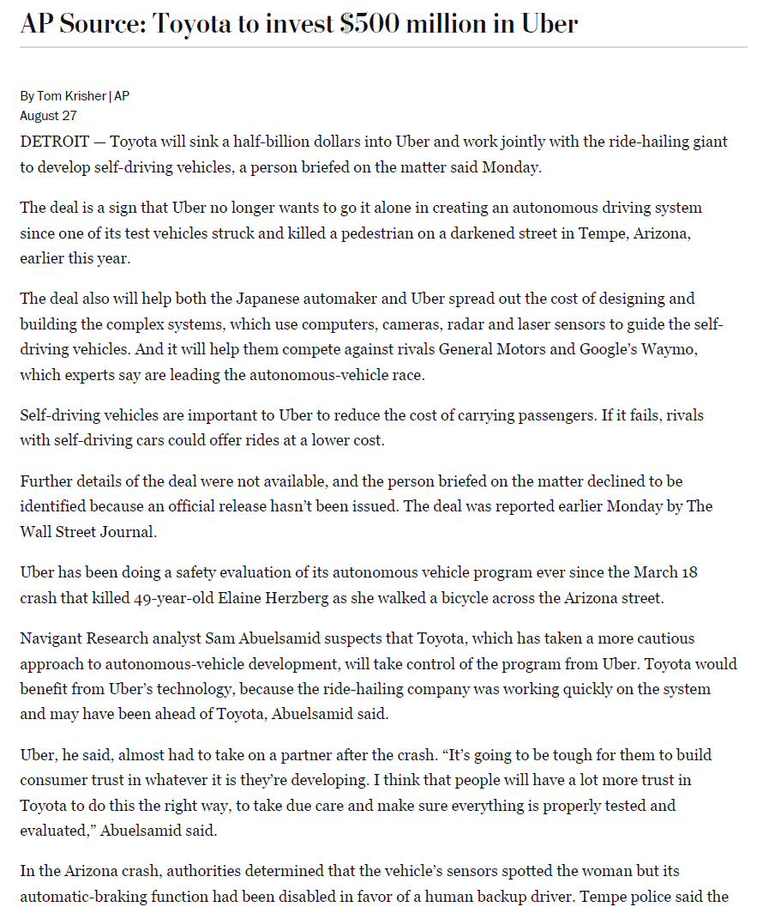
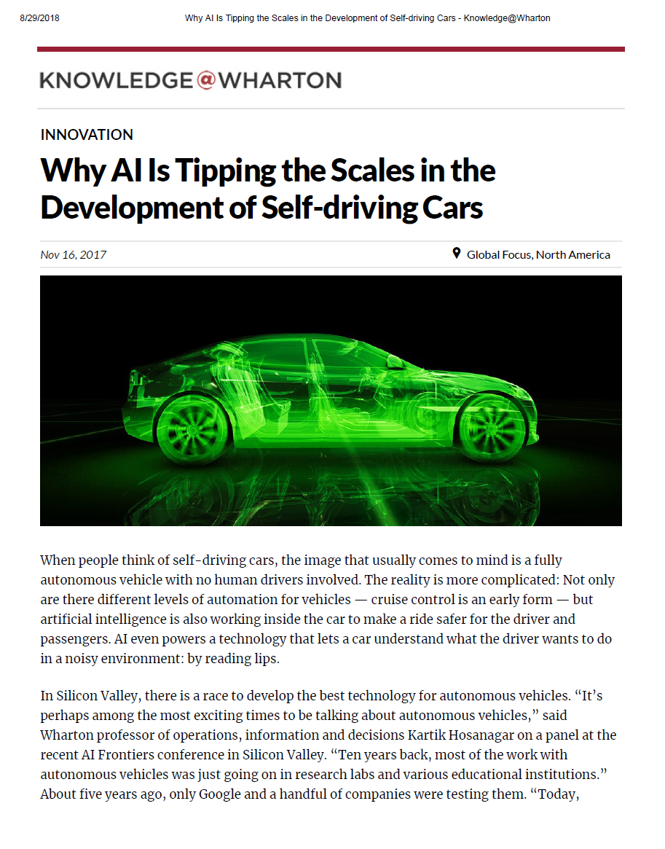
Present and Future Applications
Transportation
Customer Service
Agriculture
Healthcare
Game Theory/Military Strategy
Equity Market Transactions
Many, many more…..

Slide 6
Implications for the Workforce
Food Preparation and Serving Related Occupation
Growth Projections (2016 – 2026)
Average of 1.2% Growth Through 2026 (normal)
Reflects reduction of 83K Food Preparation/Service Related positions due to AI/Automation
Incremental Decline in Jobs of 25% by 2026
Data Source: Virginia Employment Commission, Occupational Projections (Long-Term) for Food Preparation and Serving Related Occupations in Virginia (2016 – 2026).
Notes:
There are broad implications for the workforce as a result of the introduction of AI and automated, and intelligent functions that can replace human capital, gain efficiencies and reduce labor costs.
Certain industries are much more susceptible to labor disruption and worker displacement, particularly in physical labor occupations in what are called “predictable, physical environments” including machine operation, preparing and serving fast food and customer service.
A 2017 study performed by McKinsey (a research and business consulting firm) estimated that AI facilitated automation, by 2030, could result in a decline of at least 30% of work activities in 60% of all occupations.
So, this slide shows what such a reduction might look like within the food preparation and serving industry in Virginia based on data obtained by the Virginia Employment Commission.
Based on normal growth projections in this area, its anticipated that the industry will see about 1.2% average annual growth, and gain about 43,000 jobs by 2026. However, if you assume that AI technologies gradually, beginning slowly in 2020, reduces jobs at an average rate of just 5% of the total positions annually, this results in an overall decline of 25%, or 83K of these jobs by 2026. Again, this is just one segment of one industry in Virginia, albeit one that may be disproportionately affected.
I think it’s also worth noting that income polarization will likely be exacerbated under any scenario involving significant worker obsolescence and displacement, reinforcing the need for workforce training, and education. Particularly in lower skilled job sectors, where fewer jobs due to AI related automated functions will eliminate a higher proportion of jobs and no jobs to migrate to, without additional education and training.

Slide 7
Impact on Tax Revenues and the Economy
Market Cap, Workers Employed, and Value Per Employee
“Big Three” Detroit vs. “Big Three” Silicon Valley
As previously indicated, there will be both positive and negative consequences of AI from an economic and fiscal standpoint.
Our system of taxation incentivizes AI/automation, which results in fewer employees, though the bulk of tax revenue is generated through the taxation of labor, rather than capital.
Future tax policy changes may require a limit on tax incentives encouraging job reducing AI technologies, while balancing economic growth, tax revenues and preserving labor.
“Big Three” Technology Companies
(2014 figures, in $ thousands)
“Big Three” Auto Manufacturers
(1990 in 2014 dollars, in $ thousands)
 | Market Capitalization ($ in Thousands)
 | Workers Employed
 | Company Value Per Employee ($ in Thousands)
Data Source: Should Robots Pay Taxes? Tax Policy in the Age of Automation, Harvard Law and Policy Review, Abbott and Bogenschneider.
Notes:
So, as previously indicated, there will be both positive and negative consequences as a result of AI, from an economic growth standpoint, the distribution of that growth, and the overall effects on labor.
Presently, our system(s) of taxation tend to incentivize artificial intelligence and automation, which is intended to promote business efficiency, increased productivity and economic growth, but many times at the expense of labor. This is a longstanding policy decision despite it being counterproductive from a tax revenue perspective, given that the bulk of tax revenues are generated through the taxation of labor rather than capital.
As an example of the current and future multiplying effects of efficiency through artificial intelligence and other technological means, consider the big three auto-manufacturers in Detroit in 1990 and the three largest, most valuable companies in Silicon Valley, the best modern day equivalent based on size and valuation.
For the Detroit big three, they had collective market cap of about $66 billion in 1990 (adjusted to reflect 2014 dollars), and employed 1.1 million workers, yielding about $55k in per employee value. Now on the other hand, consider the big three tech companies in Silicon Valley. They have aggregate market cap of $1.2 trillion, and only employ 137,000, yielding about $8 million in per employee value.
Now, think about that. With just about a tenth of the total workers, the tech companies created 17 times the economic value, yielding 145 times the per employee value, relative to the 1.2 million workers employed by the auto manufacturers.
So, given the increasingly changing technological landscape, and the globalized nature of modern commerce, future tax policy changes may need to require a limit on tax incentives that encourage job reducing AI technologies, while balancing the need to stimulate economic growth, ensure a sufficient tax base, and preserve domestic labor.

Slide 8
Policy Options for Consideration – Tax Policy
Tax Policy Considerations
With the transformation of the economy, and AI’s increasing influence on labor and productivity, new methods of accounting for, and appropriately taxing AI related capital may be necessary.
Changes in demand for human labor, resulting in worker displacement and reduced state/federal revenues, the way we expense and tax capital assets vs. labor income needs to be examined.
In addition, increases in corporate profits won’t be distributed to workers, requiring a re-examination of the corporate tax structure.

Slide 9
Policy Options for Consideration – Workforce Training
Continue to support STEM programs in elementary schools to promote interest from students to enroll in skill focused programs in middle and high school.
Consider expanding High School Vocational Training Programs to develop skills needed in the labor market for jobs in AI.
Increase investment in apprenticeship programs.
Consider changes to the work study programs at colleges and universities to give students career focused internships versus work in the school cafeteria or library.
Support and develop standards and certification for AI skills. Formalizing the credentials and accreditation will help employers identify qualified AI candidates.

Slide 10
What is Employee Profit-Sharing?
Profit-sharing is when “employees share in the profits of a company” by receiving “a percentage of a company’s profits based on its quarterly or annual earnings.” ¹
Publicly traded companies can offer employee stock ownership plans (ESOPs)
Private companies can offer similar plans called S corporation ESOPs
Direct purchase plans allow employees to buy shares at a discount or with a company match
Source: “Profit-Sharing Plan”. Investopedia. https://www.investopedia.com/terms/p/profitsharingplan.asp

Slide 11
Why Employee Profit Sharing?
As artificial intelligence becomes more prevalent, productivity should increase, which should in turn increase profitability
If corporations do not share the increased profits with their employees through wage growth, the hollowing out of the middle class will continue, making wealth inequality even greater
This so-called “21st century economic feudalism”² benefits only the owners of capital and not society as a whole
Source: Freeman, Richard. “Who Owns the Robots Rules the World: Workers Can Benefit from Technology that Substitutes Robots or Other Machines for Their Work by Owning Part of the Capital that Replaces Them.” https://wol.iza.org/articles/who-owns-the-robots-rules-the-world/long

Slide 12
How Can the Commonwealth Incentivize Employee Profit Sharing?
Offer tax credits to businesses that adopt various employee profit-sharing policies
Give preference in procurement to businesses that have employee profit-sharing policies in place
Host workshops with Chambers of Commerce to share best practices and methods to accomplish employee profit-sharing
Advocate for employee profit-sharing with human resource trade organizations as a recruitment and retention strategy

Slide 13
Questions?

Slide 14
Artificial Intelligence – Meet Your New Co-Worker
Long term impact on the workforce, tax revenues and state as a whole
October 19, 2018

